Slide 1
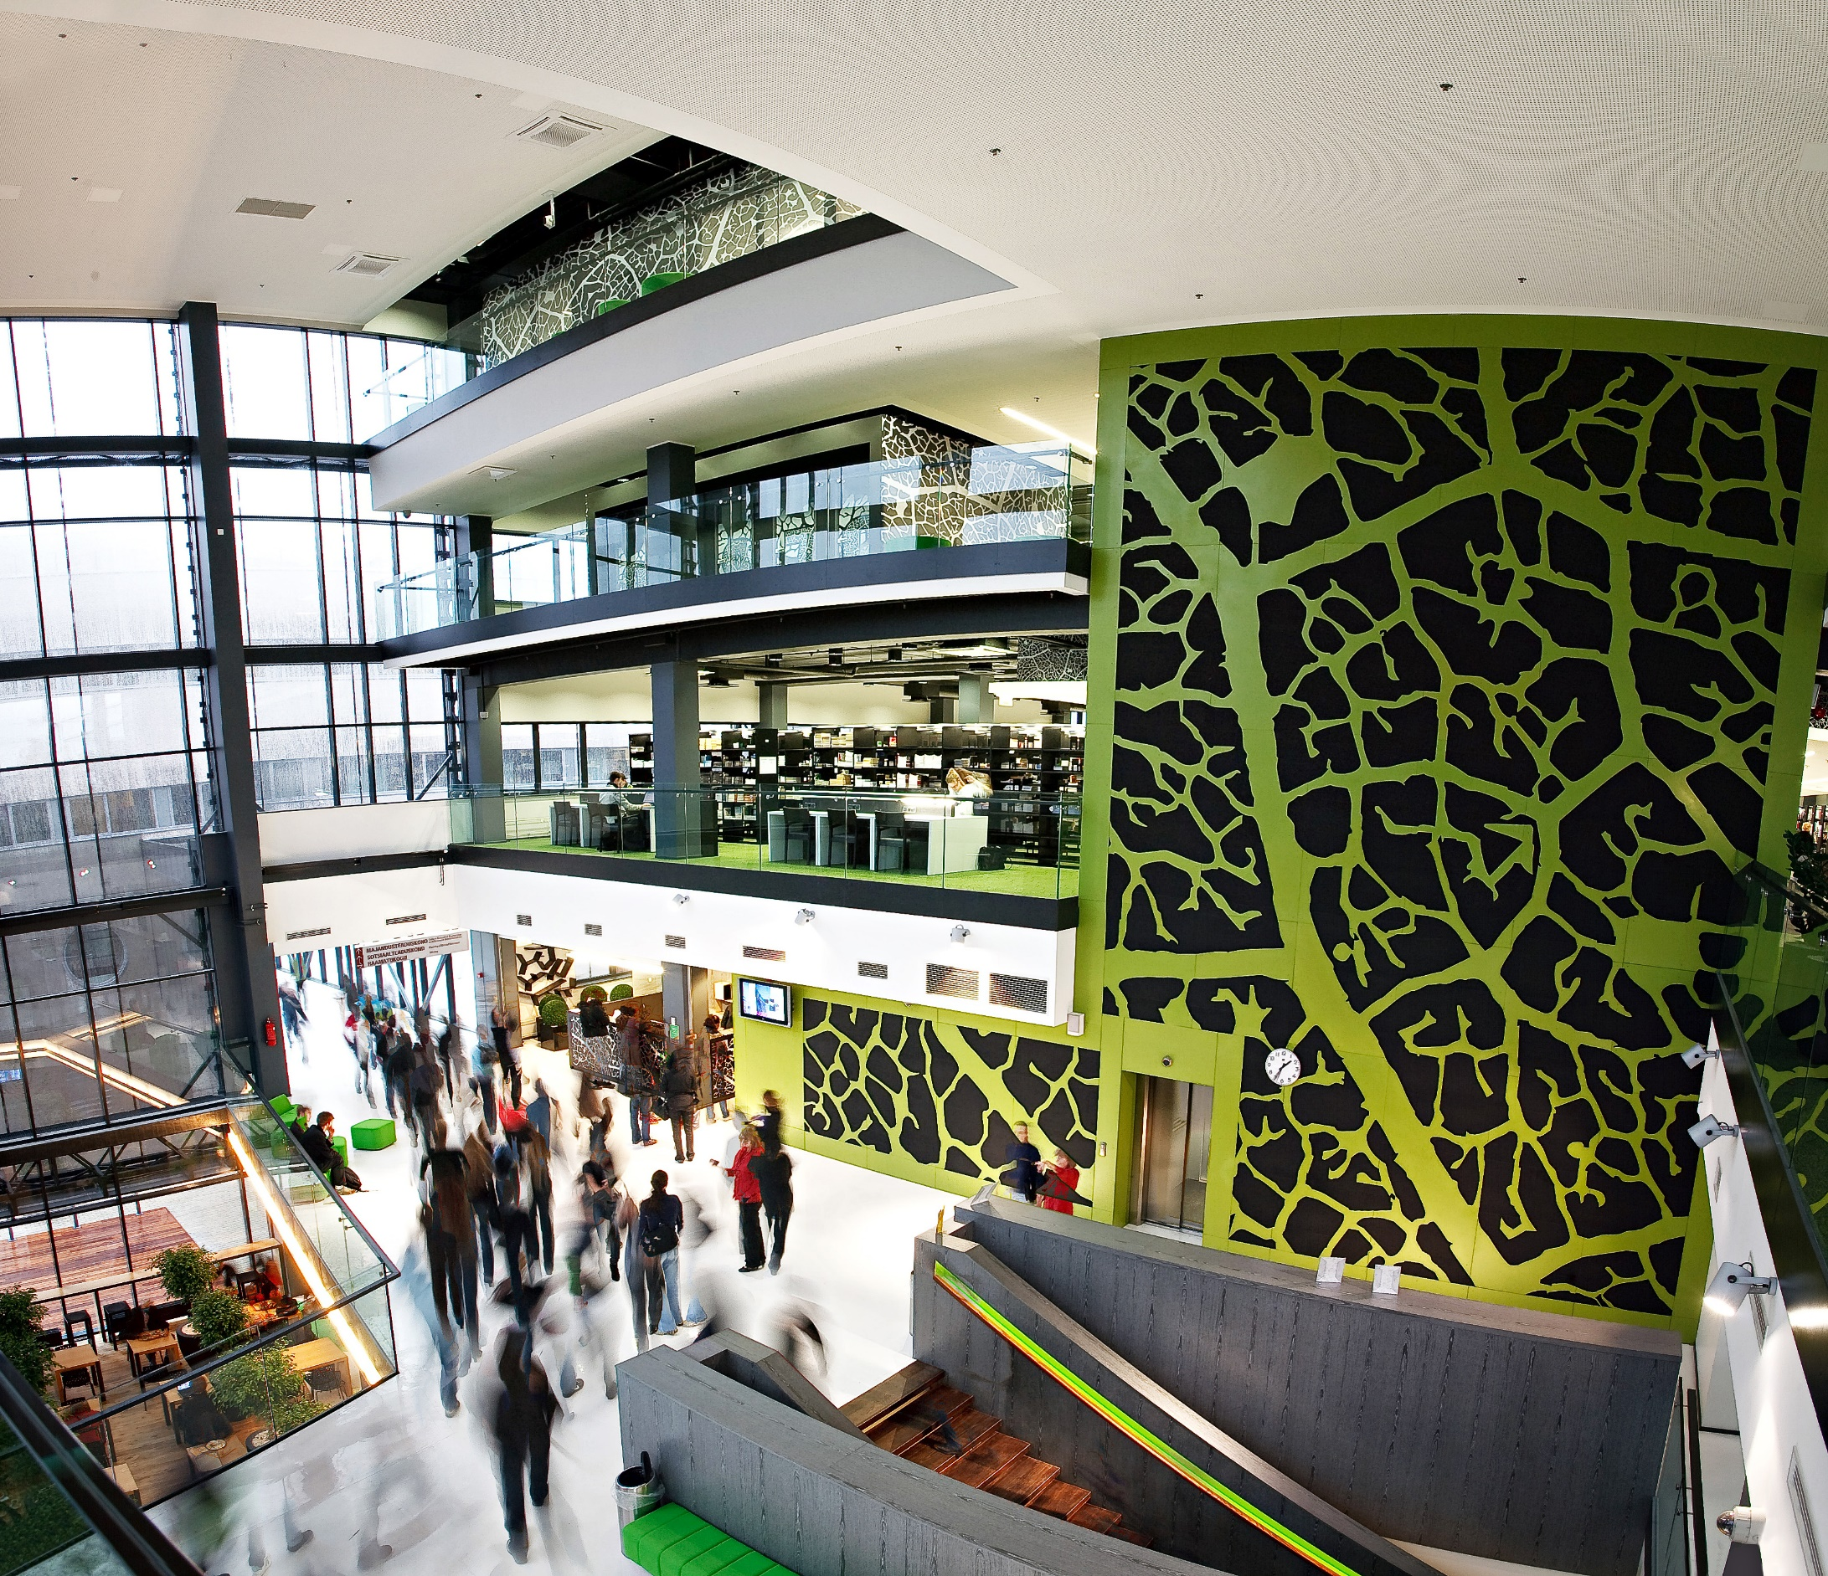
Student Change in Tallinn University of Technology

Slide 2
Outline
Foreign students dynamics over the last years in TTU
The countries sent student to TTU
Changes in social life aspects
Last doctoral programme evaluation oral recomendations for foreign students teachers.
Foreign students in Engineering Faculty at Thin film Chemical Technologies
Conclusions

Slide 3
The number of foreign students in 2013-2016

Slide 4
Foreign students percentage from all students on the level and from all students. Years 2013-2016

Slide 9
In 2017 the biggest number of graduated students in all levels.
Over 330 foreign students graduated Tallinn University of Technology (TTÜ), the most international university in Estonia, this summer, which is more than last year.
The largest number of foreign graduates came from Finland, Ukraine, India and Georgia.
Most of the foreign students completed their studies in the School of Business and Governance or Information Technologies, 166 and 105 fresh alumni respectively.
Altogether approximately 2200 young people received the TTÜ graduate certificate this summer, 729 of them in the School of Business and Governance, 704 in the School of Engineering, 485 in the School of Information Technologies, 164 in the School of Science, and 113 in the Estonian Maritime Academy. In the School of Engineering and in the School of Information Technologies there are more graduates with a Master’s degree than a Bachelor’s degree, in the School of Business and Governance and in the School of Science vice versa.

Slide 10
How the foreign students reach to TTU ?
Kuidas välistudengid TTÜsse ja Eestisse jõuavad?
Infot TTÜsse õppima asumiseks saadi • endiste tudengite soovituste põhjal • haridusmessidelt, kus TTÜ on osalenud • läbi haridusagentide ja haridusportaalide • + veeb, kohalik ülikool jne

Slide 11
Changes in social life aspects
The most important is to keep students
in teaching learning process instead of
working somewhere outside the university
Differences in teaching processes between teaching levels.
Differences in religions
as important social background

Slide 12
Last doctoral programme evaluation oral recomendations for foreign students teachers.
Every teacher must have a list of every foreseen incedent.
How to behaviour?
This kind rules are in Sweden universities.

Slide 13
Foreign students in the Engineering Faculty in the laboratory of Thin film Chemical Technologies
Laboratory has 3 master students and 5 doctoral degree students
7 foreign and one estonian
The working languages are english, estonian, russian.
Up to this time we have no incedents between laboratory rules and
national beliefs

Slide 14
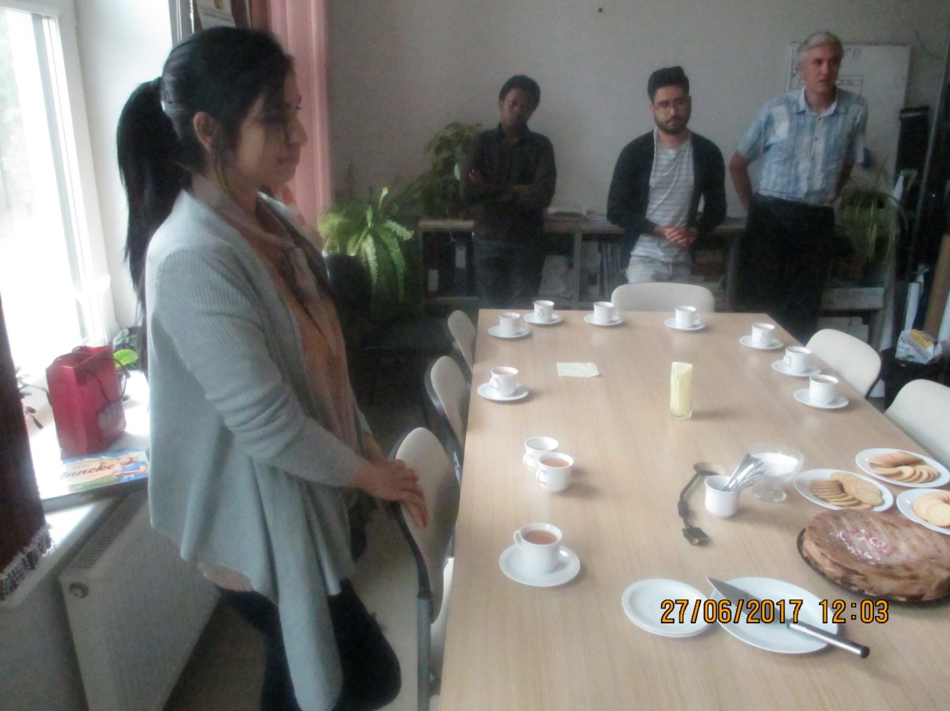
Master student Hina from Pakistan left the Thin Film Laboratory after two month hard work.

Slide 15
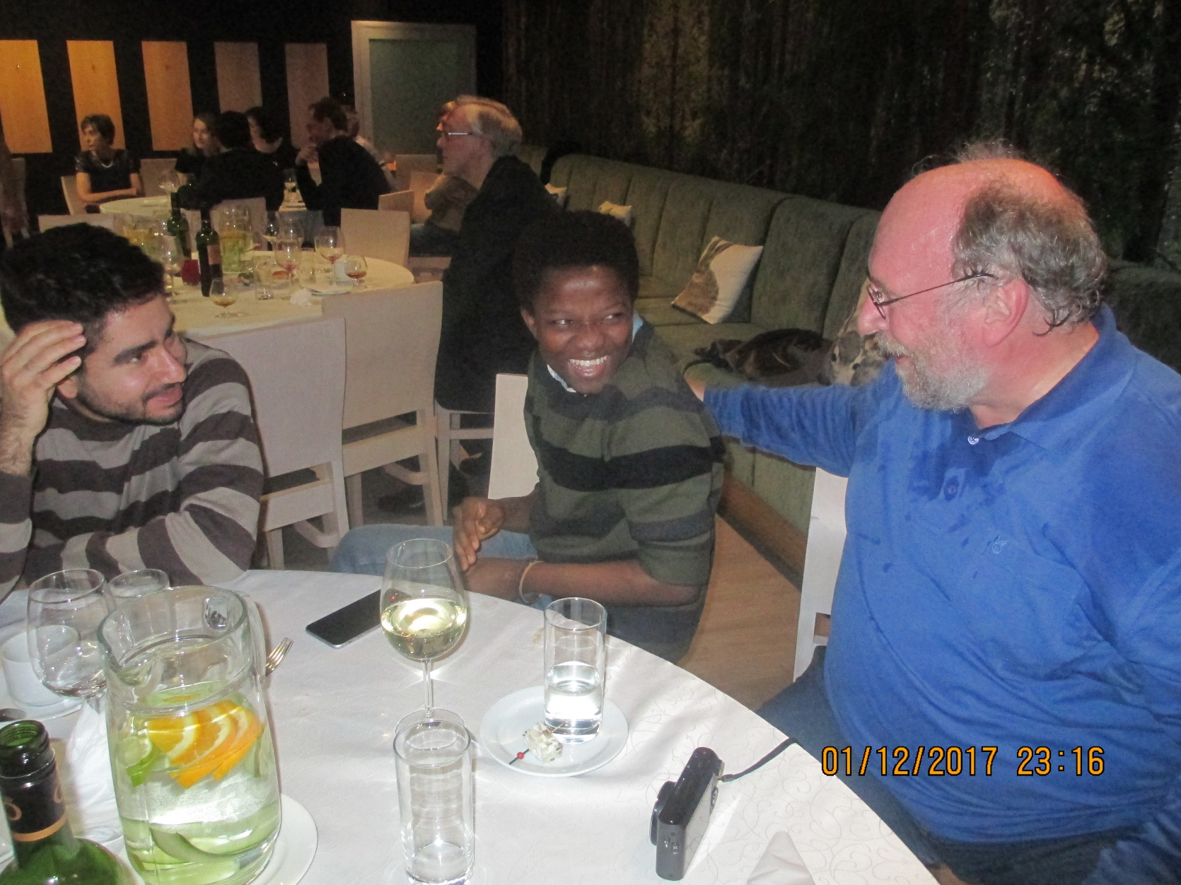
The end of the working period. Prof Dieter Meissner with the two best doctoral students

Slide 16
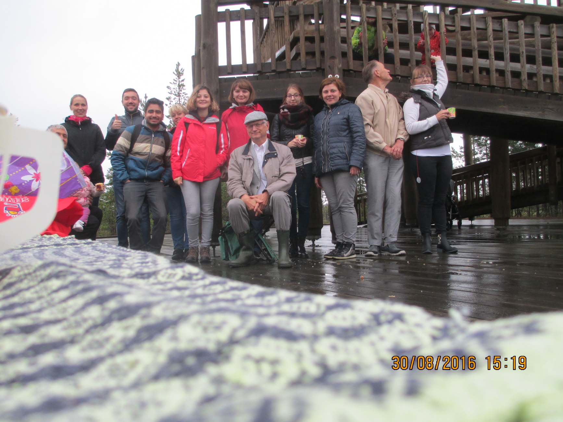
Viru bog

Slide 17
Conclusions
Up to now we can manage with foreign students nicely.
Some incidents are clarified on the level of the institute.
Tutors needed for bachelor degree students

Slide 18
Thank You for attention

