Slide 1
Tallinn University of Technology
Facts & Figures 2016
Juulius Edumeel
Academical degree
07.08.2017

Slide 2
Tallinn University of Technology –
Creating a brighter future!
Tallinn University of Technology (TTÜ) is the flagship of Estonian engineering and technology education and research, where higher education can be obtained at all levels in engineering, technological, natural, and social sciences.
The mission of Tallinn University of Technology is to be a promoter of science, technology and innovation and a leading provider of engineering and economic education in Estonia.
TTÜ values professionalism and reliability, entrepreneurship and innovation, openness and cooperativeness.

Slide 3
Tallinn University of Technology –
Creating a brighter future!
The vision of the University is innovative Estonia in a sustainable world, where TTÜ has a specific role:
TTÜ is an internationally outstanding university of engineering and technology, which brings together motivated employees and ambitious students.
The university, relying on academic competencies and professional management, responds actively to the needs of the rapidly developing society and is involved in tackling the challenges of the digital era.
Cooperation between the university, enterprises and the public sector contributes significantly to knowledge and welfare in the society.

Slide 4
Tallinn University of Technology in 2016
TTÜ is a public university, founded in 1918, ranked in top 3% of the global universities.
Source: QS and T.H.E. TTÜ holds approximately
the 650th position among over 22,000 assessed
universities.
3%
curricula opened
for admission
of them
international
106
33

Slide 5
TTÜ structure as of 2017
BOARD OF GOVERNORS
COUNCIL
RECTOR
SCHOOL OF
INFORMATION
TECHNOLOGIES
SCHOOL OF
ENGINEERING
ADMINISTRATIVE
AND SUPPORT
STRUCTURE
SCHOOL OF
SCIENCE
SCHOOL OF
BUSINESS AND
GOVERNANCE
ESTONIAN
MARITIME ACADEMY

Slide 6
Students
1,037 persons participated in
in-service training.
3,749 persons started an open
studies programme.
11,070 in TTÜ
1,440
international
students
47,794
students enrolled
in universities
in Estonia
11,070
students are
enrolled
in TTÜ
36,724
in other
universities
9,630
local
students

Slide 7
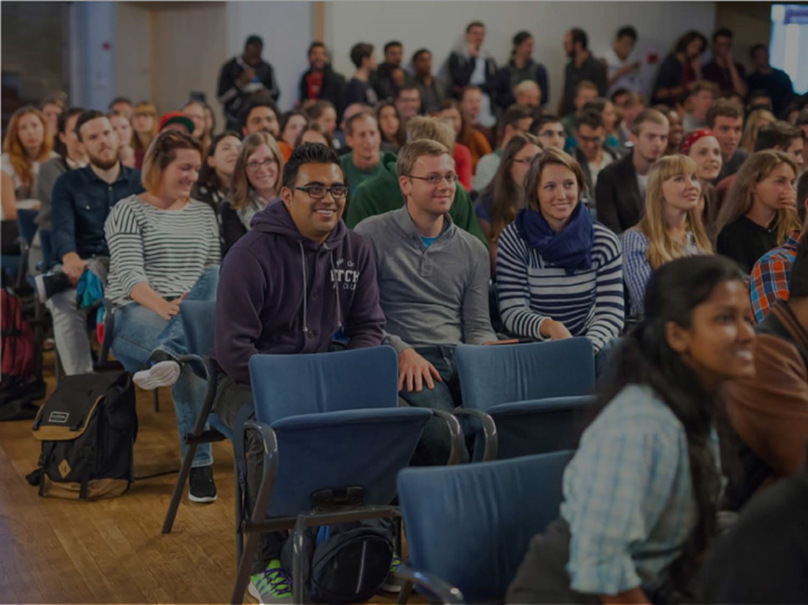
34% of all international students in Estonia attend TTÜ.
TOP10 home countries of
TTÜ international students:
Finland | 424 |  | Turkey | 83
Georgia | 106 |  | Russia | 66
Nigeria | 106 |  | China | 45
India | 98 |  | Pakistan | 40
Ukraine | 92 |  | Iran | 39
International
students from
91 counties

Slide 8
Students and alumni
Admitted in 2016
71
doctorates
3,425
students
557
international
students
2,322
graduates in 2016
85% of alumni are satisfied with studies
66,133 alumni
overall
1,001
international
alumni

Slide 9
Scholarships Level of education
In 2016, TTÜ Development Fund awarded 69 scholarships totalling
€ 114,430
81%
of employers are satisfied with the level of employees with the TTÜ
diploma
19%
of employers
expect more
Average
scholarship
€ 1,660

Slide 10
TTÜ students abroad and international students in Estonia
33 students
as interns
199
TTÜ students
studied abroad
166 exchange
students
428
international
students were
studying in
TTÜ

Slide 11
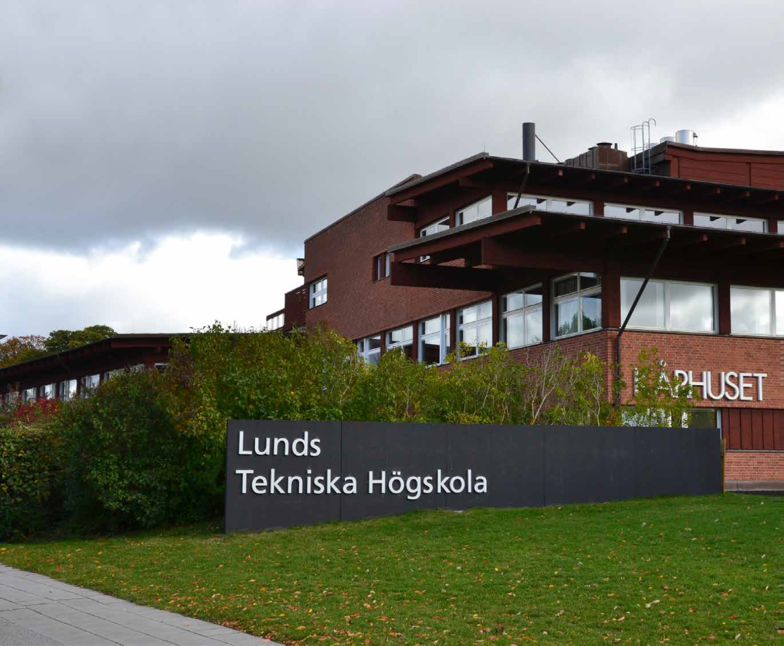
TTÜ has partner universities all over the world.

Slide 12
Student exchange partnership agreements
34 interuniversity
bilateral agreements
TTÜ has
496
cooperation
agreements
462 other
partnership
agreements

Slide 13
Research and development
Every TTÜ scientific publication was quoted 3.85 times on average during the last five years.
Local
authorship
Main partner countries
in joint publications
Norway 23
Sweden 36
Finland 70
Russia 48
1,362
scientific publication
USA 44
Intenational
co-authorship
Danmark 23
UK 31
Spain 23
Germany 59
France 31
Ukraine 23

Slide 14
Doctorates
International doctorates 112
In 2016
644
doctorates
studied in TTÜ
75 PhD's
were defended
Patent applications filed for TTÜ
48
11
9
applications
received patents
valid patents

Slide 15
Staff
Other international
staff 30
Doctorate / junior
researchers 138
International
academic staff 141
47
Average age
49
Professors
138
Academic staff
1,062
Different nationalities
Total staff
1,930
49.9%
Female staff

Slide 16
Money
2016 revenues
Operating grants received | € 47,928,000 | 59.7%
Revenue from operational activities, other income | € 16,673,000 | 20.8%
Government grants received | € 16,673,000 | 19.3%
Total | € 80,273,000 | 100%
Revenue from studies
Revenue from studies
€ 46.7 mln
Operating grants from state budget for formal education
€ 37.3 M
2016 expenses
Personnel expenses | € 46,514,000 | 53.7%
Other operating expenses | € 17,579,000 | 20.3%
Depreciation, amortisation and impairment losses | € 13,215,000 | 15.3%
Scholarships | € 7,219,000 | 8.3%
Intermediation of grants and membership fees | € 2,100,000 | 2.4%
Total | € 86,627,000 | 100%
Revenue from research
and development
Revenue from research and development
€ 25.3 M
External funding € 7.5 M

