Slide 1
Expectations and Reality of Foreign Students
Triin Roosalu
Associate Professor in Sociology
Tallinn University, School fo Governance, Law and Society
Tallinn University Employee Union Board

Slide 2
Structure of Estonian HE

Slide 3
Number of HEIs 1990-2013

Slide 4
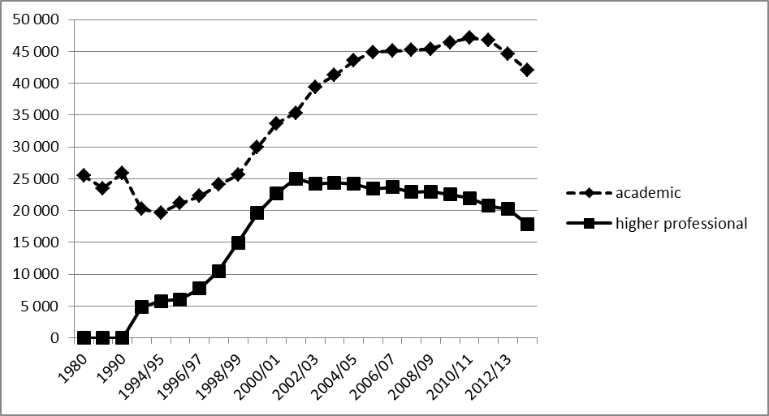
Number of Students in Higher Education

Slide 5
Publicly funded or fee paying HE students and share of academic HE students 1997-2011
Students
Academic HE
Public
Paying
Academic HE
Source: Tõnisson, 2011.

Slide 6
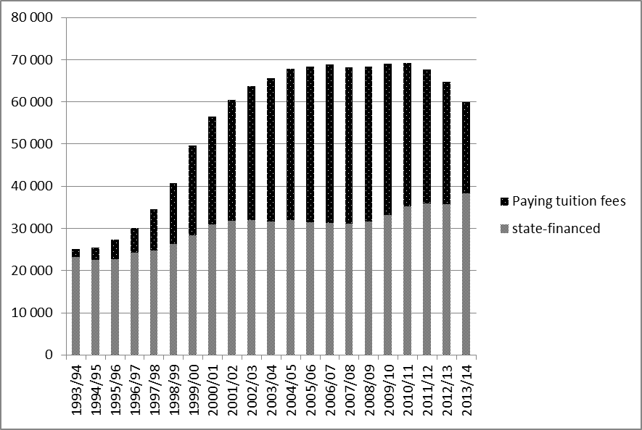
Share of state-financing increased in 2013

Slide 7
Students by language of instruction

Slide 8
Number and share of foreign students in Estonia
BA
MA
PhD
average share
Source: Estonian Ministry of Education – Kreegipuu, 2017

Slide 9
Share of foreign students by educational level
BA MA PhD Total
Country
Estonia
Lithuania
Latvia
Finland
Source: Estonian Ministry of Education – Kreegipuu, 2017

Slide 10
Distribution of foreign students in Estonia by origin
Number % Number % Number % Number % Number % Number %
Finland
Russia
Nigeria
Ukraine
Georgia
Estonia
Turkey
India
Latvia
China
Total

Slide 11
Europe
Asia
Africa
Central- and Western America
Northern America
Oceania

Slide 12
Foreign Students:
8+% of all; 11% of these in private universities
English-language MA programs – growing share among MA programs; yet only 66% of students there are foreign students
some studies exist on students and on graduates
Foreign Staff:
  less than 100 altogether in 2008/2009
  about 100 in just one (smaller) university in 2017/2018
  their prespective rarely covered with studies

Slide 13
Rationale, as stated in Ministry of Education report:
  Personal benefits for the students
    Academic skills and knowledge
    Social and sociocultural skills and knowledge
    ‘employability’ – domestic country vs host country vs other?
  Social, community level benefits
    Direct economic benefits
    Academic quality of education provision
    Keeping student numbers up
    ‘employability’ and competition - - vs human rights…?
    cultural competence/intercultural competences/reciprocity?

Slide 14
Motives vs barriers
Motives
  Intrinsic
  Instrumental
  Other?
‘ARCS’
  Attention
  Relevance
  Confidence
  Satisfaction
Barriers
  Institutional
  Situational
  Dispositional

Slide 15
Integrating to labour market?
In EU, countrywise, 16-30% of foreign students stay to integrate into labour market
In Estonia, about 28% - beyond EU average

Slide 16
Any problems?
Specific difficulties to find appropriate employment:
  Labour market entrance supported by local social networks → foreigners lack these
  In many English-language curricula, apprenticehip is not compulsory and systematic support in contacting employers is often not provided
  Foreign students are not required to master Estonian language skills → only specific jobs are available
  Not much provision in English available for professional education and as non-formal adult education → only few opportunities for qualification beyond the university program

Slide 17
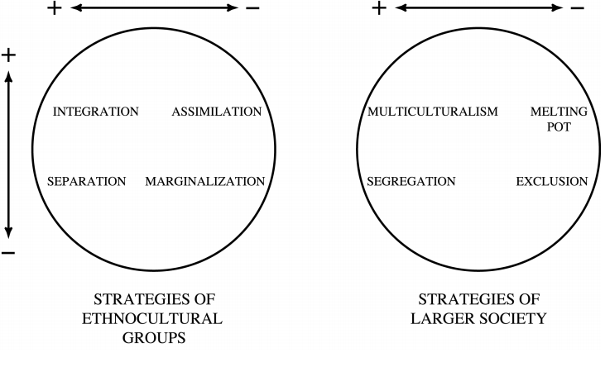
Feelings towards (country of) origin
Feelings towards destination (country)
Source: John Berry;

Slide 19
Expectations and Reality of Different Actors
  Students – domestic and foreign
  Lecturers – domestic and foreign
  Universities – host and origin
  Countries – host and origin
  layers of actors
  and each of their motives, barriers, and strategies

Slide 20
Motives vs barriers
Motives
  Intrinsic
  Instrumental
  Other?
‘ARCS’
  Attention
  Relevance
  Confidence
  Satisfaction
Barriers
  Institutional
  Situational
  Dispositional

Slide 21
Conclusions: to clarify…
Needs of and suggestions for universities
Needs of and suggestions for teaching staff
Needs of and suggestions for the sphere of education more generally, including adult education and lifelong learning
Needs of and suggestions for the community
Needs of and suggestions for the society
Needs of and suggestions for the students
Integration compass?

Slide 22
Thank you!

