Slide 1
Student Change in Tallinn University of Technology Case study: Integrated Engineering
Prof Tauno Otto
10.11.2017

Slide 2
Study programme „Integrated Engineering“ and its development
Opening of a study programme of Integrated Engineering to be taught in English was strategic decision at university level to enhance internationalisation in engineering bachelor level, but also to integrate different areas of engineering for building a broader base for further master level education.
It is the first English taught bachelor level study programme at the university amongst engineering faculties.
The study programme was prepared starting 2013, whereas into initiative group was involved representatives from all different engineering faculties.

Slide 4
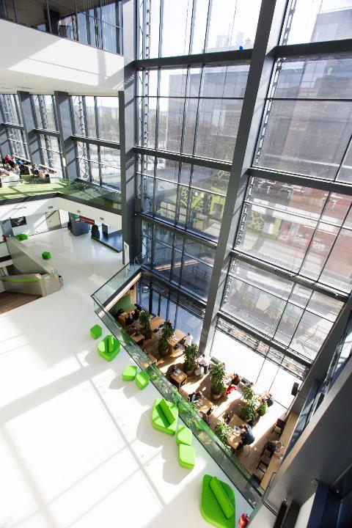
Similar programmes in other universities
University of Cardiff (UK)
Souther Utah University (USA)
The University of Dublin (Iirimaa)
University of Bath (UK)
University of British Columbia (Canada)
University of Windsor (Canada)
University of Western Ontario
University of Liverpool
Anglia Ruskin University
University Centre Peterborough
Lehigh University
Minnesota State University, Mankato
University of Gloucestershire
Northwestern University

Slide 5
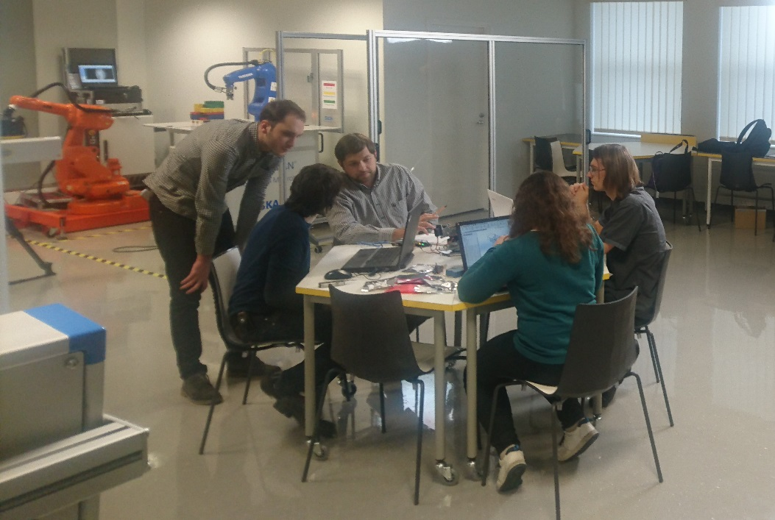
MVEB study programm admission 2017
 | Intake
Estonian citizen | 11
From abroad | 39
Male 40, incl 7 Estonians and 33 foreigners
Female 10, incl 4 Estonians ja 6 foreigners
Tuition fees and scholarships: 1 ECTS = 55 EUR. Nominal study load per 1 year = 60 ECTS/€3300, 41 tuition fee waiver scholarships available that guarantee free studies.

Slide 7
Integrated Engineering (BSc)
Currently students from Estonia: 34
Currently students from abroad: 101

Slide 8
Currently students from abroad: 101

Slide 9
Estonian colleges providing students to Integrated Engineering
Gustav Adolfi Gümnaasium
Hugo Treffneri Gümnaasium
Kohtla-Järve Ahtme Gümnaasium
Kuressaare Gümnaasium
Miina Härma Gümnaasium
Pirita Majandusgümnaasium
Rakvere Gümnaasium
Tallinna Arte Gümnaasium
Tallinna Humanitaargümnaasium
Tallinna Prantsuse Lütseum
Tallinna Saksa Gümnaasium

Slide 10
Graduated students 2017
Cameroon: 1
Republic of India: 1
Iran: 1
Georgia: 1
Ukraina: 2
Federal Republic of Nigeria: 2
Finland: 2
Estonia: 5

Slide 11
Topics of thesis
Thermal Modeling of Printed Circuit Board In a Nano Satellite
Development and implementation of a control system for an FMS
The motorized porter luggage trolley
Implementation of „Internet of Things“ (IoT) in Industry: Technical, Legal and Security Aspects
Industrial robot cell development
Magnetic levitation. Diamagnetic levitation. Levitating platform for carrying load.
The application of ICT (Information and Communication Technology) in modern manufacturing system
User interface for IRC5 controller
Risk Assessment of Production Machine Processes
Development of a Robotic Tool Changing System
Virtual reality as a factory visualization, testing and production engineering awareness tool
Modernisation of the shaft vibration testing machine
Behaviour and Strength Parameters of Bolted Joints in Small Satellites
Development of the planter for greenhouse monitoring system

Slide 12
Problems listed
Courses teaching Estonian language for foreign students are available only in limited amount
Employers still prefer specialists/trainees to have Estonian language skills, especially in case of SME-s
Lecturers are not always proficient in English, or able to recommend update literature in English
Cultural differences: honouring the clock/deadline
Immigration rules are too rigid, and it is difficult sometimes with visas

Slide 13
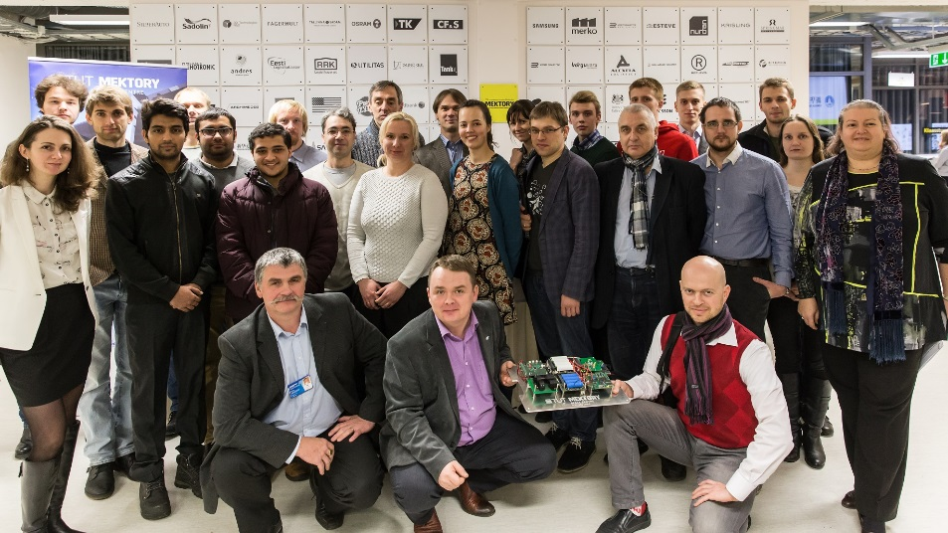
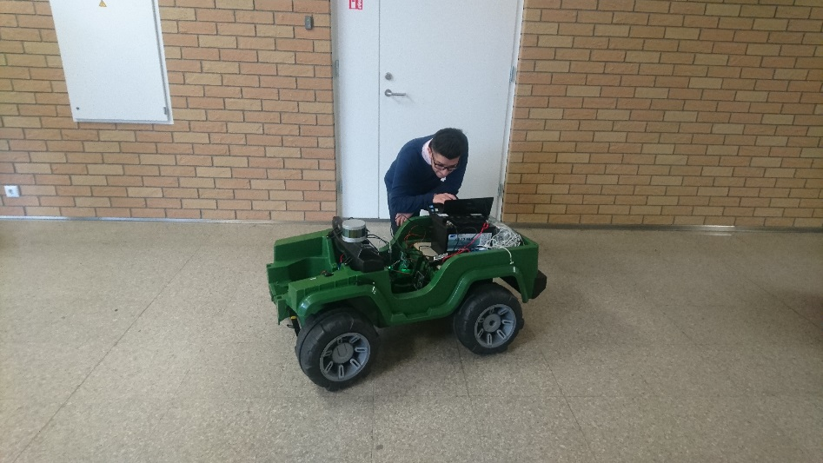
Strengths listed
Foreign students are motivated to dedicate into research at uni: Self-driving car project ISEAUTO, student nanosatellite Project, VR/AR lab development
Students are more open to transfer – mostly applying to Erasmus Exchange semester
Cultural differences sum up in International co-operation – it is possible to develop larger projects and aim stronger export potential
Mostly students after graduation stayed to Estonia for work or Master studies

Slide 14
