Slide 1
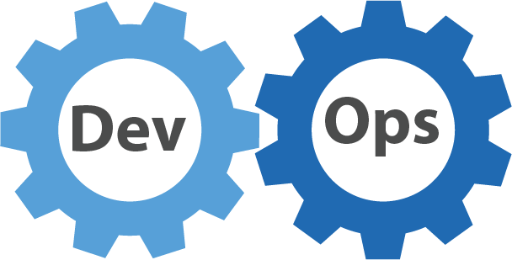
DevOps in
Telia estonia
You build it, you run it
Greg Otsa

Slide 2
Topics
Telia Company
History, maturity levels
The vision
Devops ideology and tech depth
New DevOps teams and service handovers
Initial Ops training programme
Ops competence management
Ops hands-on trainings
Ops mentorship programme
Retroperspective 1 year later – view from the teams
Main learnings
Questions

Slide 3

TELIA COMPANY
Founded in 1853
More than 21 000 employees work in Nordic and Baltic markets as well as in Russia, Azerbaijan, Georgia, Kazakhstan, Moldova, Turkey and Uzbekistan.
Key figures as of year-end 2016 for continuing operations:
net sales SEK 84,178 million
EBITDA SEK 25,836 million (excl non-recurring items)
CAPEX SEK 15,625 million
23.5 million subscriptions

Slide 4

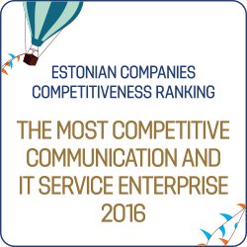
TELIA EESTI
EMT was founded in 1991, Elion in 1993
Approx. 1800 employees
Market leader in all of its focus areas: mobile,
broadband, TV and ICT services
4th place in Estonian brand reputation index in 2016
As of end of Q2 2017:
918,000 mobile customers
347,000 active users of mobile internet
233,000 broadband subscribers
177,000 TV customers

Slide 5
Different maturity levels in Telia EE tech towards devops
Technology driven – technology management
Process driven – process management – full-scale implementation started in 2011
Service driven – service maintenance management - 2013
Devops driven – service lifecycle management - 2016
BizDevOps?

Slide 6
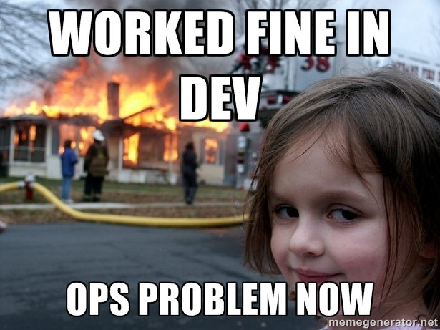

Slide 7
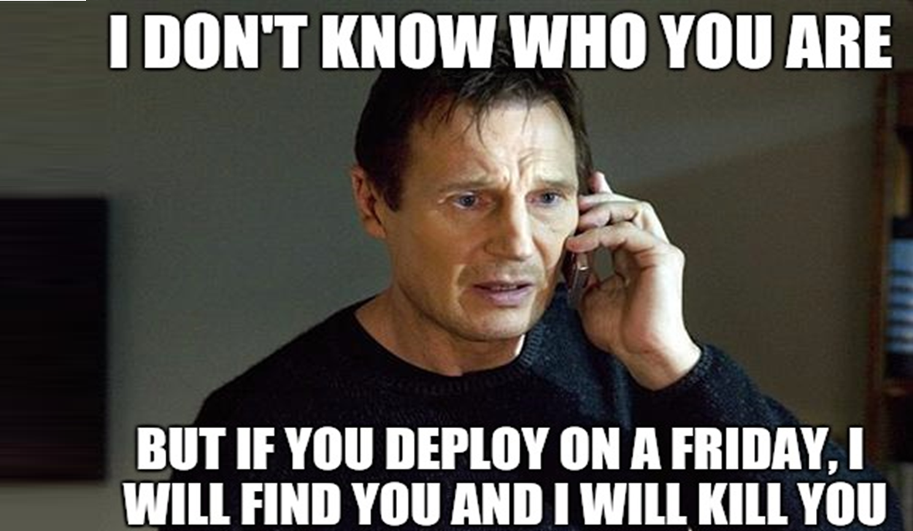

Slide 8

VISION OF TECHNOLOGY 2017
meeskonnad tunnevad omanikutunnet oma teenuste eest ja on iseseisvad ning kompetentsed nende arendamisel ja haldamisel. Infrastruktuur ja platvormid on kasutatavad teenustena.
teams feel ownership of their services.
They are independent and have the competence to both develop and operate their services. Infrastructure and platforms used as a service.

Slide 9
WHY?
Break the silos
Speed
Efficiency
Quality
World is changing (no suprise there)
  New technologies emerging
  Hard to keep people motivated with old WoW

Slide 10
Change of service team responsibilities - technical layer view
Very few teams had responsibility for OS, DB and APP servers (tomcat, apache etc) before the DevOps org. change
During the org. change all teams had to take that responsibility

Slide 11
Devops Team responsibilities
The whole stack (Service, OS, DB, APP):
  design, architecture, documentation
  development, implementation, QA
  performance, availability, latency
  capacity planning, efficiency
  change management
  metrics, monitoring, logging
  on-call emergency response
  security
  lifecycle
  cost
  quality

Slide 12
ORDER IN CHAOS?
Teams still use common infrastructure
  Compute, storage, network, virtualization, containers
  Monitoring, logging, backup
N-TIER (NFR) map governs usable technologies
Reuse as much as possible, integrate if possible
We don’t have to create everything ourself
  Use cloud SAAS!
  IAAS, PAAS do not make sense, we know how to build these

Slide 13
Devops implementation kickoff in july 2016:
New teams and service handovers
Starting position: Dev and Ops silos + Infra teams. Scope of chance: ca 300 people of 450 in Tech
New teams were created and all the devops teamlead positions became vacant
Most of the former dev or ops teamleads became a devops teamlead
After that we started an extensive programme to achieve reasonable basic standard of knowledge and situation mapping in teams
  Specialists and their roles
  Services
  Vendors
  Governance model with business etc
Priority 1 initative in technology unit
Teamleads reported weekly on the progress in one common forum
Agressive handover programme between the teams (out of ca 1000 app instances 300-500 moved between teams)
After the common basic level was achieved the central control was loosened

Slide 14
Any problems?
The teams cooperated, the tasks were progressing
But they were doing it because they were asked to do it, not because they wanted to do it
It took almost half a year of constant discussions, persuasion etc during the implementation for the real buy-in
„Pull-method“ method instead of „push-method“
Then it became „our“ thing

Slide 15
Initial ops training programme
Problem: due to merger of development and operations teams into devops teams most of them had low competence in operating system/database administration and closely related activities
Solution: internal training programme performed mainly by system administrators
Key facts:
Preparation and „recruitment“ of trainers: 1 week, programme duration: 1,5 months
16 trainers, only 1 of them had some previous experience as a trainer
14 different trainings, 28 training sessions: monitoring, backup, logging, processes, administration of OS/DBs etc
Focus mainly on general overview and our best practices, each session lasting 1-2h
100+ different people trained, most of them on several trainings
Positive feedback from trainees, in some cases need for more hands-on approach

Slide 16
Systematic approach for comp management
Assignment of competence managers for tech comp areas:
  Architecture, analysis, backup, oracle/postgre, MS SQL, linux, windows server etc
  Comp area manager is resposible for ensuring required competence in devops teams and creating/managing best practices
  Comp area manager is not resposible for motivating people or checking if people are following these best practices
Competence evaluation model:
Mapping people competence levels for each competence:
  -1 not needed in team
  0 no competence
  1 basic knowledge (desired state for devops dev-focused people)
  2 is independent 95% of the time (desired state devops ops-focused people)
  3 can train and support level 2 people
For each ops competence specific requirements for competence levels 1, 2, 3

Slide 17
OPS compentence hands-on training programme
Devops team’s ops-focused people self-evaluation per competence areas (see previous slide)
Based on the evaluation results and interviews hands-on training programme
Both internal and external trainings (security, VMware, backup, linux etc)
First trainings started this January
2 ops-focused specialists per team achieved level2 in needed competences 2017Q2
Dev-focused people will achieve level1 in needed competences 2017Q4
Lab environments for trying things out
Specific competence needs handled separately by competence area managers

Slide 18
OPS Mentorship programme
For supporting teams achieving ops competence level2 we initated a mentorship programme
Each team needing regular support got a personal mentor
Mentors were „recruited“ from former sysadmin teams who already had competence level2-3
Mentors got a monthly fixed bonus to normal salary
In most cases the mentor selected a team, usually it was the team he had handovers ongoing
Mentors supported teams on Linux and MS competences
Each mentor created a competence development plan with his mentee and his teamlead
The plan was based on ops competence training programme
No official mentorship inside the same team
Mentorship programme lasted 3 months
Currently same mentors support their teams for 5% dev/complicated incident cases

Slide 19
Devops implementation governance model
Weekly 30min steering with C3 managers (who report to CTO)
Agenda includes current hot topics like
  Last handovers
  Closing legacy systems
  Competence management, dev competence mgmt gaining momentum
  Tooling
  etc
C3 managers take the topics to their management team meetings
Additionally bi-weekly DevOps forum with C4 teamleads and dev/service managers
  Agenda includes roles, comp management, trainings, process issues, infra roadmap etc

Slide 20
Retro 1 year later – view from the teams
Tech vision 2017: Teams feel ownership of their services. They are independent and have the competence to both develop and operate their services. Infrastructure and platforms used as a service.
The vision was „decoupled“ to parts and each part had several aspects detailed
90min interviews were performed with the DevOps teamleads that were most affected by the change
Asked to evaluate the past, present and future needs of 2017 DevOps vision + give feedback for the org. change management team.
Results:
Overall satisfaction was good, teams felt that it was the right thing to do and that it is done.
Two main issues were with shared java/DB clusters + monoliths and with the limited freedom in team OPEX management – vendor support vs PEX vs trainings vs team events etc
Feedback to project team: courage to do it, support, it is done. For some teams too much micromanagement in the beginning, not clearly communicated change KPIs
Way forward: BizDevOps, solving main issues and continuing with competence management

Slide 21
Main learnings
Cultural and behavioural change takes time
You need need to get the real buy-in from teamleads and teams
Keep an open mind and flexibility to make exceptions where necessary
Teams need a lot of support in the beginning. They start from different position
(the change needs constant monitoring and management)
It’s harder to do it if you are providing the infra and platforms in-house
Strong competence management is needed
Some specialists are not willing to change and personnel changes are inevitable

Slide 22



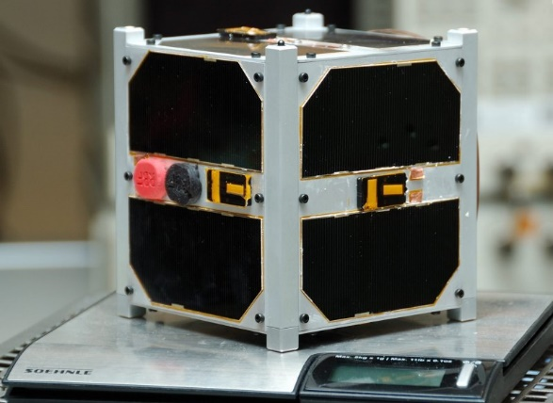
The road ahead
Some companies
Telia EE
mostly
Some companies
Some teams

Slide 23

?

