Slide 1
Craftsmanship
The Codeborne way
Anton Keks @antonkeks

Slide 2


Slide 3
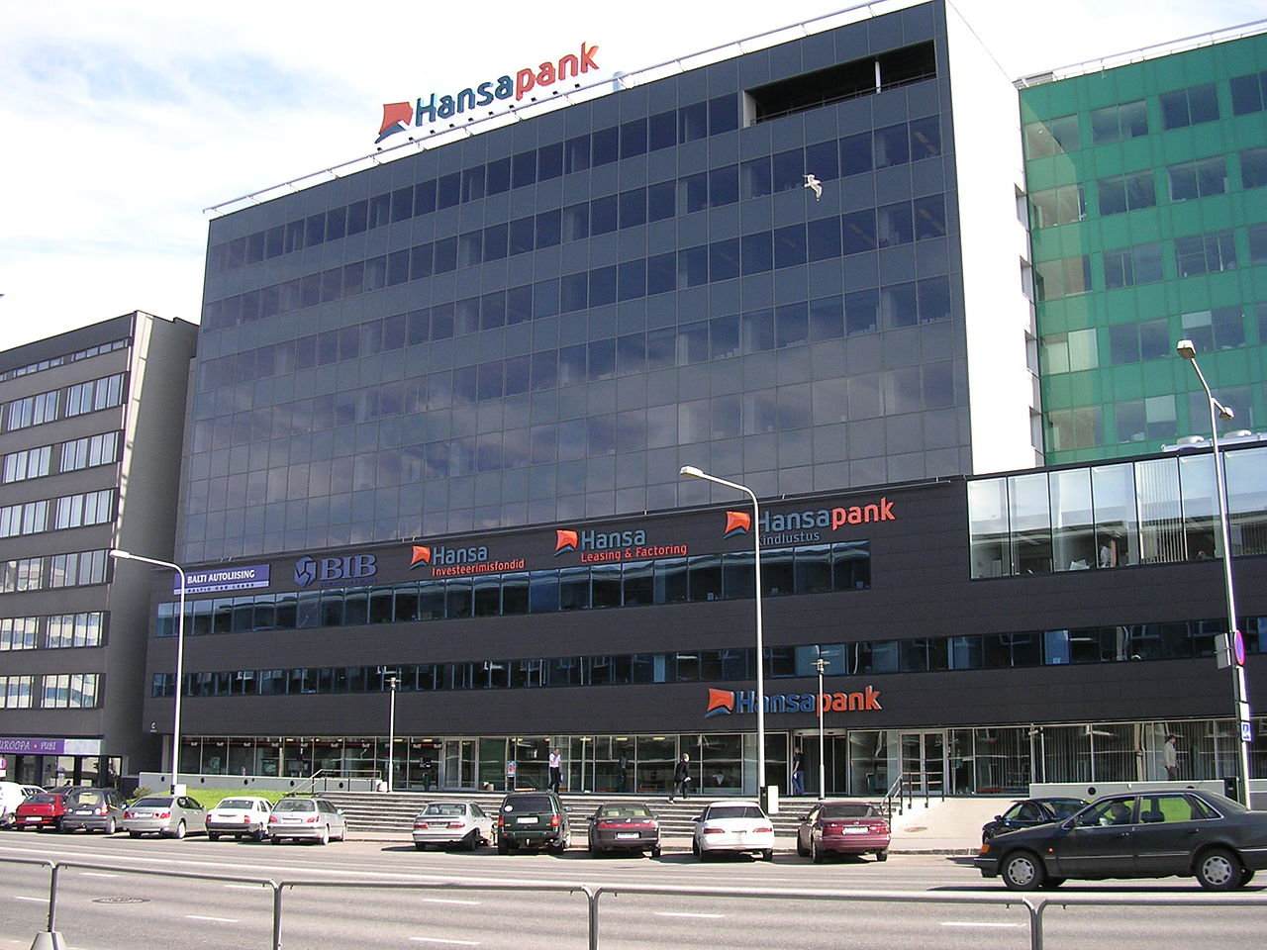
It all started in Hansapank

Slide 4
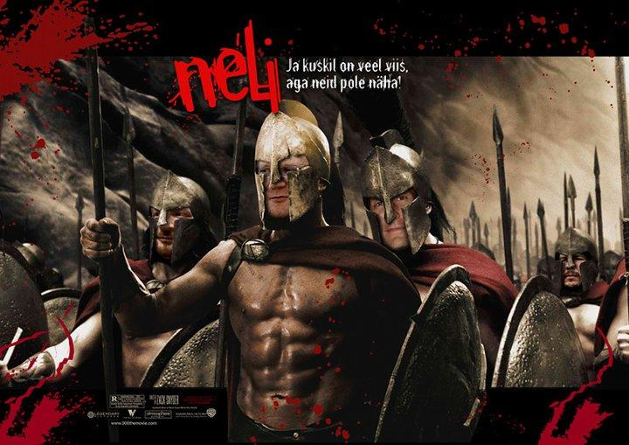
8 March 2010
9 people left Swedbank to start Codeborne
1 joined from HireRight

Slide 5
Codeborne
Locally owned old-fashioned business (not a startup)
3x Äripäev top 3 IT company in Estonia
Present and past customers in Estonia:
Eesti Energia, Swedbank, LHV, Telia, Starman, Ericsson, Elering, Regio, ABB, Luminor
Plus many from Russia, Norway, Sweden, Japan, Czech Republic
Sponsor of Devclub, Agile Saturday, Tartu Maraton

Slide 6
Codeborne in 2018
33 people
1 CEO/sales
1 office manager
2 designers/front-end
24 software craftsmen
5 software craftswomen
0 project managers
0 analysts
0 testers

Slide 8
Agile manifesto
Individuals and interactions over processes and tools
Working software over comprehensive documentation
Customer collaboration over contract negotiation
Responding to change over following a plan
That is, while there is value in the items on the right,
we value the items on the left more. http://www.agilemanifesto.org/

Slide 9


Slide 10
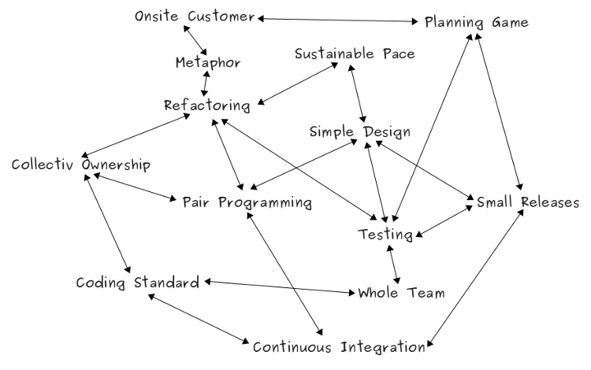
e

Slide 11
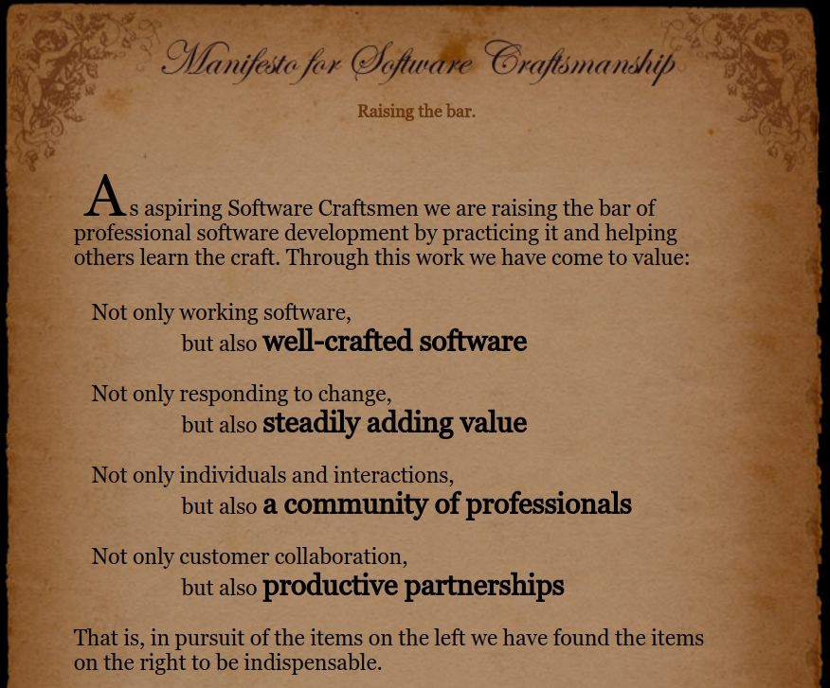

Slide 12
Software craftsman should be able to
Talk to customer directly
Understand the underlying problem,
not how customer proposes to solve it
Propose solutions
Break the problem into small chunks,
write down as user-centric stories
Design UI flow
Write working code
Write automated tests to avoid regressions
Deploy the system to the end users
Evolve the system design/architecture by refactoring when needed
Old-fashioned software developer

Slide 13
Projects
Usually staffed with 2-4-6 people
Who are responsible for everything

Slide 14
Project routine
Before start: make sure we have business and tech contacts
Kick-off meeting with them
  Storytelling
Iterations (1 week)
  Stand-up meetings (mostly over video)
  Developers focus on user stories
  Continuous integration server builds and tests every change
  Continuous delivery to a demo server
Iteration planning
  Demo
  Prioritization & storytelling
Until agreed deadline or can finish anytime for any reason

Slide 15
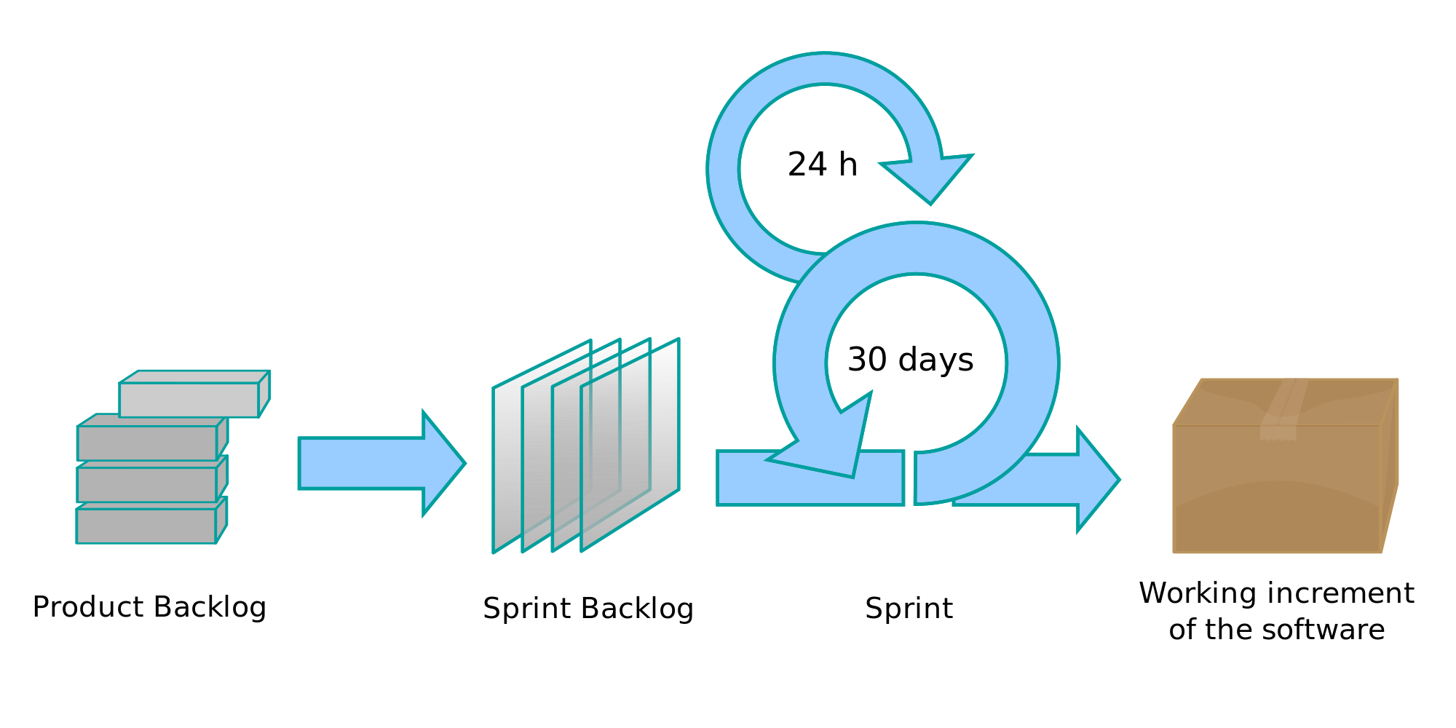

Slide 16
User stories
Systems evolve implementing user stories
“As a bank’s customer I can pay for my mobile phone”
“Customer can pay for mobile phone”
Every new functionality must benefit someone
This benefit should be verifiable (definition of done)
A story must be smaller than the iteration (1w)
We don’t waste too much time estimating, S/M/L is enough
- see #noestimates

Slide 17
Pivotal Tracker
www.pivotaltracker.com
(Forget JIRA!)

Slide 18
Launching big things
Pilot / POC (Proof of Concept)
Internal launch for big/existing organizations ASAP
MVP (Minimal Viable Product)
to the end-users ASAP
Iterative improvement based on user feedback

Slide 19
Technologies
They come and go
Every team chooses programming language, frameworks, libraries
We use Java, Ruby, Python, Scala, Kotlin, C
+ JavaScript and HTML/CSS, etc
Clean code is more important than else
“Leave the campground cleaner than you found it”

Slide 20
Technical excellence
No Agile methodology works without this
Collective code ownership
Continuous integration
Repeatable builds
TDD - Test Driven Development
JED - Just Enough Design, Refactoring, YAGNI
Simplicity, KISS
Automation (no repetitive tasks, DRY)

Slide 21
Small steps for everything
Small and frequent commits
Small and completable user stories
Small (short) iterations
Small and regular releases

Slide 22
Good tools matter
Linux workstations
Git
Intellij IDEA and other JetBrains IDEs
Pivotal Tracker
Make your own
e.g. CI alert screen, Git author selector for pair programming, Selenide for concise UI testing

Slide 23
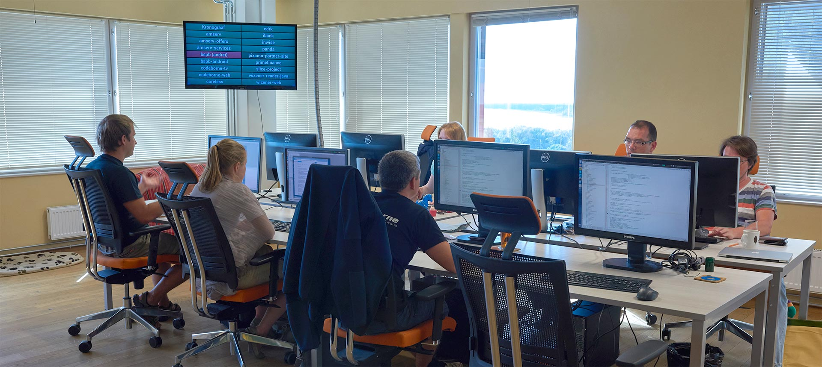

Slide 24
Pair Programming
Nearly 100% of the time
Extreme code review
Two heads are always better than one
Knowledge sharing / Mentoring
Focus
TDD enforcement
Fun

Slide 25
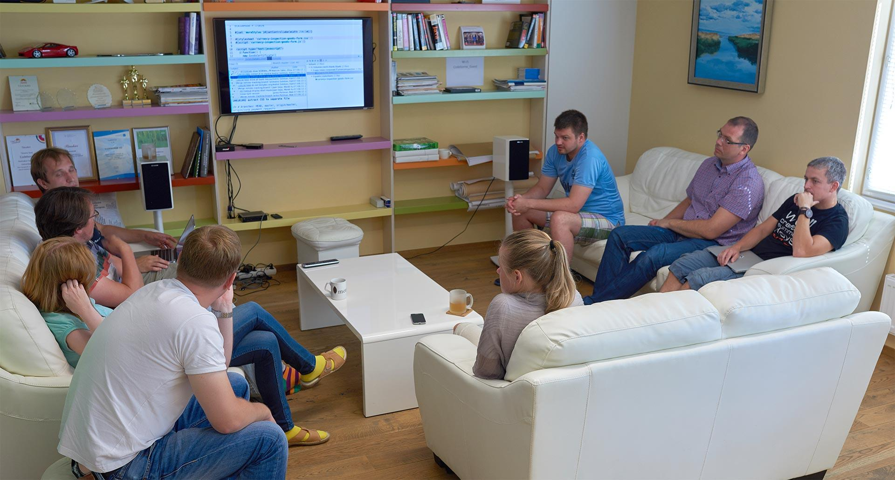
Collective code reviews
For even bigger teams

Slide 26
Mainline based development
Single integration branch
Good for CI
Nobody is working on old code
Feature branches only when absolutely necessary
Release anytime
Feature toggling if necessary
e.g. new features are first visible to a group of users

Slide 27
or GitHub Flow (usable w/o GitHub)
For our largest team (12+6), to save time on code reviews
https://guides.github.com/introduction/flow/
All development in feature branches, followed by Pull-Requests
CI builds all branches and PRs
Master is deployable to production at any time, contains only reviewed and accepted code

Slide 28
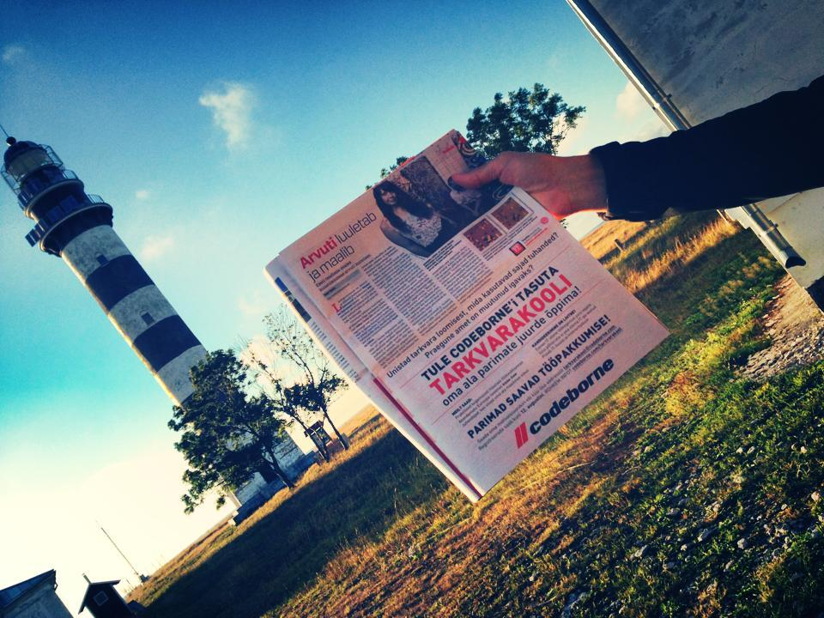

Slide 29
Tarkvarakool - Software School
Facebook works better than newspapers
School for non-IT people experienced in something else
IT in Estonia really needs many more good specialists
Many existing ones are spoiled with ineffective processes
Many students want to become managers instead
(there are too many useless managers everywhere)
e-Estonia image needs to be maintained
Has inspired Vali-IT government program

Slide 30
3rd level of professionalism
You are very good at doing it
You are so good, so you can innovate
You are so good, so you can teach others to innovate, too
(then your innovation becomes the norm)

Slide 31
More company culture
Daily company standup
TEX (TEchnology EXchange) weekly meetings
Month’s Last Friday lunch + retro
Fullmoon pub crawling
Out of office working week in Summer

Slide 32
Retros

Slide 33
Thanks!
codeborne.com/2015/08/10/working-agile.html

