Slide 1

PROGRAMMING II
Vladimir Viies, Lembit Jürimägi, Risto Heinsaar vladimir.viies@gmail.com
Tallinn 2023

Slide 2
tests

Slide 3
Written exam
WE=code+theory question

Slide 4
FINAL RESULT=> written exam(max 65p)+ HW I(max 15p)+ HW II(max 15p) + HW III(max 10p)
*From the point out of 50 - pass to written exam(Lab max36+Test I max 20 + Test II max 20 + bonus max 10 ) NB! Pass to pre- exam => 61p before 11.12.2020
1. |  | file -system, programming with files |  |  | I homework beginning |  |  | max15p
 |  | moodle enviroment
2. |  | records, | programming with records, DB
 |  | recursionI
3. | week5 | test I | files+ records
 |  | MK
4. |  | dynamic memory usage, recursionII |  |  | II homework beginning |  |  | max 15p
5. |  | programming with DM
 |  | MK
6. | week13 | test II |  | DM,recursion
 |  |  |  |  | III homework beginning |  |  | max 10p
7. |  | C++
 |  |  |  |  | dedline to defense of homeworks
8. |  | final test(if it is necessary) |  |  | NB!the possibility to write the written exam
--------------------end of lectures----------------------------

Slide 5
Possible groups and levels
R.Heinsaar &co=> ICT121
V.Viies&co=>ICT122
I-level( fails ,functions, structures,HW1) => max result „2“
II-level( I-level+dynamic memory+HW2) => max result „4“
III-level(II-level+OOP+HW3) => max „5“

Slide 6
Homework (I)-example
Files and structures
Write an algorithm and matching code for a program with the following functional requirements:
Data is read from a plain text file „F1.txt“ and stored as a structure. The data file must contain the given attributes:
  Name - string
  Age - integer
  Income - floating point
Program will output:
  To file „F2.txt“ all of the entries whose age is below the average.
  To file „F3.txt“ all of the entries whose income is above the average.

Slide 7
File-System Interface
File Concept
Access Methods
Directory Structure
File-System Mounting
File Sharing
Protection

Slide 8
File Concept
Contiguous logical address space
Types:
  Data
    numeric
    character
    binary
  Program

Slide 9
File Structure
None - sequence of words, bytes
Simple record structure
  Lines
  Fixed length
  Variable length
Complex Structures
  Formatted document
  Relocatable load file
Can simulate last two with first method by inserting appropriate control characters
Who decides:
  Operating system
  Program

Slide 10
File Attributes
Name – only information kept in human-readable form
Identifier – unique tag (number) identifies file within file system
Type – needed for systems that support different types
Location – pointer to file location on device
Size – current file size
Protection – controls who can do reading, writing, executing
Time, date, and user identification – data for protection, security, and usage monitoring
Information about files are kept in the directory structure, which is maintained on the disk

Slide 11
File Operations
File is an abstract data type
Create
Write
Read
Reposition within file
Delete
Truncate
Open(F_{i}) – search the directory structure on disk for entry F_{i}, and move the content of entry to memory
Close (F_{i}) – move the content of entry F_{i} in memory to directory structure on disk

Slide 12
Open Files
Several pieces of data are needed to manage open files:
  File pointer: pointer to last read/write location, per process that has the file open
  File-open count: counter of number of times a file is open – to allow removal of data from open-file table when last processes closes it
  Disk location of the file: cache of data access information
  Access rights: per-process access mode information

Slide 13
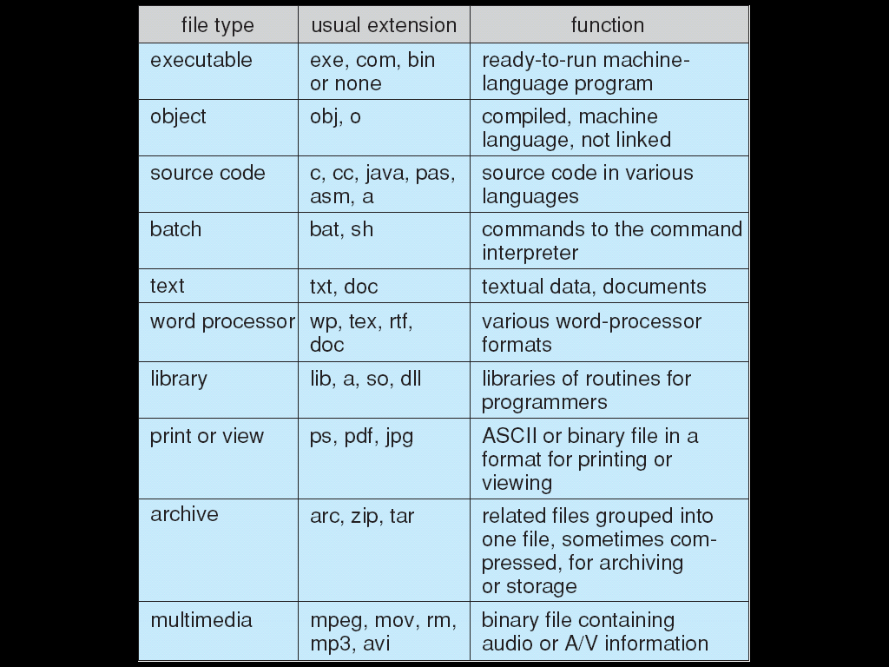
File Types – Name, Extension

Slide 14
Access Methods
Sequential Access
read next
write next
reset
no read after last write
(rewrite)
Direct Access
read n
write n
position to n
read next
write next
rewrite n
n = relative block number

Slide 15
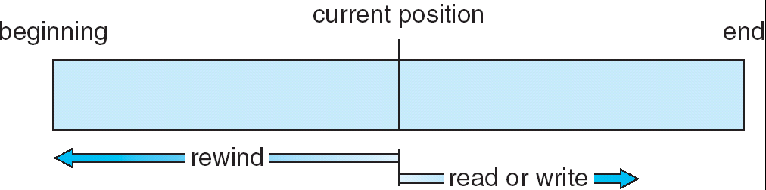
Sequential-access File

Slide 16
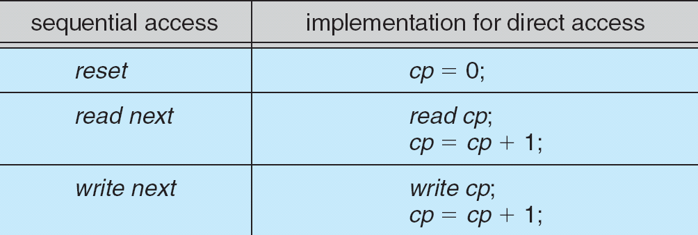
Simulation of Sequential Access on a Direct-access File

Slide 17
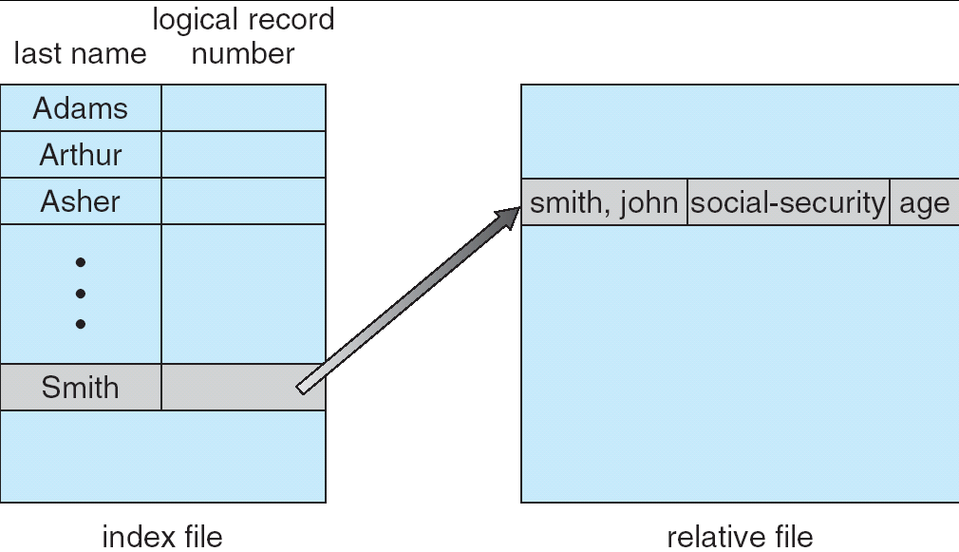
Example of Index and Relative Files

Slide 18
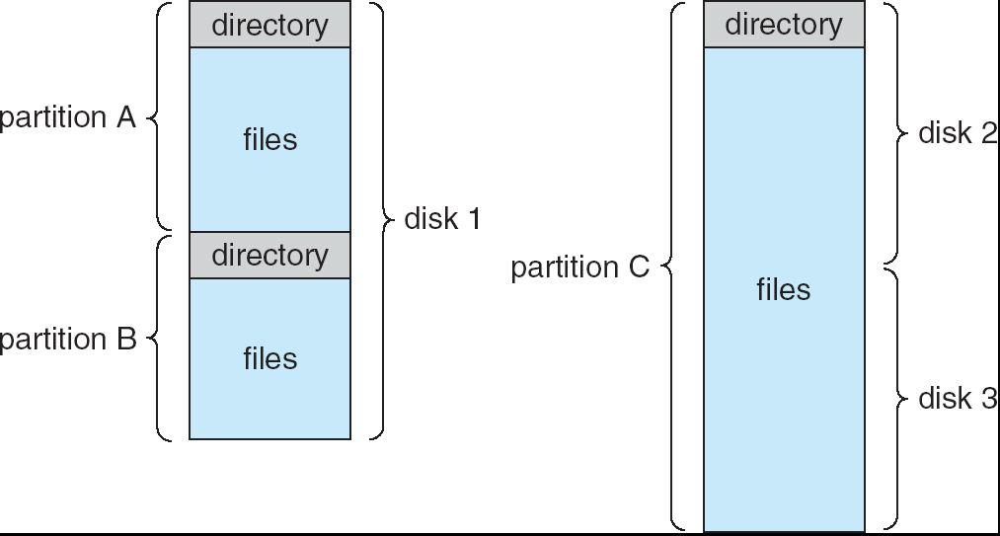
A Typical File-system Organization

Slide 19
Operations Performed on Directory
Search for a file
Create a file
Delete a file
List a directory
Rename a file
Traverse the file system

Slide 20
Organize the Directory (Logically) to Obtain
Efficiency – locating a file quickly
Naming – convenient to users
  Two users can have same name for different files
  The same file can have several different names
Grouping – logical grouping of files by properties, (e.g., all Java programs, all games, …)

Slide 21
Protection
File owner/creator should be able to control:
  what can be done
  by whom
Types of access
  Read
  Write
  Execute
  Append
  Delete
  List

Slide 22
Access Lists and Groups
Mode of access: read, write, execute
Three classes of users
RWX
a) owner access 7 ⇒ 1 1 1
RWX
b) group access 6 ⇒ 1 1 0
RWX
c) public access 1 ⇒ 0 0 1
Ask manager to create a group (unique name), say G, and add some users to the group.
For a particular file (say game) or subdirectory, define an appropriate access.
owner
group
public
chmod
761
game
Attach a group to a file
chgrp G game

Slide 23
File handling
File handling is done by the operating system. Various system calls are needed to access files and the specifics of these depend from OS to OS.
C hides these specifics from the programmer by wrapping the functionality into several functions that all use a pointer to a FILE structure.
This ensures that the program code is platform independent, even thought the implementation is not.

Slide 24
Accessing files
Files are an external resource.
In the case of such resources it is necessary to explicitly set up a connection to the resource.
This means:
  opening the connection;
  doing something via the connection (like read or write);
  shutting down the connection after you're done.

Slide 25
Opening a file
Function fopen() is used for opening a file.
It requires 2 parameters, the name or path to the file and access mode, which specifies whether the file is opened for reading ("r"), writing ("w") or appending ("a") data.
The function returns a pointer to FILE structure that is used by all subsequent calls to that file.
If the function fails (for example, when reading from a file that doesn't exist or trying to create a file with the same name as an existing folder) NULL pointer is returned instead.

Slide 26
Opening a file (2)
FILE *fopen(const char *filename, const char *mode)
//Example:
FILE *f;
//open file test.txt for reading
f = fopen("test.txt", "r");
if(f == NULL) //file could not be opened
exit(0); //exit the program

Slide 27
Position in file
Files are sequential access, reading and writing advances the position you're at in the file.
This is the legacy of the time when files used to be stored on external magnetic tape devices, where indeed tape had to be winded for the read or write to occur.
Function rewind() is used to get back to the beginning of the file.
void rewind(FILE *stream)

Slide 28
Reading from a file
Function fscanf() is used for reading formatted input. It behaves just like scanf(), except first parameter must be the FILE pointer. It returns the number of variables it was able to successfully fill out according to the format.
int fscanf(FILE *stream, const char *format, ...)

Slide 29
Reading from a file (2)
Function fgets() reads a line from the file including the end of line symbol(s). The parameters are the string to store the text, length of that string and FILE pointer. If the function fails it returns a NULL pointer.
char *fgets(char *str, int n, FILE *stream)

Slide 30
Reading from a file (3)
//Example:
int x; //define some variables
char buf[200];
FILE *f = fopen("test.txt", "r"); //open for reading
if(f != NULL){ //if succesful
if (fscanf(f, "%d", &x) == 1) //if read succeeded
printf("%d\n", x); //then print
else if (!feof(f)){ //else if not yet fileend
fgets(buf, 200, f); //read to buffer
printf(buf); //print that
}
fclose(f); //close file
}

Slide 31
Writing to a file
Function fprintf() is used for writing formatted output to a file. Behaves just like printf(), except first parameter must be the FILE pointer.
int fprintf(FILE *stream, const char *format, ...)
Function fputs() is used for writing a string to a file.
int fputs(const char *str, FILE *stream)

Slide 32
Writing to a file (2)
//Example:
FILE *f=fopen("test.txt","w");//open for writing
if(f != NULL){ //did fopen succeed?
fprintf(f, "High %d!\n", 5);//write to file
fputs("Some text.");
fclose(f); //close file
}

Slide 33
Closing the file
Function fclose() is used for closing the connection to file. Any read or write after fclose() will fail.
int fclose(FILE *stream)
If fclose() is not called then the OS will close all the files opened by the application anyway once it exits. If the application crashes then the written contents to the file(s) may be lost.

Slide 34
Header files
For a larger project it makes sense to break the program code into several files.
Custom datatypes and function prototypes are moved into .h header files. The implementation of these functions remains in the .c code files.
In order to use datatypes or functions of another module you have to:
  include the corresponding header file to your code file
  tell the compiler to compile the code file where the functionality has been implemented as well

Slide 35
Header files (2)
tst.h
typedef struct typename{
int a;
float b;
char s[10];
} test_struct;
void printAll(int n, struct typename *M);
tst.c
#include <stdio.h>
#include "tst.h"
void printAll(int n, struct typename *M){
int i;
for(i = 0; i < n; i++)
printf("%s\n", M[i].s);
}

Slide 36
Header files (3)
main.c
#include "tst.h"
int main(void){
test_struct M[2] = {12, 3.7, "Thomas", 14, 4.4, "Matthew"};
printAll(2, M);
}
Compiling:
gcc main.c tst.c -o test -Wall
Running:
./test

Slide 37
Shell sort algorithm (1)
(has less exchanges, presumes that data is partially sorted)

Slide 38
External sorting files(bonus task 4p)
F 97 20 53 04 32 15 50 89 48 95 04 37 n = 12
F1 97, 04 32 48 95
F2 20 53, 15 50 89, 04 37
F3 20 53 97, 04 37
F4 04 15 32 48 50 89 95
F1 04 15 20 32 48 50 53 89 95 97
F2 04 37
F3 04 04 15 20 32 37 48 50 53 89 95 97
F4

Slide 39
End of file system

Slide 40
Structures
Structures are used for grouping different datatypes together into a single unit. It's possible to declare a single variable as a structure but usually the aim is to declare a new datatype and then use this datatype for declaring many variables.
//Example: single variable
struct {
int a;
float b;
char s[10];
} x;

Slide 41
Structures (2)
//Example: datatype
struct typename{
int a;
float b;
char s[10];
} ;
//defining variables of type "struct typename"
struct typename x;
struct typename M[20];

Slide 42
Structures (3)
In order to access fields of a structure record selector . is used after the variable name.
C permits assignment operation for structures. This assignment copies over all fields in the structure.
//Example:
x.a = 14;
strcpy(x.s, "hello");
M[5] = x;
printf(M[5].s);

Slide 43
Structures and pointers
If a structure variable is of a pointer type then the record selector changes to ->
Arrays are always pointers to the first element in the array. When it comes to function parameters then there's no difference between declaring a parameter a pointer or an array.
//Example:
void printAll(int n, struct typename *M){ //could be: M[]
int i;
for(i = 0; i < n; i++)
printf("%04d %s\n", M[i].a, M[i].s);
}
void printFirst(struct typename *M){
printf("%04d %s\n", M->a, M->s); //could be: M[0].x, M[0].s
}

Slide 44
Typedef
It quickly becomes annoying to always type "struct typename" when declaring a variable.
Typedef can be used to give the type a new and shorter name.
//Example:
typedef struct typename{
int a;
float b;
char s[10];
} test_struct;
test_struct x;

