Slide 1
Memory Management I
All data in memory before and after processing
All instructions in memory in order to execute
Memory management determines what is in memory when
  Optimizing CPU utilization and computer response to users
Memory management activities
  Keeping track of which parts of memory are currently being used and by whom
  Deciding which processes (or parts thereof) and data to move into and out of memory
  Allocating and deallocating memory space as needed

Slide 2
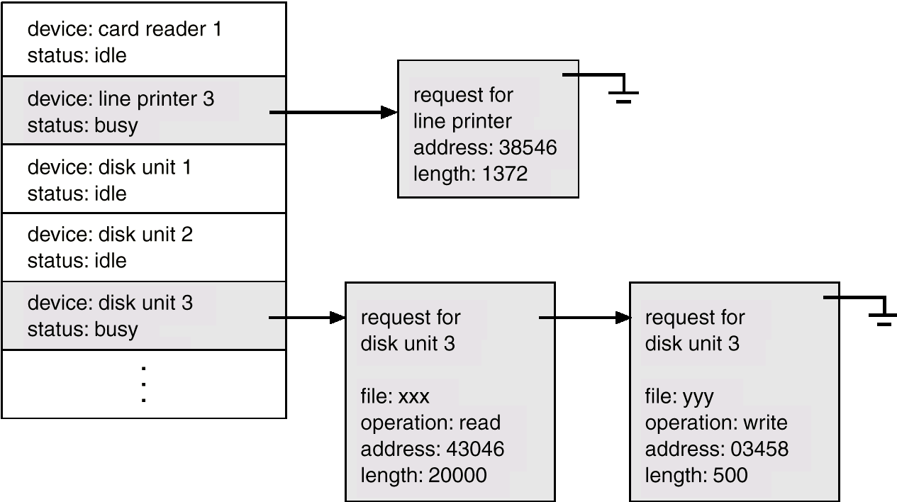
Device-Status Table

Slide 3
Storage Structure
Main memory – only large storage media that the CPU can access directly.
Secondary storage – extension of main memory that provides large nonvolatile storage capacity.
Magnetic disks – rigid metal or glass platters covered with magnetic recording material
  Disk surface is logically divided into tracks, which are subdivided into sectors.
  The disk controller determines the logical interaction between the device and the computer.

Slide 4
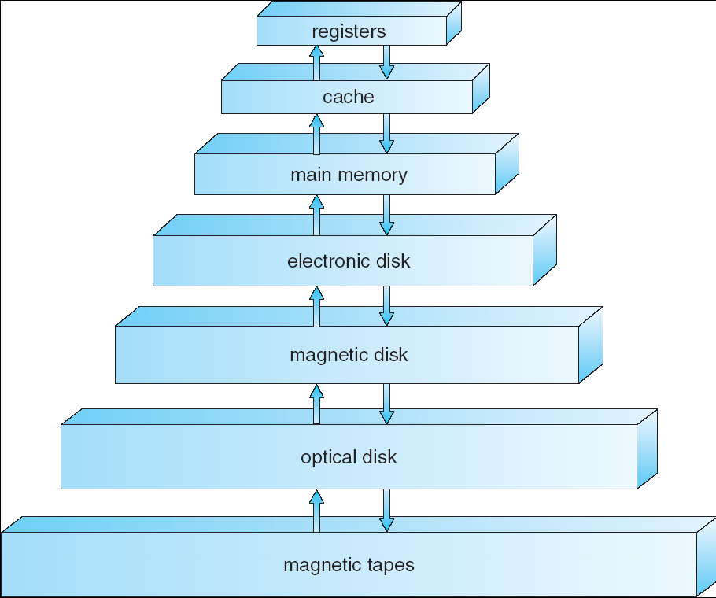
Storage-Device Hierarchy

Slide 5
Caching
Important principle, performed at many levels in a computer (in hardware, operating system, software)
Information in use copied from slower to faster storage temporarily
Faster storage (cache) checked first to determine if information is there
  If it is, information used directly from the cache (fast)
  If not, data copied to cache and used there
Cache smaller than storage being cached
  Cache management important design problem
  Cache size and replacement policy

Slide 6
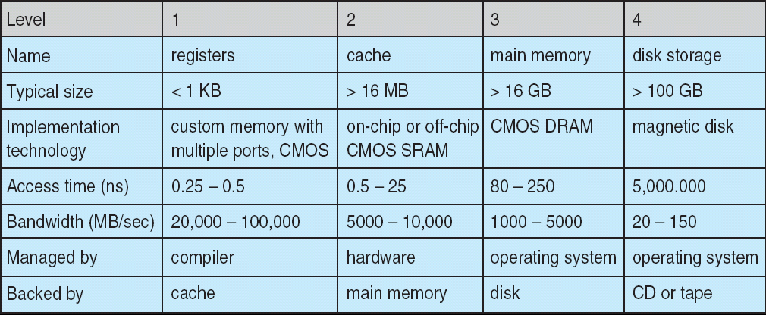
Performance of Various Levels of Storage
Movement between levels of storage hierarchy can be explicit or implicit

Slide 7
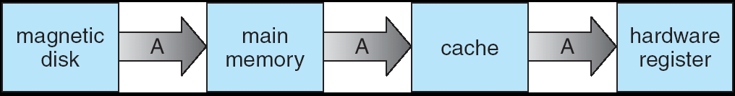
Migration of Integer A from Disk to Register
Multitasking environments must be careful to use most recent value, no matter where it is stored in the storage hierarchy
Multiprocessor environment must provide cache coherency in hardware such that all CPUs have the most recent value in their cache
Distributed environment situation even more complex
  Several copies of a datum can exist

Slide 8
Storage Management
OS provides uniform, logical view of information storage
  Abstracts physical properties to logical storage unit - file
  Each medium is controlled by device (i.e., disk drive, tape drive)
    Varying properties include access speed, capacity, data-transfer rate, access method (sequential or random)
File-System management
  Files usually organized into directories
  Access control on most systems to determine who can access what
  OS activities include
    Creating and deleting files and directories
    Primitives to manipulate files and dirs
    Mapping files onto secondary storage
    Backup files onto stable (non-volatile) storage media

Slide 9
Memory Management
Linux’s physical memory-management system deals with allocating and freeing pages, groups of pages, and small blocks of memory
It has additional mechanisms for handling virtual memory, memory mapped into the address space of running processes
Splits memory into 3 different zones due to hardware characteristics

Slide 10
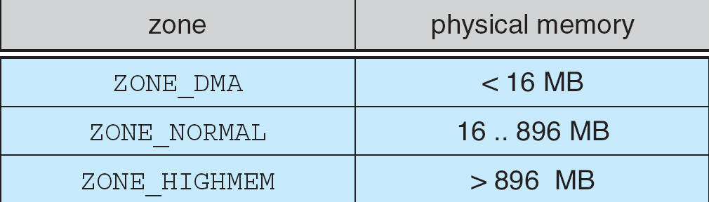
Relationship of Zones and Physical Addresses on 80x86

Slide 11
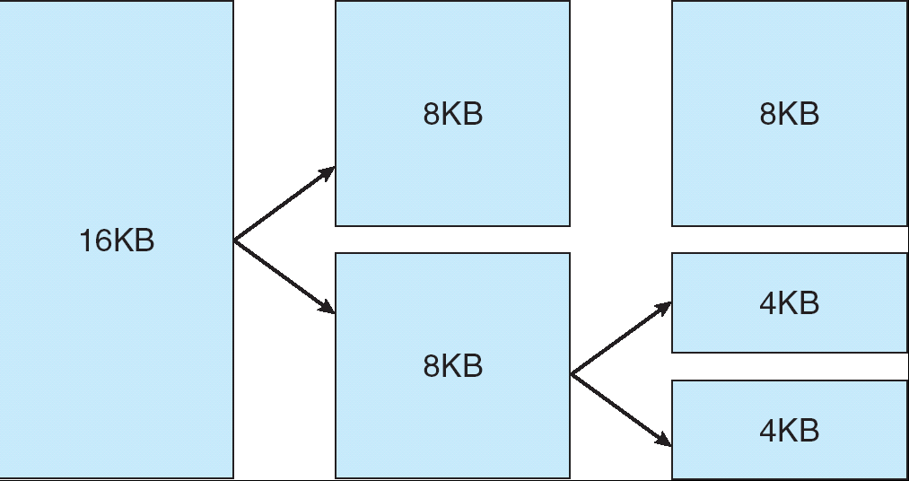
Splitting of Memory in a Buddy Heap

Slide 12
Managing Physical Memory
The page allocator allocates and frees all physical pages; it can allocate ranges of physically-contiguous pages on request
The allocator uses a buddy-heap algorithm to keep track of available physical pages
  Each allocatable memory region is paired with an adjacent partner
  Whenever two allocated partner regions are both freed up they are combined to form a larger region
  If a small memory request cannot be satisfied by allocating an existing small free region, then a larger free region will be subdivided into two partners to satisfy the request
Memory allocations in the Linux kernel occur either statically (drivers reserve a contiguous area of memory during system boot time) or dynamically (via the page allocator)
Also uses slab allocator for kernel memory

Slide 13
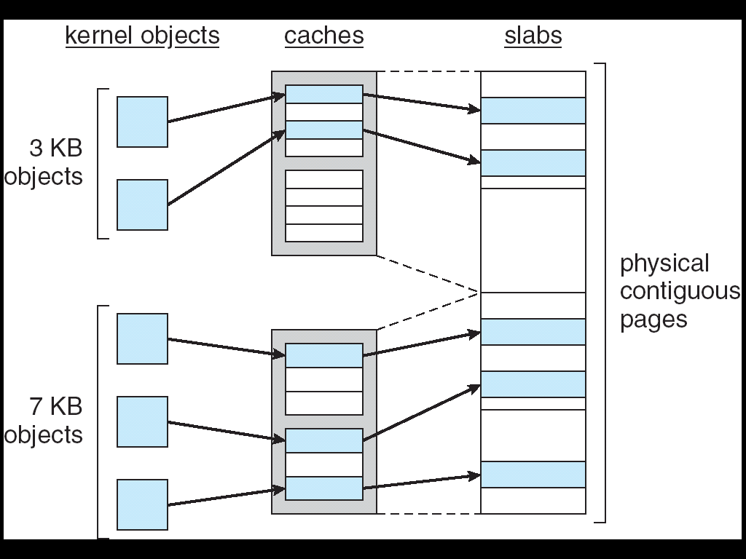
21.07

Slide 14
Virtual Memory
The VM system maintains the address space visible to each process: It creates pages of virtual memory on demand, and manages the loading of those pages from disk or their swapping back out to disk as required
The VM manager maintains two separate views of a process’s address space:
  A logical view describing instructions concerning the layout of the address space
    The address space consists of a set of nonoverlapping regions, each representing a continuous, page-aligned subset of the address space
  A physical view of each address space which is stored in the hardware page tables for the process

Slide 15
Virtual Memory (Cont.)
Virtual memory regions are characterized by:
  The backing store, which describes from where the pages for a region come; regions are usually backed by a file or by nothing (demand-zero memory)
  The region’s reaction to writes (page sharing or copy-on-write)
The kernel creates a new virtual address space
  1. When a process runs a new program with the exec system call
  2. Upon creation of a new process by the fork system call

Slide 16
Virtual Memory (Cont.)
On executing a new program, the process is given a new, completely empty virtual-address space; the program-loading routines populate the address space with virtual-memory regions
Creating a new process with fork involves creating a complete copy of the existing process’s virtual address space
  The kernel copies the parent process’s VMA descriptors, then creates a new set of page tables for the child
  The parent’s page tables are copied directly into the child’s, with the reference count of each page covered being incremented
  After the fork, the parent and child share the same physical pages of memory in their address spaces

Slide 17
Virtual Memory (Cont.)
The VM paging system relocates pages of memory from physical memory out to disk when the memory is needed for something else
The VM paging system can be divided into two sections:
  The pageout-policy algorithm decides which pages to write out to disk, and when
  The paging mechanism actually carries out the transfer, and pages data back into physical memory as needed

Slide 18
Virtual Memory (Cont.)
The Linux kernel reserves a constant, architecture-dependent region of the virtual address space of every process for its own internal use
This kernel virtual-memory area contains two regions:
  A static area that contains page table references to every available physical page of memory in the system, so that there is a simple translation from physical to virtual addresses when running kernel code
  The reminder of the reserved section is not reserved for any specific purpose; its page-table entries can be modified to point to any other areas of memory

Slide 19
Executing and Loading User Programs
Linux maintains a table of functions for loading programs; it gives each function the opportunity to try loading the given file when an exec system call is made
The registration of multiple loader routines allows Linux to support both the ELF and a.out binary formats
Initially, binary-file pages are mapped into virtual memory
  Only when a program tries to access a given page will a page fault result in that page being loaded into physical memory
An ELF-format binary file consists of a header followed by several page-aligned sections
  The ELF loader works by reading the header and mapping the sections of the file into separate regions of virtual memory

Slide 20
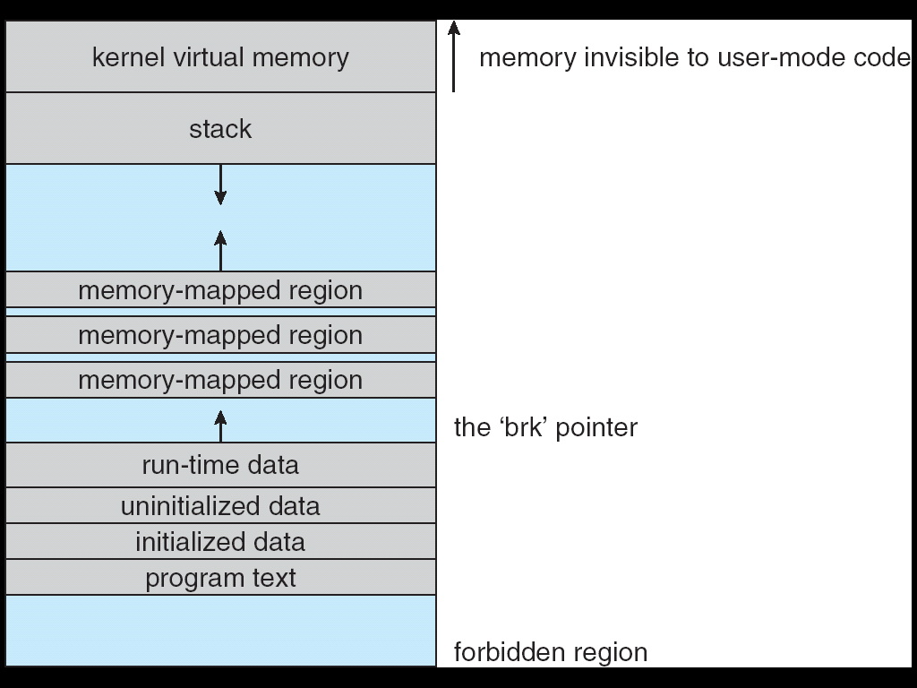
Memory Layout for ELF Programs

Slide 21
Static and Dynamic Linking
A program whose necessary library functions are embedded directly in the program’s executable binary file is statically linked to its libraries
The main disadvantage of static linkage is that every program generated must contain copies of exactly the same common system library functions
Dynamic linking is more efficient in terms of both physical memory and disk-space usage because it loads the system libraries into memory only once

