Slide 1
Structures

Slide 2
Structures
Is a complex data type
Structures are used for grouping different data types together into a single unit.
A human’s natural way of thinking about real-world objects
c
struct employee
{
char name[20];
char surname[20];
int age;
char position[20];
float salary;
};

Slide 3
Storing in memory
1 byte
...
J
O
H
N
\0
D
O
E
\0
X
X
X
X
...
char * 10
char * 10
int

Slide 4
Examples
struct date
{
int day;
int month;
int year;
};
struct complex {
float real;
float imaginary;
};
struct point {
float x;
float y;
float z;
};

Slide 5
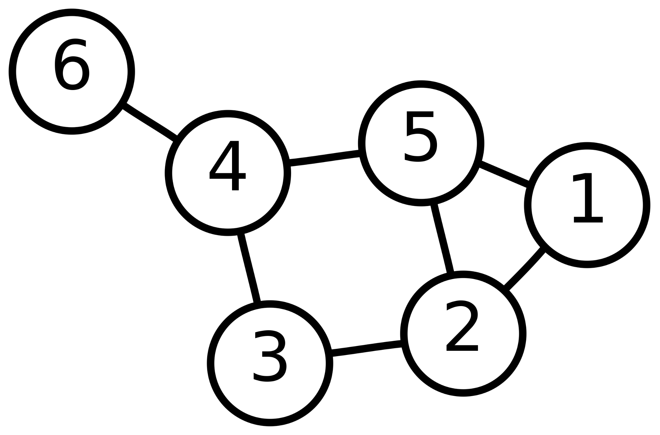
Example (Graph)
typedef struct NodeData {
int id;
int isVisited;
} node_data;
typedef struct Node {
node_data data;
node * adjacent[20];
} node;

Slide 6
Implementation of Structs

Slide 7
Typedef closure
typedef statement is used to rename data types.
Usage of typedef helps to, improve readability of code and avoid mistakes (simply for programmer’s convenience)
// typedef <known_type> <name>;
typedef int size_t;
typedef int err_t;
typedef int bool;

Slide 8
size_t numberOfRecords = 0;
err_t getNumberOfLines(char* filename, size_t* numberOfLines);
bool isError(err_t err);
void printError(err_t err);

Slide 9
Creating types for structure
Pattern
Example
// Pattern to remember:
typedef struct StructName {
int a;
// ...
} struct_name;
typedef struct Employee {
char name[20];
char surname[20];
int age;
char position[20];
int salary;
} employee_t;

Slide 10
Creating instances
typedef struct Student
{
char name[20];
char surname[20];
int age;
} student;
student unknownStudent;
student knownStudent = {"John", "Doe", 20};
student class[20];
student almostKnownStudent = {.name = "John", .surname = "Doe"};

Slide 11
Reading / Writing fields
Direct access
Pointer access
student stud = {"John", "Doe", 20};
// Read / Write
stud.age = 21;
void printStudentAge(student stud) {
printf("Age: %d\n", stud.age);
// Won’t have effect outside the
function:
stud.name = "James";
}
student *pStudent = &stud;
// Read / Write
pStudent->age = 22;
void printStudentAge(student* stud) {
printf("Age: %d\n", stud->age);
// Will have effect outside the
function:
stud->age = "Scott";
}

Slide 12
Scanning
scanf("%s %s %d", stud.name, stud.surname, &stud.age);
fscanf("students.txt", "%s %s %d", stud.name, stud.surname, &stud.age);
sscanf("John Doe 20", "%s %s %d", stud.name, stud.surname, &stud.age);

Slide 13
Tasks

Slide 14
Demo tasks (2 points)
Create employee structure (First name, Last name, salary)
Create a single instance of employee
Create a function to print employee, print employee
Create a function to read employee from console
Update the program, to have a company struct with name, address, array of employees. Create instance of the company
Create method to print a company, which uses a method to print a single employee for each of them
Modify a program to read company data from file. The file contains name in first line, address in second and list of employees in next lines
* Later you’ll need to push this program to GitLab

Slide 15
Classwork (2 points)
Task: Create a program to rank candidates on next elections. The program has to:
Read candidates from file:
  Ask user for filename.
  Check if file exists. If not - print an error and finis execution.
  Count number of records in file and rewind.
  Read surname, party and number of votes from file and parse them to structure for each candidate.
Create a method to print candidates in table form (Use you design skills. You may search how to format outputs). Print candidates.
Sort candidates by number of votes and print again.
Requirements:
All logic must be separated into functions. Structures have to be used. Try to format user prompts and output in an easy to understand way. Save code to elections.c file and data to elections.txt and add them to

Slide 16
Small homework (2 points)
Task: Create a program to find weekday of birthday. The program has to:
Read people from file:
  Ask user for filename.
  Check if file exists. If not - give user one more attempt
  Count number of people in file and rewind.
  Read name, surname, day, month year for every person.
Create a method to print person, birth date and weekday in table form (Use you design skills. You may search how to format outputs). Print people and at what day of week they were born
Ask user for year X and print people again, but this time - with weekdays of their birthday in year X.
Requirements:
All logic must be separated into functions. Structures have to be used. Try to format user prompts and output in an easy to understand way. Save code to birthday.c file and data to birthdays.txt and add them to GitLab repository created today - don’t create a new one

Slide 17

What is Git?

Slide 18

Imagine, you have been working on a large project …

Slide 19


… Maybe with a team …

Slide 20
Q: What problems may you face?

Slide 21
Problems
🗂️ Large, disorganized codebase
😕 No one knows who has done what
📦 Impossible for everybody to have an up to date files
✏️ Overriding each other’s improvements

Slide 22
Problems (In real life)
🗂️ “What’s inside asdfgsefg.c file”
😕 “Who of you has written this?”
📦 “Are you sure, you’ve sent me the latest version of main.c”?
✏️ “Why have you deleted my int readfile() function?”

Slide 23
Git helps you with that!
But how?

Slide 24
Git’s approach
💡
time

Slide 25
Commits
Commit is snapshot of your codebase, after some set of changes was made.
Commit 📸

Slide 26
Commit examples
main.c added
input.h library created
🦊
🦁
Initial commit
Documentation added
🦁
🦊
Note: Every commit must have a commit message

Slide 27
Branches
🦊: I’ll work on program logic
🦁: I will do inputs from file
🦁: Also, I will create outputs
👈
master branch

Slide 28
Branches
🦊: I’ll work on program logic
🦁: I will do inputs from file
🦁: Also, I will create outputs
👈
master branch
👈
input branch
👈
output branch
👈
logic branch

Slide 29
Merge
🦊: I’ll work on program logic
🦁: I will do inputs from file
🦁: Also, I will create outputs

Slide 30
How merge looks like?
input.c [master]
1
2
3
4
5
6
7
8
9
10
// TODO: create following functions:
// readFileName
// inputFile
// parseLine
input.c [input]
int readFileName(char *fileName) {
printf("Enter file name: ");
scanf("%s", fileName);
return 0;
}
int inputFile(char *name) {
FILE *file = fopen(name, "r");
if (file == NULL)
{
....
1
2
3
4

Slide 31
// TODO: create following functions:
// readFileName
// inputFile
// parseLine
int readFileName(char *fileName) {
printf("Enter file name: ");
scanf("%s", fileName);
return 0;
}
int inputFile(char *name) {
FILE *file = fopen(name, "r");
if (file == NULL)
{
....
input.c [Git changes]

Slide 32
Git remote repositories

Slide 33
Git remote repositories
There is a problem: changes to repository is made locally. So you’ll need a hosting service to store code there and make it accessible from any computer
The most popular are:
GitLab (Which we will use)
GitHub
BitBucket

Slide 34
Synchronizing changes
GitLab
“Push”
🦊
🦁

Slide 35
Synchronizing changes
GitLab
“Push”
🦊
🦁

Slide 36
Synchronizing changes
GitLab
“Clone”
🦊
🦁

Slide 37
Synchronizing changes
GitLab
🦊
🦁

Slide 38
Synchronizing changes
GitLab
“Push”
🦊
🦁

Slide 39
Synchronizing changes
GitLab
“Push”
🦊
🦁

Slide 40
Synchronizing changes
GitLab
“Push”
🦊
🦁

Slide 41
Synchronizing changes
GitLab
“Pull”
🦊
🦁

Slide 42
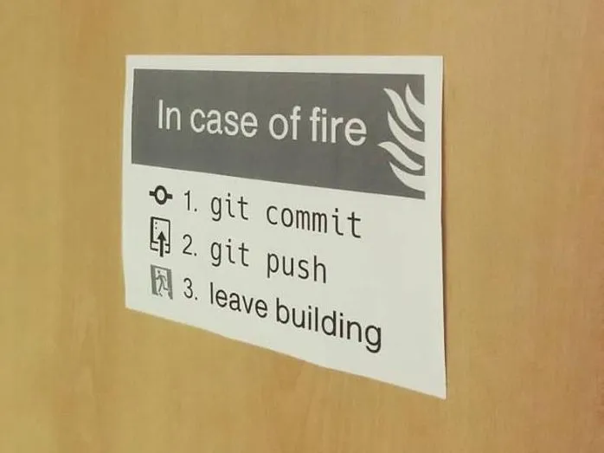

Slide 43
Let’s try

Slide 44
Guide (to create a repository)
Create a folder in your computer. Create the main file you’ll be working with
Open this folder in terminal and run git init
Go to gitlab.pld.ttu.ee
Create new private project
In description write your name, surname, student code and name of work (Homemork X or Lab Week X ):
Example: YYYYYYYYY - XXXXXXMVEB - Homework
Inside your project go to “Members” tab and add @Vladimir.Viies as “Masters”
Follow the instructions there
Every time you have done a set of changes, run the following commands:
git commit -m “ [What have you done] ”
git push

