Slide 1
GIT and version control
Kristo Kakkum

Slide 2
GIT
Created by Linus Torvalds in 2005 for Linux Kernel development
Distributed Version Control
Free and open source
Most used Version Control

Slide 3
Version Control
Allows to files/projects/directories
Access previous versions
Track changes
Centralised and Distributed

Slide 4
Centralised Version Control
Central server for project storage
All versions in central server
Only one person can change a file at a time
When server crashes, all data lost

Slide 5
Distributed Version Control
Entire project on local machine
All actions can be done locally
No single point of failure
Faster performance

Slide 6
GIT Installation Windows
https://git-scm.com/install/windows
Install setup
After install in Windows open GIT bash

Slide 7
GIT Installation MacOS
Run git –version in terminal to see if it already installed
https://git-scm.com/install/mac
Install home brew from brwe.sh
Run brew install git in terminal

Slide 8
GIT Installation Linux
https://git-scm.com/install/linux
Use your distribution package manager

Slide 9
GIT Commands
git config -- global user.name “username”
git config -- global user.email “email”
git config –list
git clone url
git add .
git status

Slide 10
GIT Commands
git commit -m ”Comment about version”
git log
git push origin master
git pull
Offical documentation
https://git-scm.com/docs

Slide 11
GitLab
https://gitlab.cs.ttu.ee/
Go to gitlab Taltech
Login using Taltech Uni-id and password
Click ‘Create a project’ then ‘Create blank project’

Slide 12
GitLab
Give your project name and set visibility to internal
Then copy the repository URL
Run command git clone in terminal
cd to the created repository directory

Slide 13
GitLab
Make a new .c file that does the following:
using functions returns the result of division between 2 user inputed floating point numbers
Then use git add . -to notify git of the new files and confirm it using git status
Then use git commit-m “comment what you did/changed”

Slide 14
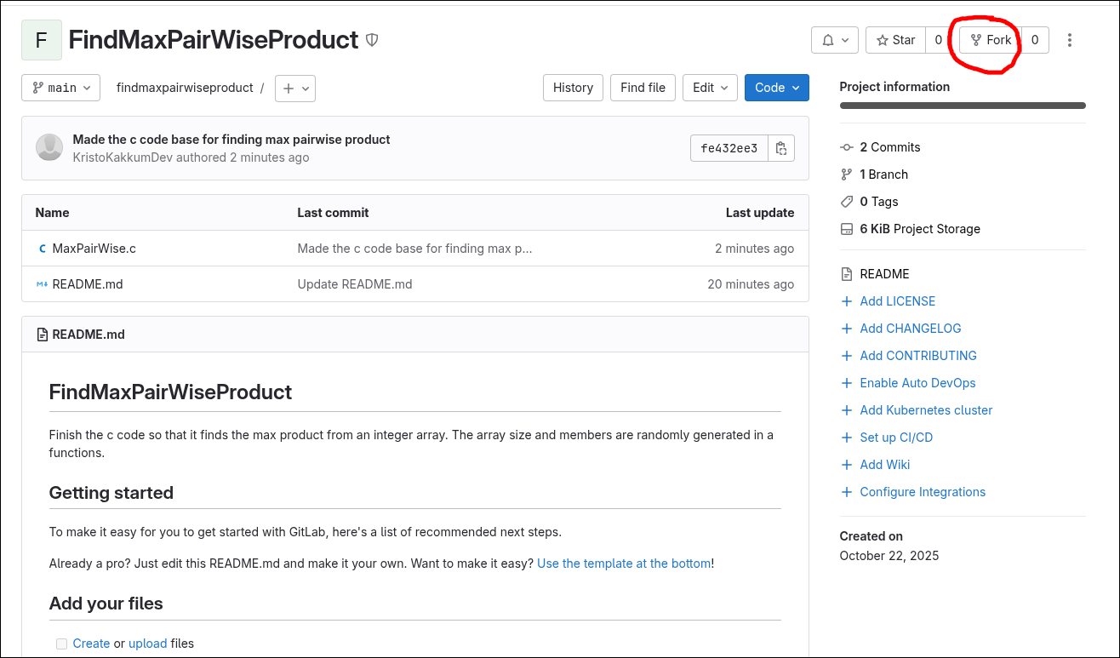
Collaboration using GIT
https://gitlab.cs.ttu.ee/krkadf/findmaxpairwiseproduct/-/blob/main/MaxPairWise.c?ref_type=heads
Fork the repository
Then copy url
Open the forked repo

Slide 15
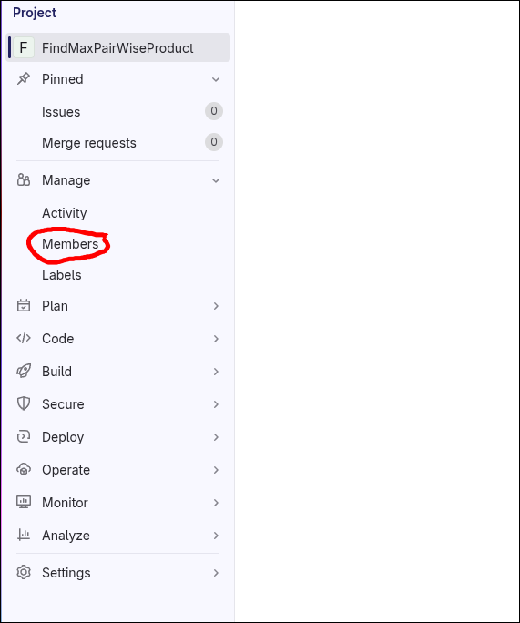
Collaboration using GIT
In Gitlab click manage and members
Invite member
Add their username or email
Role as maintainer

Slide 16
Collaboration using GIT
Use git clone url and go to the directory
Create a new branch git checkout -b branch-name
Implement the code for your task
Use git add . then git commit -m”what you did”
git push origin branch-name

Slide 17
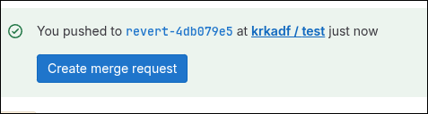
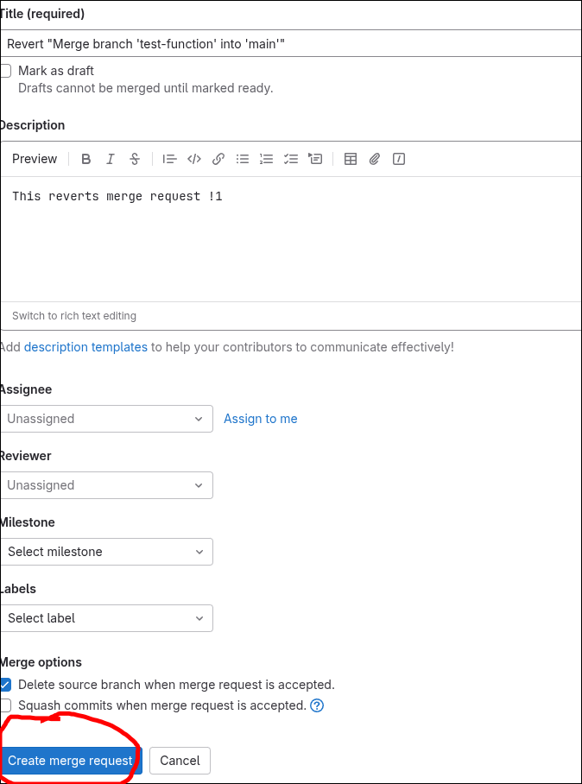
Merge
Now clicked create merge request
And click merge
Then git pull origin main
Test your code
Send repository link to kakkumkristo@gmail.com

