Slide 1


Slide 2
Lab 13

Slide 3
What are pointers and why we need to use them?
They are variables like everything else
Variable with a value of memory address
Must, when we are doing dynamic memory allocation
NB! Right now we do not talk about this. This will be major topic in Programming II

Slide 4
Pointers - What?
Arrays
  Strings
Streams
  FILE
  stdin
  stdout
  stderr
Function
  Pass by reference
  Return memory address
  Return block of memory
  Function pointers
Dynamic memory allocation
typeless pointers (void)
Data structures
  Trees
  Function pointers
Access and modify values in registers
...

Slide 5
Operations with pointers
Operation | What does it do
int *p | Declaring pointer
&number | Asking the number’s address
p = &number | Giving pointer the number’s address
*p | Dereference - value in memory address (where p points to)
printf("The address is: %p", p) | Printing the address value
printf("The value is: %d", *p) | Printing the value

Slide 6
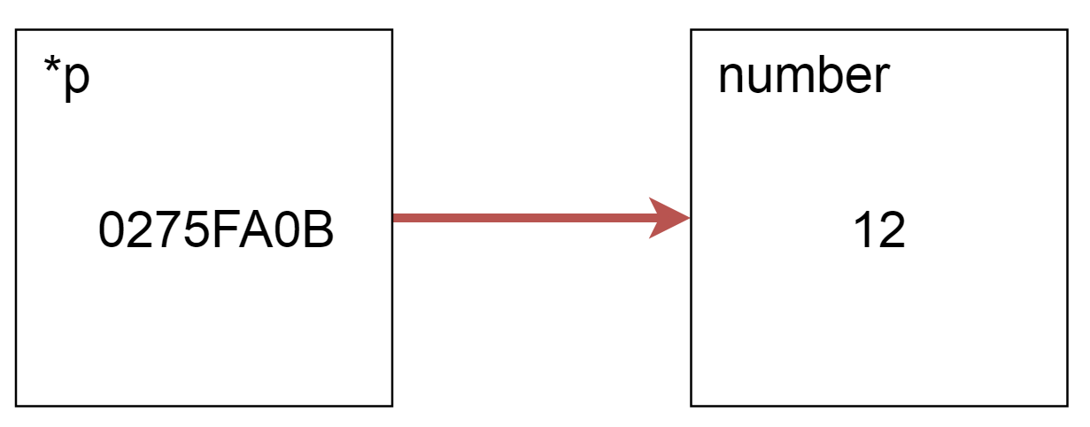
Visual presentation

Slide 7
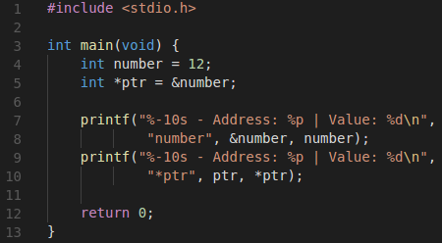
Visual example in code

Slide 8
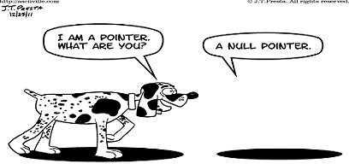
NULL pointer
Fun video

Slide 9
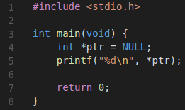
NULL pointers cont.
A pointer can be set to NULL
  datatype *pointer = NULL
Pointer variable that has been declared but not yet assigned a value is considered uninitialized.
You cannot dereference a NULL pointer (Segmentation fault):

Slide 10
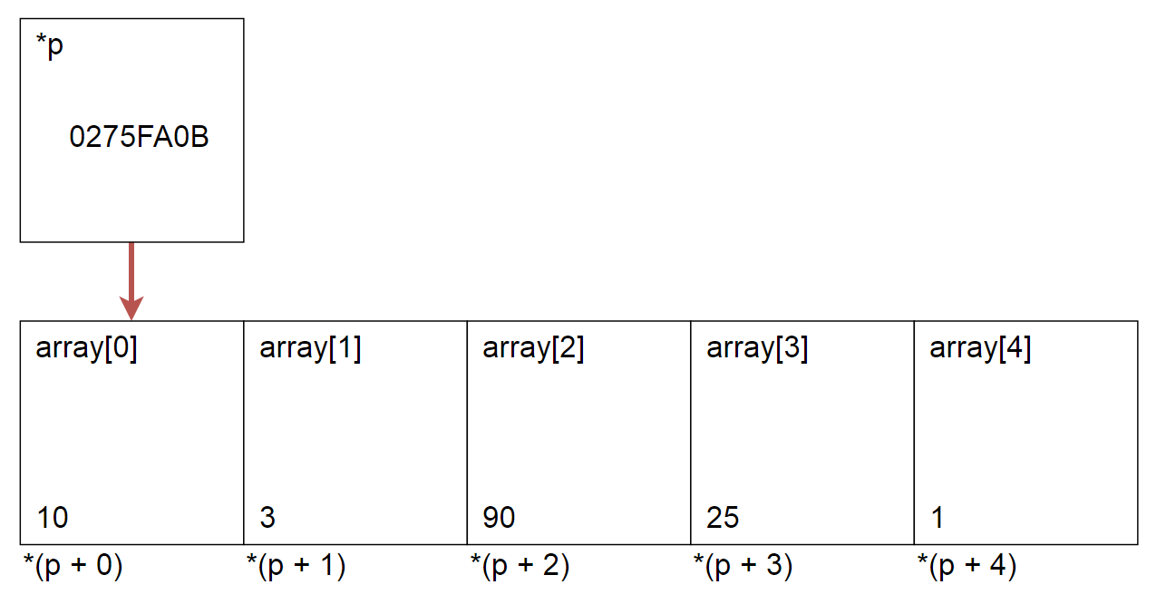
Visual example

Slide 11
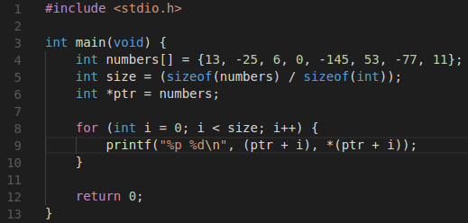
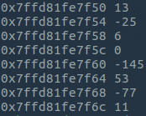
Visual example

Slide 12
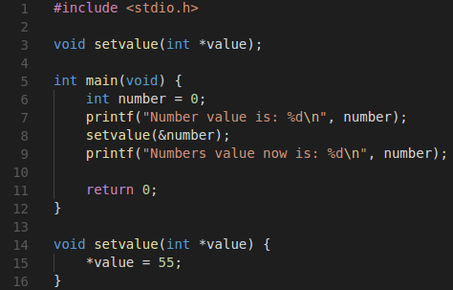

Pointers in functions

Slide 13
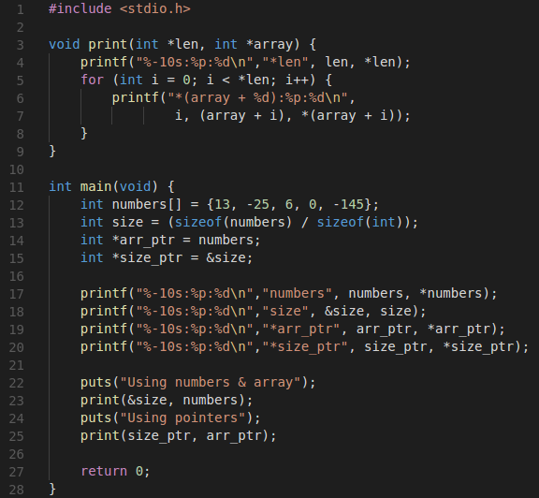

Slide 14
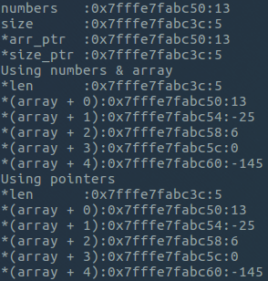

Slide 15
Practical Work
Task 0 - Warmup
Write a program, that prints the value and address of a given variable. Create the variables yourself.
Both the printing and assigning the pointer to the variable must be in a seperate functions. Function must take the pointer as a parameter.

Slide 16
What is Cryptography
Discipline or techniques employed in protecting integrity or secrecy of electronic messages by converting them into unreadable (cipher text) form. Only the use of a secret key can convert the cipher text back into human readable (clear text) form. Cryptography software and/or hardware devices use mathematical formulas (algorithms) to change text from one form to another.

Slide 17
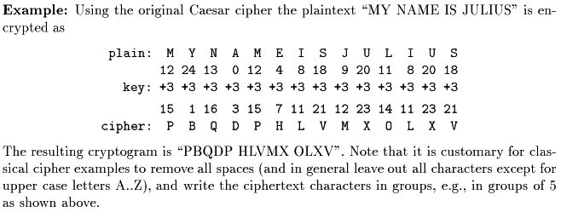
Example of crypting

Slide 18
Caesar Cipher
Create a program, which is able to crypt and decrypt user input message by using Caesar cipher 1p
Program should support (the more you do the more points you get):
  uppercase letters [A-Z] MUST HAVE!
  lowercase letters [a-z] 0.5p
  numbers [0-9] 0.5p
  punctuation marks and whitespaces not ciphered
  [ \t\n\v\f,._!?:;[]()@#$%^&*+/=-`”’\] 0.5p
Working menu 0.25p
Pointers 0.5p
Pointer arithmetic 0.5p
Create key from string (function) 0.5p
Hint: You can pass the pointer to the first element of string to function.
Program must use functions!
Program must not have global variables!
0p if those rules are violated.

Slide 19
Additional reading
5 minute guide [ Link ]
Pointer basics [ Link ]

Slide 20

Questions?

