Slide 1
Data types
Simple types
  integers
  real numbers
  characters
Complex types
  arrays
  strings (array of characters)
  records / structures

Slide 2
Range of unsigned integers
When defining variables one must keep in mind what is the maximum permitted value for that variable type
1 byte / 8 bits. C type: unsigned char.
Range 0 .. 255
2 bytes / 16 bits. C type: unsigned short int (unsigned short).
Range 0 .. 65535
4 bytes / 32 bits. C type: unsigned long int (unsigned long, unsigned int).
Range 0 .. 4294967295 ~ 0 .. 4,29*10⁹
8 bytes / 64 bits. C type: unsigned long long int (unsigned long long).
Range 0 .. 18446744073709551615 ~ 0 .. 18,4*10¹⁸

Slide 3
Overflow
What happens when the value goes outside the permitted range?
Example: adding 8-bit unsigned integers 1 and 255.
You get an overflow and the highest bit is lost.
The result is the remainder of division (result / 256)
1 | 1 | 1 | 1 | 1 | 1 | 1 | 1
+ |  |  |  |  |  |  |  | 1 | = | 1
 | 1 | 1 | 1 | 1 | 1 | 1 | 1 | 1 | = | 255
1 | 0 | 0 | 0 | 0 | 0 | 0 | 0 | 0 | = | 0
= | = | = | = | = | = | = | = | =
256 | 128 | 64 | 32 | 16 | 8 | 4 | 2 | 1
1 | 1 | 1 | 1
+ |  |  | 1 | 1 | 1 | 0 | 0 | 1 | = | 57
 | 1 | 1 | 1 | 1 | 0 | 0 | 0 | 0 | = | 240
1 | 0 | 0 | 1 | 0 | 1 | 0 | 0 | 1 | = | 41
= | = | = | = | = | = | = | = | =
256 | 128 | 64 | 32 | 16 | 8 | 4 | 2 | 1

Slide 4
Range of signed integers
Again the datatype determines the minimum and maximum permitted value.
1 byte / 8 bits. C type: char.
Range -128 .. 127
2 bytes / 16 bits. C type: short int (short).
Range -32768 .. 32767
4 bytes / 32 bits. C type: long int (long, int).
Range -2147483648 .. 2147483647 ~ -2.1*10⁹ .. 2,1*10⁹
8 bytes / 64 bits. C type: long long int (long long).
Range -9223372036854775808 .. 9223372036854775807
~ -9,2*10¹⁸ .. 9,2*10¹⁸

Slide 5
Characters
ASCII standard uses 7 bits to encode upper and lowercase Latin letters, digits and punctuation.
Character "1" is encoded with a value 49, "A" is 65, "a" is 97
C datatype is char, same as signed 8-bit integer
A single character in C is surrounded by single quotation marks: 'A'
Special symbols in C are escaped using backslash
  \n is a newline character
  \" is a quotation mark
  \t is tab
  \\ is backslash itself

Slide 6
Storing numbers in a computer
We have already used integers and real numbers.
When a number is on the screen or gets read from keyboard then it will be in text format – an array of characters.
For various math tasks this array needs to be converted to binary format.
We have also used functions such as scanf and printf that can do it. There are other functions such as atoi, atof, strtol, strtof.
But how do they work? How do they convert from one format to another?
That brings us to the numeral systems.

Slide 7
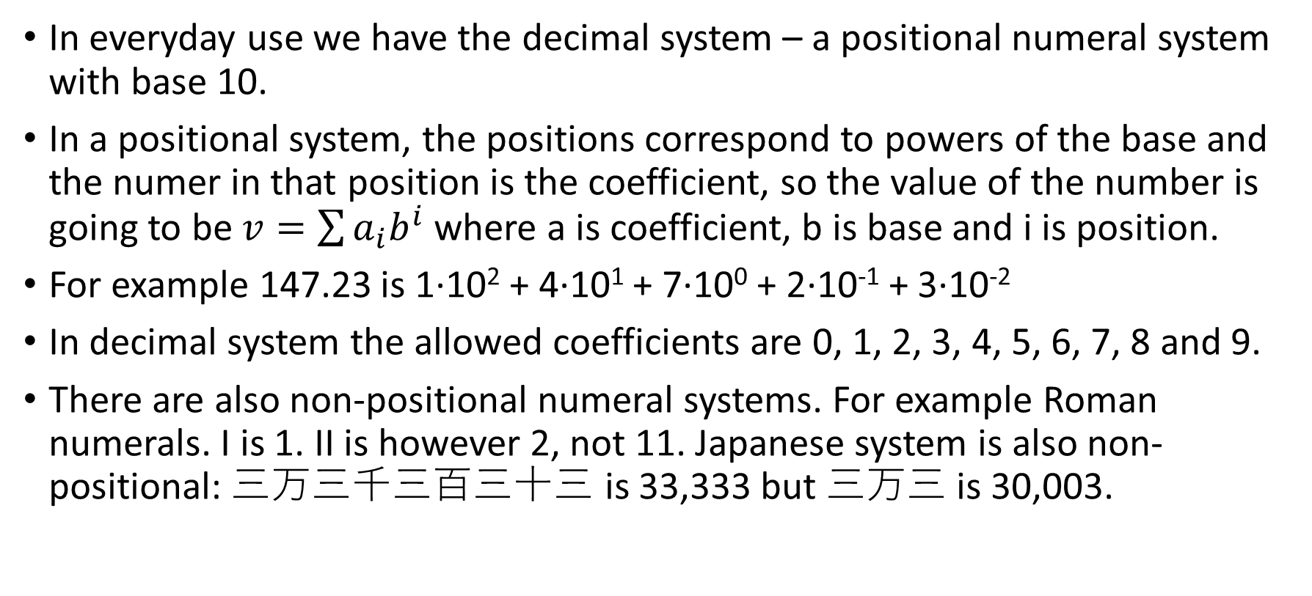
Numeral systems
In everyday use we have the decimal system – a positional numeral system with base 10.
In a positional system, the positions correspond to powers of the base and the numer in that position is the coefficient, so the value of the number is going to be $v=\sum{a_{i}b^{i}}$ where a is coefficient, b is base and i is position.
For example 147.23 is 1·10² + 4·10¹ + 7·10⁰ + 2·10⁻¹ + 3·10⁻²
In decimal system the allowed coefficients are 0, 1, 2, 3, 4, 5, 6, 7, 8 and 9.
There are also non-positional numeral systems. For example Roman numerals. I is 1. II is however 2, not 11. Japanese system is also non-positional: 三万三千三百三十三 is 33,333 but 三万三 is 30,003.

Slide 8
Binary system
Transistor is a device with two states, it can permit the current to pass or not. These states can be encoded with 1 and 0.
Since the transistor is the basis of all computing technology, binary system is used in computers.
The decimal number 147.23 is much longer in binary:
1001 0011.0011 1010 is 1·2⁷ + 1·2⁴ + 1·2¹ + 1·2⁰ + 1·2⁻³ + 1·2⁻⁴ + 1·2⁻⁵ + 1·2⁻⁷
When we add these we get: 128 + 16 + 2 + 1 + 0.125 + 0.0625 + 0.03125 + 0.0078125 = 147.2265625, which isn't equal to 147.23-ga.
Therefore comparing real numbers in a computer is dangerous, especially if one of them is a result of series of operations. In this case we can again use the text.

Slide 9
Number length in various systems
In a binary system 147 was already 8 digits.
It may seem that 2 is very inefficcient base.
However the value of the positions grows exponentially and even with base 2, exponential function grows very fast.
The number of digits grows logarithmically.
To represent 1000 we need log₂1000 ≈ 10 bits.
To represent 1,000,000 we need log₂1,000,000 ≈ 20 bits.
Generally one decimal place is ≈ 3.3 binary places and 10 binary places are ≈ 3 decimal places.
64 bits is therefore ≈ 6*3 + 4/3.3 ≈ slightly over 19 decimal places.

Slide 10
Numeral systems with base larger than 10
We use following digits 0, 1, 2, 3, 4, 5, 6, 7, 8 ja 9
As long as the base of another numeral system is smaller than 10 we can use a subset of digits.
When the base is larger than 10 then digits won't cover all coefficients any more.
Then letters will be used and they can be encoded as follows:
  A – 10
  B – 11
  etc..
For hexadecimal systems (base 16) the coefficients are 0..9 and A..F
Hexadecimal system is quite common in computers because one byte corresponds to two symbols.
Converting is very easy, 1 symbol becomes exactly 4 bits and vice versa

Slide 11
Reading integer of X-system
When readign an integer we can start from the beginning or the end.
From the beginning
  Let's pick 0 for total_value
  Multiply total_value with base
  Add current coefficient to total_value
  Move towards the end
  If there are more coefficients then go to 2 else total_value has the value
From the end
  Let's pick 0 for the totoal_value and 1 for position_value
  Multiply the coefficient with position_value and add to total_value
  Move towards the beginning and multiply the position_value with base
  If there are more coefficients then go to 2 else total_value has the value

Slide 12
Reading fraction of X-system
This is always easier to do from the beginning
  Pick 0 for total_value, 1 / base for position_value
  Let's multiply current coefficient with position_value and add to total_value
  Move towards the end and divide position_value by base.
  If there are more coefficients then go to 2, else total_value is the answer.

Slide 13
Writing integer in x-system
It is more efficient to do it from the end but then we get the coefficients in reversed order.
  Move to beginning of array
  Divide source_number by base and find the remainder
  Store the remainder in array, move to next position in array
  Divide source_number by base
  if source_number > 0, then go to 2
  Move to previous position and print the coefficient
  If we're not at the beginning of array then go to 6 else answer has been printed

Slide 14
Writing integer in x-system
Also possible to do from the beginning
  Set position_value to 1
  If source_number / position_value is greater than base then go to 3 else go to 4
  Multiply position_value by base and go to 2
  Find the coefficient by dividing source_number with position_value, print it
  Subtract coefficient * position_value from source_number
  Divide position_value by base.
  If position_value > 0 then go to 4 else answer has been printed

Slide 15
Writing fraction in x-system
This is better to do from the beginning
  Print decimal symbol
  Multiply source_number by base.
  Print integer portion
  Subtract integer portion from the number
  If the source_number isn't 0 and we have room* then go to 2 else we're done
Room signifies, how many "decimal places" we want
For example printing 0.5 in a numeral system with base 3 the source_number will always remain non-zero.

