Slide 2
FILES

Slide 3
File properties
Name – only information kept in human-readable form
Identifier – unique tag (number) identifies file within file system
Type – needed for systems that support different types
Location – pointer to file location on device
Size – current file size
Protection – controls who can do reading, writing, executing
Time, date, and user identification – data for protection, security, and usage monitoring
Information about files are kept in the directory structure, which is maintained on the disk

Slide 4
Operations with files
File is an abstract data type
Create
Write
Read
Reposition within file
Delete
Truncate
Open(F_{i}) – search the directory structure on disk for entry F_{i}, and move the content of entry to memory
Close (F_{i}) – move the content of entry F_{i} in memory to directory structure on disk

Slide 5
Opening the file
Several pieces of data are needed to manage open files:
File pointer: pointer to last read/write location, per process that has the file open
File-open count: counter of number of times a file is open – to allow removal of data from open-file table when last processes closes it
Disk location of the file: cache of data access information
Access rights: per-process access mode information

Slide 6
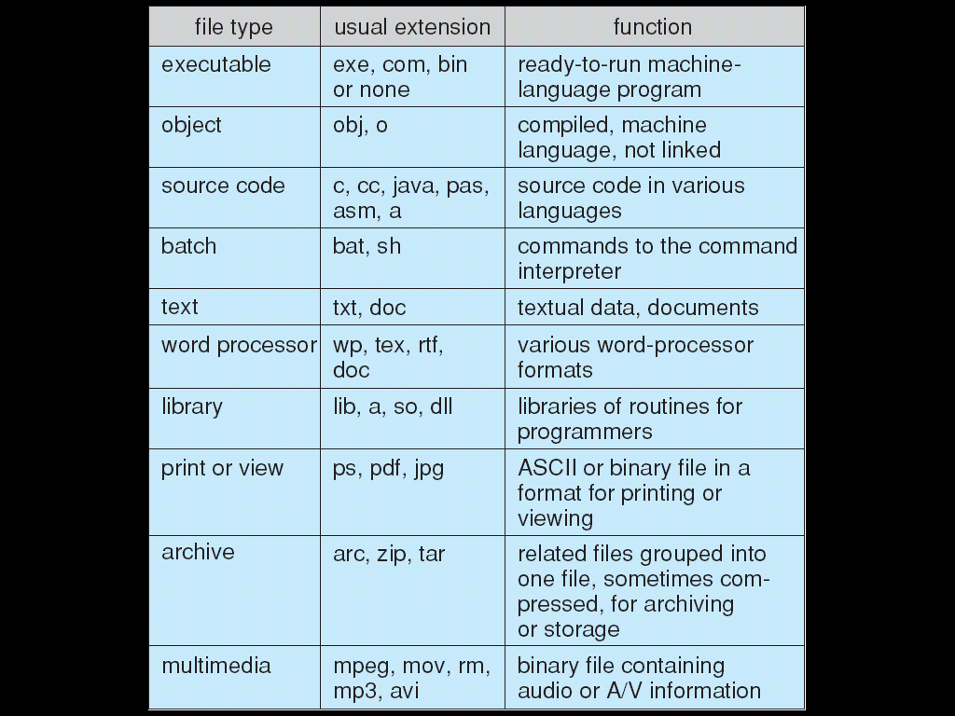
File types

Slide 7
File Access methods
Sequential Access
read next
write next
reset
no read after last write
(rewrite)
Direct Access
read n
write n
position to n
read next
write next
rewrite n
n = relative block number

Slide 8
Sequential file processing

Slide 9
Direct accrss

Slide 10
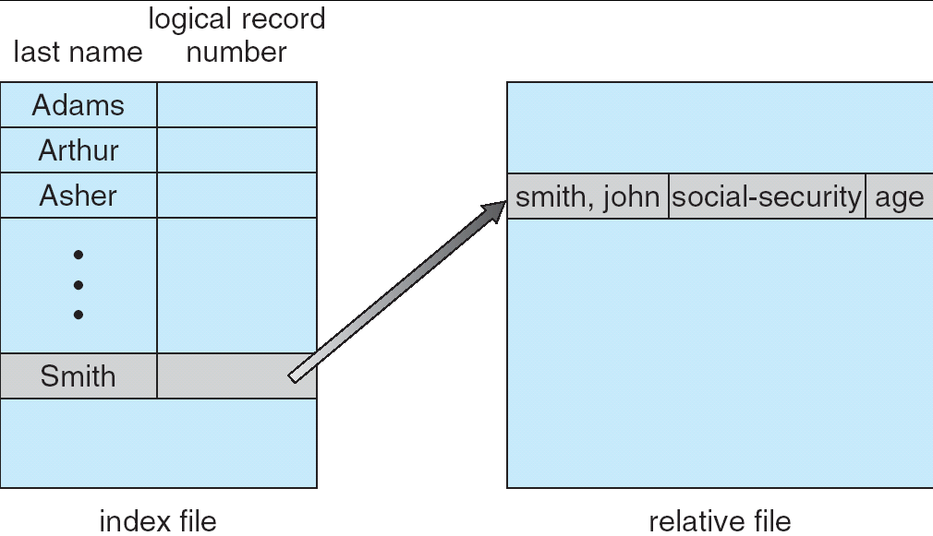
Index files
Notes:
10

Slide 11
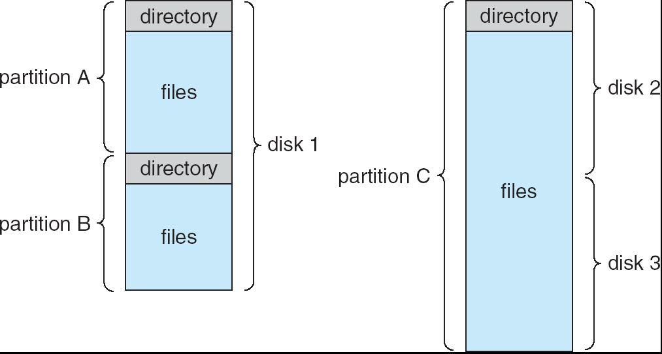
Usual file system

Slide 12
Library related operations
Search for a file
Create a file
Delete a file
List a directory
Rename a file

Slide 13
Library organization to simplify management
Efficiency – locating a file quickly
Naming – convenient to users
Two users can have same name for different files
The same file can have several different names
Grouping – logical grouping of files by properties, (e.g., all Java programs, all games, …)

Slide 14
Access lists and grouping
Mode of access: read, write, execute
Three classes of users
RWX
a) owner access 7 ⇒ 1 1 1 RWX
b) group access 6 ⇒ 1 1 0
RWX
c) public access 4 ⇒ 1 0 0 Ask manager to create a group (unique name), say G, and add some users to the group.
For a particular file (say game) or subdirectory, define an appropriate access.
owner
group
public
chmod
764
game
Attach a group to a file chgrp G game

Slide 15
Protection
File owner/creator should be able to control:
what can be done
by whom
Types of access
Read
Write
Execute
Append
Delete
List

Slide 16
Opening the file
Pointers can also be used to read and write from a file
#include <stdio.h>
#include <stdlib.h>
int main (void)
{FILE *loe= fopen(“esimene.txt”, “r”);
fprintf(loe, “The first sample”);
fclose(loe); // belongs to every decent file job
}
/*via variable“loe” file can be opened esimene.txt for reading – r, the text is read and the file is closed
*/

Slide 17
Reading from a file
#include <stdio.h>
#include <stdlib.h>
int main(void)
{ char rida[128];
FILE *sisse=fopen("tervitus.txt", "r"); // r - for reading
while(!feof(sisse))
{ // fscanf(sisse, "%s", rida);
//võtab ühe sõna
fgets(rida, 128, sisse);
printf("%s", rida); }
fclose(sisse);
return 1; }
fsacnf and fgets can both be used, but not simultaneously

Slide 18
Writing a file
As an example we had:
FILE *kirjuta= fopen(“esimene.txt”, “w”);
fprintf(kirjuta,“The first sample”);// text to be printed in the file
fclose(kirjuta);// belongs to every decent file job
NB!In the case of "w", the previous content is overwritten with each file opening !
FILE *kirjuta= fopen(“esimene.txt”, “a”);
fprintf(kirjuta, “The first sample”);
NB!“a” case, each opening and writing is appended to the existing file.

Slide 19
Distribution of program text between different files
File

Slide 20
Distribution of program text between different files
It is certainly more useful to divide a larger program into sub-functions and divide them in turn between different files according to the topic. For example: the printout of several differently formed arrays would be useful to write as a separate subfunction. But why not as a separate file.

Slide 21
Example
The task is to form an array and print it on the screen;
Swap the row and column of the array with the index value given as an integer by the user. Print to the screen each step that is done with the array.
Undoubtedly, as a long program text, the whole code becomes too difficult to manage.
To begin with, you must create a separate subfunction for printing to the screen, and then upload it to a separate file.

Slide 22
Step 0 from subfunction to file
#include<stdio.h>
#include<time.h> // for random
#include<stdlib.h> // for random
void valjastus(int n, int a[n][n]) //subfunktion
{ int i,j;
for(i=0;i<n;i++)
{for(j=0;j<n;j++)
{ printf(" %d |",a[i][j]);
}
printf("\n");
}
}
int main(void)
{ int i,j;
....
return 0;}

Slide 23
Steps 1 and 2 from subfunction to file
Put all the text of the sub-function valjastus(int n, int a[n][n]) into a separate file called valjastus.c .Add the file to be added to the libraries of the main program.
Before:
#include<stdio.h>
#include<time.h> // for random
#include<stdlib.h> // for random
After:
#include<stdio.h>
#include<time.h> // for random
#include<stdlib.h> // for random
#include “valjastus.c // the file you created with the subfunction
valjastus(int n, int a[n][n])

Slide 24
Step 3 from subfunction to file
Compile, run, and verify program operation.
More little reminders:
Once created, the printout of the array does not need to be copied again in the next program. It is enough to write a sentence to the libraries
#include “valjastus.c ” and it must be checked that this file to be added with a sub-function valjastus() would be in the same directory as the new program.
Good luck simplifying your work!

Slide 25
Täname, et läbisid mooduli II !
Jätka aine omandamist ja lahenda kodutööd !
Tutvu ainetega Infotehnoloogia teaduskonna õppematerjalide kodulehel www.tud.ttu.ee

