Slide 2
TASK
Enter the coordinates of the points. Enter the coordinates of the center of the circle. Enter the radius of the circle. Find which points lie inside the circle.

Slide 3
Explanation of the assignment
We define input variables and output variables
INPUT
N -integer
X[N] Y[N] – arrays of integers
TX TY- integer
R- integer
OUTPUT
K - integer
X[K] Y[K]-arrays of integers

Slide 4
SUBTASKS
int main(void){
int N= sisse(‘’number of points’’);
int R=sisse(‘’ the radius of the circle’’);
int Tx=sisse(‘’the x coordinate of the center of the circle’’);
int Ty=sisse(‘’the y coordinate of the center of the circle’’);
int X[N],Y[N],K;
void points(N,X,Y);
void result(&K,X,Y);
void out(K,X,Y);
return 0;}

Slide 5
Prototypes
The prototype gives a general description of the function, a rule how to use it.
int sisse(char [ ]);
void points(int N, int [N], int [N]);
or
void ponts(int, int [ ], int[ ]);
void result(int *,int[ ],int [ ]);
Void out(int ,int [ ], int [ ]);

Slide 6
Modes of Execution
User mode
Less-privileged mode
User programs typically execute in this mode
System mode, control mode, or kernel mode
More-privileged mode
Kernel of the operating system
Notes:
every program must be accept that exist more privileged mode than his

Slide 7
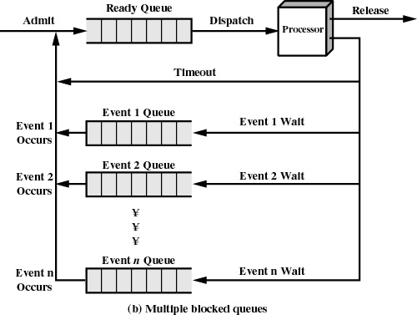
Notes:
here is classical multiple queues system. In what levels OS execute user program?

Slide 8
Reasons for Process Termination
I/O failure
Invalid instruction
happens when try to execute data
Privileged instruction
Data misuse
Operating system intervention
such as when deadlock occurs
Parent terminates so child processes terminate
Parent request
Notes:
If we got execute time, we must know now, that our processes can be terminated if(p.r taotlus)

Slide 9
When to Switch a Process
Clock interrupt
process has executed for the maximum allowable time slice
I/O interrupt
Memory fault
memory address is in virtual memory so it must be brought into main memory
Notes:
every language disigner must be accepted that process switching happen if

Slide 10
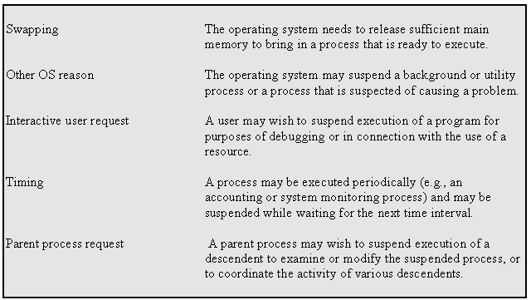
Reasons for Process Suspension
Notes:
every language disigner must be accepted that process suspensioon(peatamine) happen if

Slide 11
State
Instructions- represent state transition via program execution
You have a choice: implement with hardware, (quick yet inflexible)
You have a choice: implement with software, (slow and flexible)
Notes:
every procces has three sätteis in order; Under execute; termination status

Slide 12
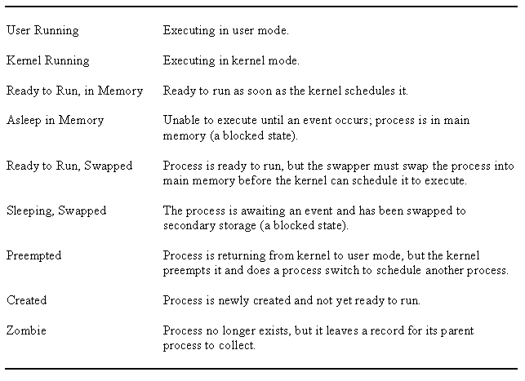
UNIX Process States

Slide 13
Memory Tables
Allocation of main memory to processes
Allocation of secondary memory to processes
Protection attributes for access to shared memory regions
Information needed to manage virtual memory
Notes:
for successful execute we must know how system realize memory management

Slide 14
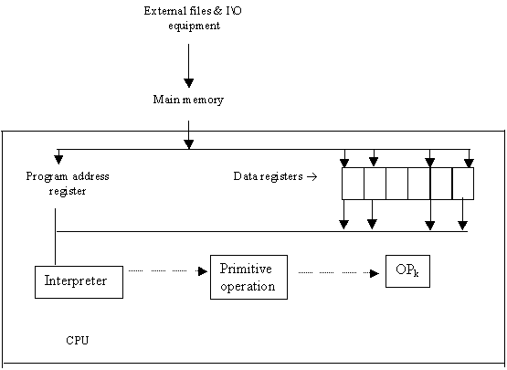
COMPUTER ORGANIZATION
Notes:
At the first level, we can look at the computer in a simplified way, but this is not enough for developing the language

Slide 15
Interpreter
Fetch op code
De-code op code
Fetch necessary operands
Branch to primitive (OP_{k})
Then repeat until the end of the program
Notes:
Võtab,sisestab

Slide 16
TRANSLATION VS. INTERPRETATION I
Translation: program written for level n machine translated to level 1 machine
Advantages: -statements decoded ONCE -efficient execution
Disadvantages: -space consumption
Interpretation: program written for level n + 1 is executed on level n machine
Advantages: -space conservation
Disadvantages: -execution

Slide 17
TRANSLATION VS. INTERPRETATION II
TRANSLATORS
Compiler: high level-> machine
Assembler: one to one, assembly -> machine
Loader: relocatable version of machine code -> machine code
Link editor: combines collections of relocatable programs -> single relocatable machine program
Pre-processor: extended language -> standard language

Slide 18
TRANSLATION VS. INTERPRETATION III
INTERPRETER
Fetch op code
De-code op code
Fetch necessary operands
Branch to primitive (OP_{k})
Then repeat until the end of the program

Slide 19
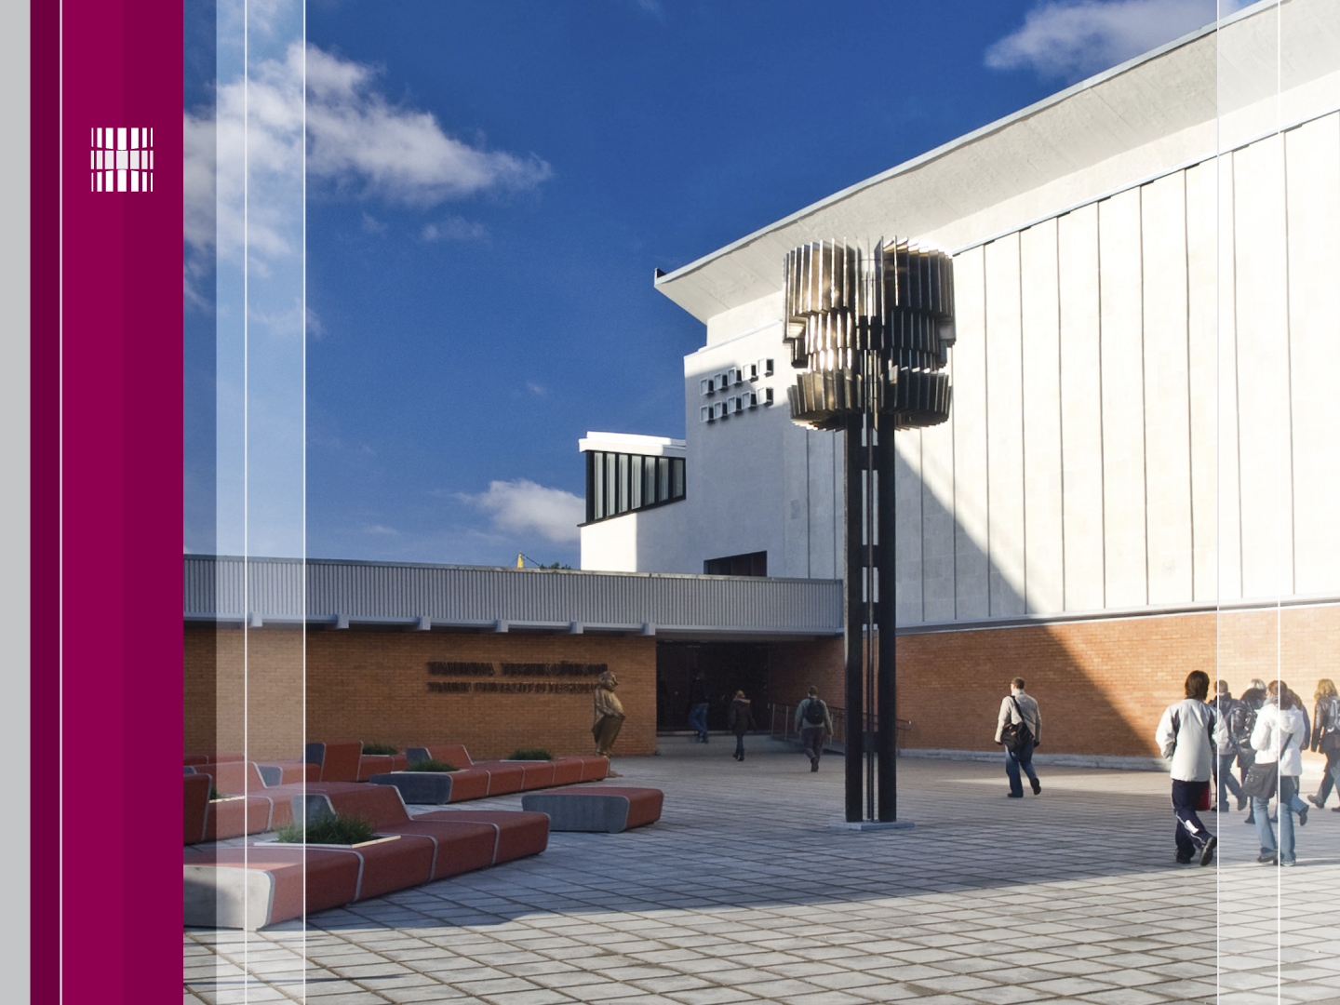
Thanks for Your attention!
Tutvu ainetega Infotehnoloogia teaduskonna õppematerjalide kodulehel
Look at www.tud.ttu.ee

