Slide 2
TASK
Enter the coordinates of the points. Enter the coordinates of the center of the circle. Enter the radius of the circle. Find which points lie inside the circle.

Slide 3
Explanation of the assignment
We define input variables and output variables
INPUT
N -integer
X[N] Y[N] – arrays of integers
TX TY- integer
R- integer
OUTPUT
K - integer
X[K] Y[K]-arrays of integers

Slide 4
SUBTASKS
int main(void){
int N= sisse(‘’number of points’’);
int R=sisse(‘’ the radius of the circle’’);
int Tx=sisse(‘’the x coordinate of the center of the circle’’);
int Ty=sisse(‘’the y coordinate of the center of the circle’’);
int X[N],Y[N],K;
void points(N,X,Y);
void result(&K,X,Y);
void out(K,X,Y);
return 0;}

Slide 5
Prototypes
The prototype gives a general description of the function, a rule how to use it.
int sisse(char [ ]);
void points(int N, int [N], int [N]);
or
void ponts(int, int [ ], int[ ]);
void result(int *,int[ ],int [ ]);
Void out(int ,int [ ], int [ ]);

Slide 6
Modes of Execution
User mode
Less-privileged mode
User programs typically execute in this mode
System mode, control mode, or kernel mode
More-privileged mode
Kernel of the operating system
Notes:
every program must be accept that exist more privileged mode than his

Slide 7
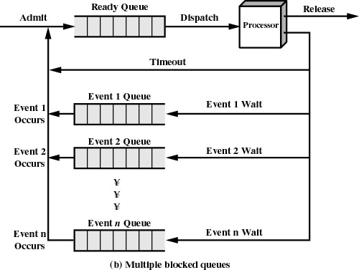
Notes:
here is classical multiple queues system. In what levels OS execute user program?

Slide 8
Reasons for Process Termination
I/O failure
Invalid instruction
happens when try to execute data
Privileged instruction
Data misuse
Operating system intervention
such as when deadlock occurs
Parent terminates so child processes terminate
Parent request
Notes:
If we got execute time, we must know now, that our processes can be terminated if(p.r taotlus)

Slide 9
When to Switch a Process
Clock interrupt
process has executed for the maximum allowable time slice
I/O interrupt
Memory fault
memory address is in virtual memory so it must be brought into main memory
Notes:
every language disigner must be accepted that process switching happen if

Slide 10
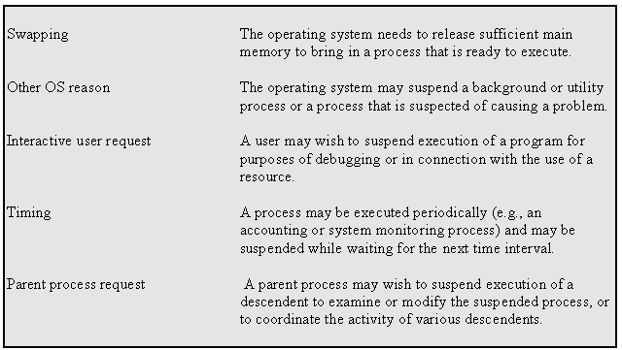
Reasons for Process Suspension
Notes:
every language disigner must be accepted that process suspensioon(peatamine) happen if

Slide 11
State
Instructions- represent state transition via program execution
You have a choice: implement with hardware, (quick yet inflexible)
You have a choice: implement with software, (slow and flexible)
Notes:
every procces has three sätteis in order; Under execute; termination status

Slide 12
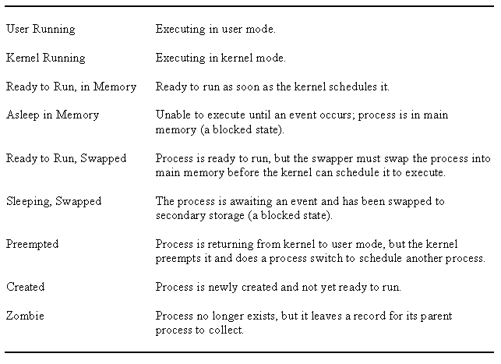
UNIX Process States

Slide 13
Memory Tables
Allocation of main memory to processes
Allocation of secondary memory to processes
Protection attributes for access to shared memory regions
Information needed to manage virtual memory
Notes:
for successful execute we must know how system realize memory management

Slide 14
File Concept
Contiguous logical address space
Types:
Data
numeric
character
binary
Program
Notes:
what kind of file concepts we can used

Slide 15
File Attributes
Name – only information kept in human-readable form
Identifier – unique tag (number) identifies file within file system
Type – needed for systems that support different types
Location – pointer to file location on device
Size – current file size
Protection – controls who can do reading, writing, executing
Time, date, and user identification – data for protection, security, and usage monitoring
Information about files are kept in the directory structure, which is maintained on the disk
Notes:
there are much file attributes exist and we can used them or not

Slide 16
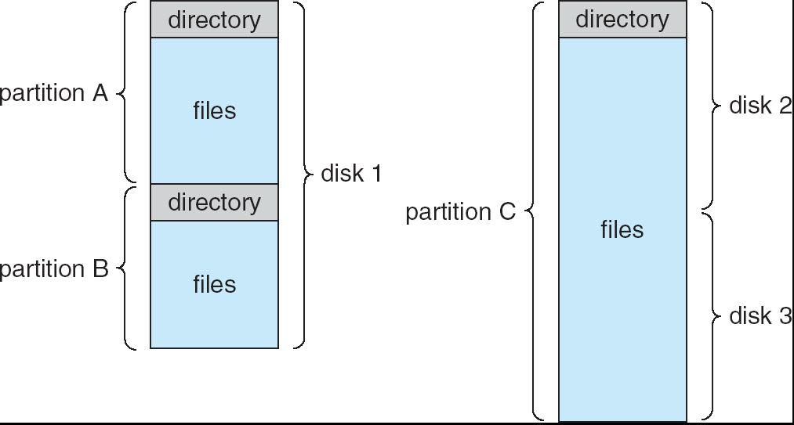
A Typical File-system Organization

Slide 17
File Structure
None - sequence of words, bytes
Simple record structure
Lines
Fixed length
Variable length
Complex Structures
Formatted document
Relocatable load file
Can simulate last two with first method by inserting appropriate control characters
Who decides:
Operating system
Program
Notes:
again it is very important for language what kind of file structure it accept

Slide 18
Operations Performed on Directory
Search for a file
Create a file
Delete a file
List a directory
Rename a file
Traverse the file system
Notes:
läbima

Slide 19
Access Methods
Sequential Access
read next
write next
reset
no read after last write
(rewrite)
Direct Access
read n
write n
position to n
read next
write next
rewrite n
n = relative block number
Notes:
Most of languages have both possibilities

Slide 20
File Operations
File is an abstract data type
Create
Write
Read
Reposition within file
Delete
Truncate
Open(F_{i}) – search the directory structure on disk for entry F_{i}, and move the content of entry to memory
Close (F_{i}) – move the content of entry F_{i} in memory to directory structure on disk
Notes:
and traditionally Os give users to system functions to be operating with files

Slide 21
Open File Locking
Mandatory or advisory:
Mandatory – access is denied depending on locks held and requested
Advisory – processes can find status of locks and decide what to do
Notes:
Os meediates file locking vahendab juurdepääsu

Slide 22
Open Files
Several pieces of data are needed to manage open files:
File pointer: pointer to last read/write location, per process that has the file open
File-open count: counter of number of times a file is open – to allow removal of data from open-file table when last processes closes it
Disk location of the file: cache of data access information
Access rights: per-process access mode information
Notes:
All this must be taken into account when programming language is being developed

Slide 23
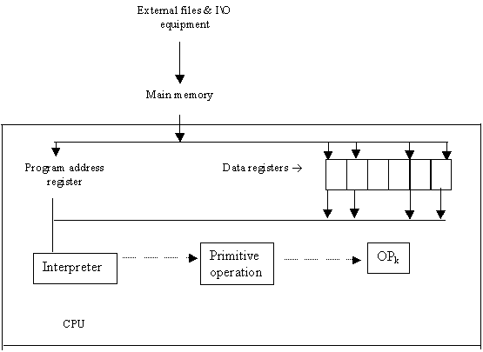
COMPUTER ORGANIZATION
Notes:
At the first level, we can look at the computer in a simplified way, but this is not enough for developing the language

Slide 24
Interpreter
Fetch op code
De-code op code
Fetch necessary operands
Branch to primitive (OP_{k})
Then repeat until the end of the program
Notes:
Võtab,sisestab

Slide 25
TRANSLATION VS. INTERPRETATION I
Translation: program written for level n machine translated to level 1 machine
Advantages: -statements decoded ONCE -efficient execution
Disadvantages: -space consumption
Interpretation: program written for level n + 1 is executed on level n machine
Advantages: -space conservation
Disadvantages: -execution

Slide 26
TRANSLATION VS. INTERPRETATION II
TRANSLATORS
Compiler: high level-> machine
Assembler: one to one, assembly -> machine
Loader: relocatable version of machine code -> machine code
Link editor: combines collections of relocatable programs -> single relocatable machine program
Pre-processor: extended language -> standard language

Slide 27
TRANSLATION VS. INTERPRETATION III
INTERPRETER
Fetch op code
De-code op code
Fetch necessary operands
Branch to primitive (OP_{k})
Then repeat until the end of the program

Slide 28
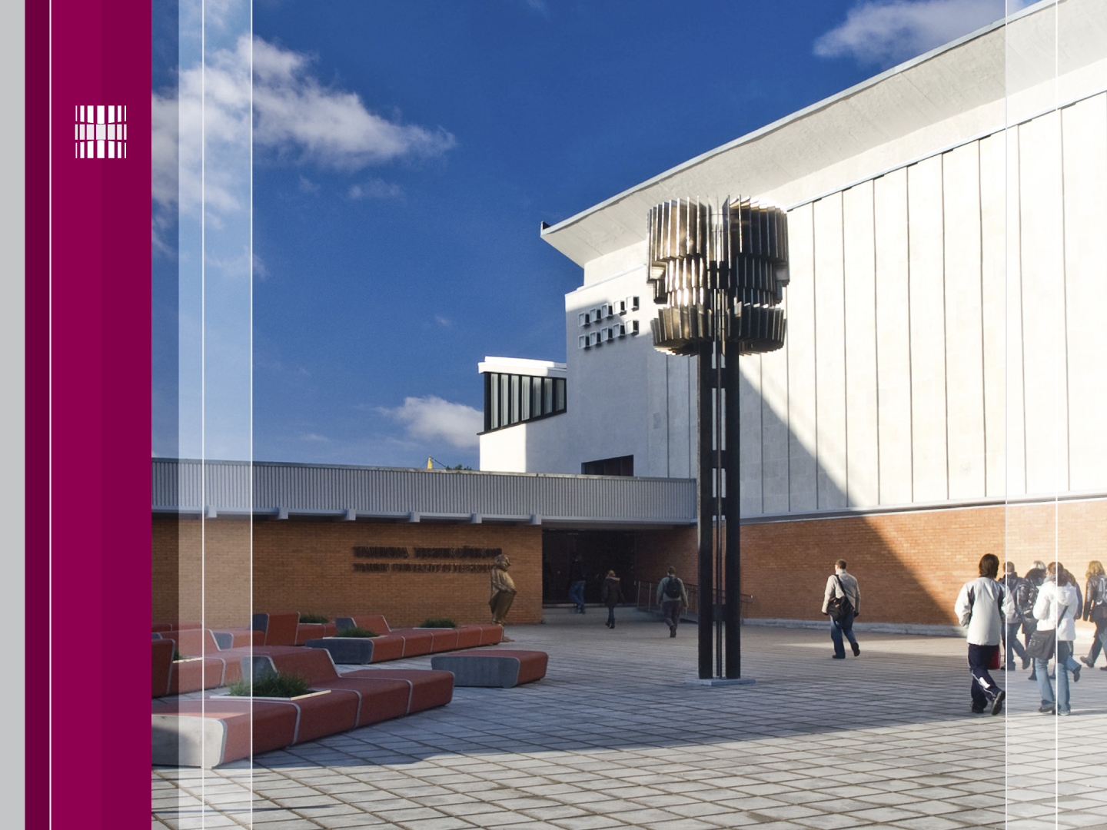
Thanks for Your attention!
Tutvu ainetega Infotehnoloogia teaduskonna õppematerjalide kodulehel
Look at www.tud.ttu.ee

