Slide 1

Creating and implementing algorithms
Risto Heinsaar, Vladimir Viies,
Joonatan Oskar Melioranski
vladimir.viies@gmail.com
Tallinn 2023

Slide 2
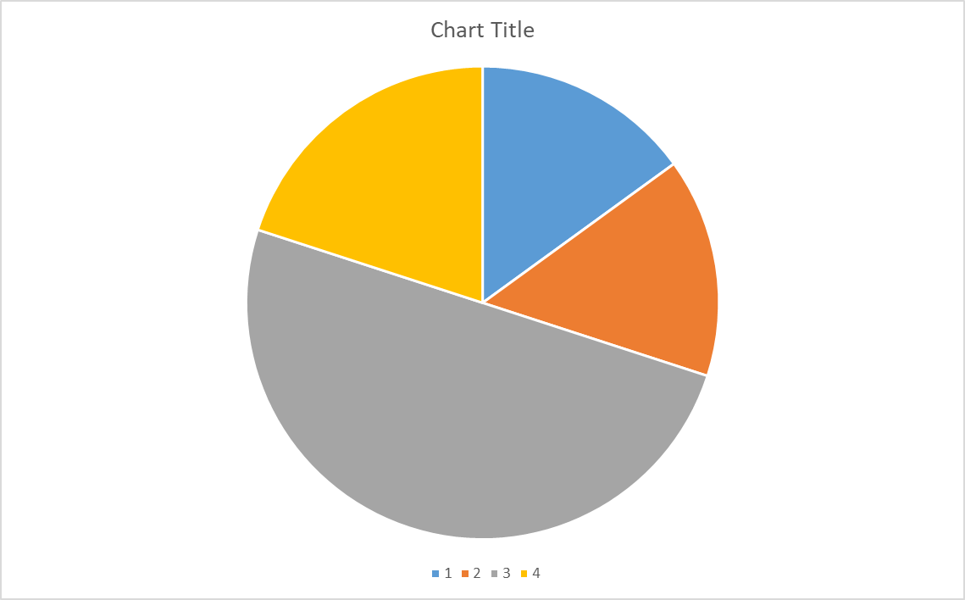
Final result IAX0583
Homework 1 max15p
Part of class works max 20p
Homework 2 max15p
Exam 50p

Slide 3
To pass the exam
TEST 40p ; CLASS WORKS 60p
To pass the preliminary exam 60p;To pass the exam 50p
Individual consultations from 14.09.2022 at 11.00-12.00; 15.00-16.00 U05 104 NB! 1 day before arrival by e-mail vladimir.viies@gmail.com

Slide 4
Lectures, tests and homework in the PROGRAMMING I
1 Algorithm definition, language statements, UML, editors 1. Got the homework I
Number systems, conversions, possibility of pre-exam, arrays and indices, extremums
5 Bubble sort, shell sort different tasks 6 I homework OK
Functions, subroutines, parameters 7.II homework handed in
9 Compiling a complete program in C language 11.II homework OK
___________________________________________________________________
11 TEST 12 FAILS 13 Pre-eksam
14 Programming the MK
15 NB! homework submission deadline, homework protection
16 Follow-up work, if necessary. Exam times in session

Slide 5

Algorithm realization, the language choice
Mis on algoritm?

Slide 7
DATA
INPUT
DATA
PROCESSING
RESULTS
OUTPUT
Structural approach is well suited to Jackson editor

Slide 8
ALGORITHM CREATING 5
Algorithm graphical presentation tools 4
(Using the UML activity diagram)

Slide 10
Tasks for the first month 1

Slide 11
Data types
• Simple types
• integers
• real numbers
• characters
• Complex types
• arrays
• strings (array of characters)
• records / structures

Slide 12
Range of unsigned integers
• When defining variables one must keep in mind what is the maximum permitted value for that variable type
• 1 byte / 8 bits. C type: unsigned char. Range 0 .. 255
• 2 bytes / 16 bits. C type: unsigned short int (unsigned short). Range 0 .. 65535
• 4 bytes / 32 bits. C type: unsigned long int (unsigned long, unsigned int). Range 0 .. 4294967295 ~ 0 .. 4,29*109
• 8 bytes / 64 bits. C type: unsigned long long int (unsigned long long). Range 0 .. 18446744073709551615 ~ 0 .. 18,4*1018

Slide 13
What happens when the value goes outside the permitted range?
• Example: adding 8-bit unsigned integers 1 and 255.
• You get an overflow and the highest bit is lost.
A=1 B=255 A+B=>?
1 1 1 1 1 1 1 1 => 255 + 1
0 0 0 0 0 0 0 0 => 0

Slide 14
Range of signed integers
• Again the datatype determines the minimum and maximum permitted value.
• 1 byte / 8 bits. C type: char. Range -128 .. 127
• 2 bytes / 16 bits. C type: short int (short). Range -32768 .. 32767
• 4 bytes / 32 bits. C type: long int (long, int). Range -2147483648 .. 2147483647 ~ -2.1*109 .. 2,1*109
• 8 bytes / 64 bits. C type: long long int (long long).
Range -9223372036854775808 .. 9223372036854775807 ~ -9,2*1018 .. 9,2*1018

Slide 15
Range and precision of floating point numbers
Floating point numbers have a huge range but limited precision
• 2 bytes / 16 bits. (Half precision) C does not have this type. Sign 1 bit, exponent 5 bits, mantissa 10 + 1 bits Range 10-5 .. 105, ~3 decimal places
• 4 bytes / 32 bits. (Single precision) C type: float. Sign 1 bit, exponent 8 bits, mantissa 23 + 1 bits Range 10-38 .. 1038, ~7 decimal places
• 8 bytes / 64 bits. (Double precision) C type: double. Sign 1 bit, exponent 11 bits, mantissa 52 + 1 bits Range 10-308 .. 10308 , ~16 decimal places
• 10 bytes / 80 bits. (Extended) C type: long double. Sign 1 bit, exponent 15 bits, mantissa 63 + 1 bits Range 10-4932 .. 104932, ~19 decimal places

Slide 16
Characters
ASCII standard uses 7 bits to encode upper and lowercase Latin letters, digits and punctuation.
• Character "1" is encoded with a value 49, "A" is 65, "a" is 97
• C datatype is char, same as signed 8-bit integer
• A single character in C is surrounded by single quotation marks: 'A'
• Special symbols in C are escaped using backslash
• \n is a newline character
• \" is a quotation mark
• \t is tab
• \\ is backslash itself

Slide 17
Declaring variables
In C every variable must be declared and associated
with a data type
• The data type could consist of multiple words
(unsigned long integer)
• Variable name must be a single word, starts with a letter, may contain letters, digits and underscore
• Variable may be initialized during declaration:
unsigned int a = 10, x, y;
float z;

Slide 18
Memory is allocated for the variable
• Changing the value of the variable to a constant or a result of some operatrion is done with assignment
variable_name = 5;
• Asignment is not commutative, var = 5 is not the same as
5 = var NB!
• The variable that we want to assign to must be to the
left of the equal sign
• If the same variable is on both side of the equal sign then they are interpreted as the variable at different moments in time
variable = variable + 1
New value Current value

Slide 19
Operators
• Operators can be separated as following:
• Arithmetic operators
• Addition, subtraction, etc
• Logic / bitwise operators
• Boole operations with bits, AND, OR but also shift
• Boolean operators / comparison
• Is equal, is less…..
• Operation needs to be assigned for anything to happen, "a + b" doesn't change the values of either a or b

Slide 20
Arithmetic operators
• a + b // addition
• a - b // subtraction
• a * b // multiplication
• a / b // division ,the sign for division is not ":"!
• a % b // modulo, remainder of division Unary operators
• a++ // incrementing a by 1
• a-- // decrementing a by 1

Slide 21
Boolean operators
• a == b // Are a and b equal. Do NOT use single equal sign here!
• a != b // Are a and b not equal
• a < b // Is a less than b
• a >= b // Is a greater or equal to b
• a > b // Is a greater than b
• a <= b // Is a less or equal to b Composite operators
• (a < b) && (c < d) // Are both conditions true (AND)
• (a < b) || (c < d) // Is at least one of the conditions true (OR)
• !(a == b) // Is the condition not true (INVERSION)
Boolean operators return zero or one! However, in C language a condition is considered true if it is not zero. if(a) is the same as if(a != 0)

Slide 22
Constants
• Constants can be defined with a preprocessor directive #define
• Directives must be at the beginning of the line
Example: #define STEP 8
• Preprocessor replaces all such constants in the code with their value before compiling, therefore it isn't slower than writing these constant values everywhere yourself but now you can replace them all with a single edit

Slide 23
Blanks and address operator
• %d – signed decimal
• %f %g – float type real number
• %lg – double type real number (must be used when reading)
• %c – single character
• & – location of the following variable in memory
• Address operator must be used for simple data types like numbers and characters
int a; double x; char c;
scanf("%d %lf %c", &a, &x, &c);

Slide 24
Formatted text (defined in library stdio.h)
• There are functions in C for reading and writing formatted text
• The format is passed as a string constant where it is possible to define typed blanks
• The blanks are filled with values passed as additional parameters
• When reading, the blanks will be converted according to type and saved to the memory location of the variable
• Example: printf("Number: %d\n", a); // Print decimal value of a scanf("X%d Y", &b); /* An example of expected input: "X26 Y", the value of 26 will be saved to the memory address of variable b, however if the format is incorrect (for example just "26") then nothing will be read*/
• When reading data the format usually consists of just the blank or blanks separated by spaces. There are some exceptions like time, date, etc

Slide 25
Commenting the code
• Occasionally there might be some constants in the code for some specific values, for example distance between Earth and Moon
• Another person may not be able to figure out what that number means
• Therefore such numeric constants should be avoided or at least commented
There are two options for commenting
• // a comment upto the end of the line
• /* a comment over multiple lines, very useful for disabling parts of the code, to end the multi-line comment use: */

Slide 26
Conditional statements
• if checks for the condition and carries out the following statement or block of statements if the statement is true (not zero)
• else may be used to specify an action that should take place when the condition is not true
• if there are several statements that need to be grouped together then brackets {} must be used. if(a < b) printf("%d", a); //single statement
else{ //group of statements
printf("%d", b);// stmt 1
b = 0; // stmt 2
} // end of group

Slide 27
C LOOPS
WHILE
while(a < 10){ // repeat if a < 10 printf("%d\n", a);
a = a + 1;} // change the value of a
DO WHILE
do{ printf(„insert a: "); scanf("%d", &a); }
while(a <= 0);
FOR
for(i = 0; i < 10; i++){ printf("%d\n", i); }

Slide 28
Main program
The main program is named main
• It is declared as a function: int main(void)
• int signifies that the function returns an integer value (to OS)
• The body of the function is between brackets { }
• The application starts execution from main #include<stdio.h> //use library stdio (printf)
int main(void){ //main program
printf("hey\n"); //print a message
return 0; }
//exit from function

Slide 29
While loop
• While loop checks for the condition and repeats the subsequent statement (or body of the loop) while the condition is true
• Usually a block of statements follows the while statement, as one of the statements within it should change the condition.
• If the condition is not true when the while statement was reached for the first time then the body won't be executed even once while(a < 10){ // repeat if a < 10 printf("%d\n", a);
a = a + 1; // change the value of a
}

Slide 30
Tasks for the first month2

Slide 31
Multiple choices have advantages when there are at least three choices, preferably more. switch(expression){case value1: action1case value2: action2...default: actionx}
According to the value of the expression, the "entry point" is selected, from which the execution of the activities starts. Statements are executed up to the closing parenthesis of the switch statement, unless otherwise indicated. In most cases, however, the logic of the program is such that at the end of almost every activity corresponding to the found value, an "exit point" is determined with a break statement, which ends the execution of the given language construction . Multiple options are well suited for the realization of simple menus with numerical selection.

Slide 32
For example, the language used can be selected with the following program section:
char *what, yes, no, vastus; int lang;
printf("1 - Eesti\n2 - English\n3 - Russki\n");scanf("%d", &lang);
switch(lang){
case 1 : what="Kas jatkata"; yes='J'; no='E'; break;
case 2 : what="Continue"; yes='Y'; no='N‘; break;
case 3 : what="Prodolzat"; yes='D'; no='H'; break;
// default : what="???"; yes='1'; no='0';}
printf("%s? (%c/%c) > ", what, yes, no);
If you enter one as the option answer, the screenshot will look like this:
1 - Eesti
2 - English
3 – Russki
1

Slide 33
Libraries
• Library is a collection of functions, variables and constants, that can be added to your application
• Preprocessor directive #include is needed to add a library
• Besides these functions there are:
• fgets – reads one row of text from a file (or terminal)
• fputs – writes unformatted text to file (or terminal)
• fgetc – reads a character from file (or terminal)
• fputc – writes a character to file (or terminal)
• Besides this library we will use others for functions that manipulate text (string.h), for math functions (math.h), for random numbers, conversion and memory functions (stdlib.h)

Slide 34
Math library math.h
This library can be added to your application with: #include
The one difference compared to other C libraries is that during compilation the library needs to be added again with
-lm: gcc task3.c -lm // if use a.out
Trigonometric functions
All these operate with values in radians and use floating point numbers for parameters and return values
• Main functions: sin(x), cos(x), tan(x)
• Inverse functions: asin(x), acos(x), atan(x)
• Hyperbolic functions: sinh(x), cosh(x), tanh(x)
• The library includes a constant for 𝜋𝜋: M_PI

Slide 35
Exponent functions
• exp(x) – returns e to the power of x
• log(x) – returns natural logarithm of x
• log10(x) – returns common logarithm of x
• pow(x, y) – returns x to the power of y
• sqrt(x) – returns square root of x
• Useful constant for e: M_E
• The power function pow()is not always necessary. For example for x2 it is much more optimal to use just multiplication: x*x

Slide 36
More functions
• fabs(x) – returns absolute value of x
• ceil(x) – rounds x to a higher value
• 1.1 -> 2.0
• -1.9 -> -1.0
• floor(x) – rounds x to a lower value
• 1.9 -> 1.0
• -1.1 -> -2.0
• round(x) – rounds x away from 0
• 0.5 -> 1.0
• -0.5 -> -1.0

Slide 37
#include <stdio.h> #define REGION 2#define STEP 0.25
int main(void){ float a, b, c, E, x, y;
printf("This program print table of values\n");
printf("around extremum of quadratic function\n");
printf("Please enter coefficcients a b c: ");
scanf("%g %g %g", &a, &b, &c);
E = 0; if(a != 0) E = -b / (2 * a);
for(x = E - REGION; x < E + REGION; x = x + STEP)
{ y = a * x * x + b * x + c;
printf("%6.2f | %6.2f\n", x, y);}
return 0;
}

Slide 38
Arrays
• When the task requires storing just a couple of values to be solved then the corresponding variables can be declared separately.
• Once we have many values and we're not even sure how many might be needed, then grouping these values into a single unit makes it easier to operate on these.
• For example, last week's task was about a triangle formed by 3 points on an XY plane. Using 6 variables for storing the coordinates is not most optimal.
• In such a case it makes sense to use an array and an index to address the specific values..

Slide 39
Creating array in C
• When creating an array, its length must be specified.
• C doesn't permit changing the array length (at least not without dynamic memory allocation but that's topic for Programming 2).
• The length of array is specified within square brackets: [ ]
int num[10]; //creates array num with 10 elements
• C allows providing a variable for array length, the value that the variable had at the time of creating the array will remain fixed:
int n = 5; int M[n]; //array is created with length 5
n = 7; //array length doesn't change

Slide 40
Accessing elements of an array
• Each element has an index, this index value must be provided within square brackets when accessing the element.
• In C that index starts from 0, first element has index of 0.
• If the length of array is n, then last element has an index of n-1.
• Index can be a variable, usually an iterator.
• C doesn't check whether the bounds of an array have been exceeded, the programmer must track that themselves. int num[3] = {2, 3, 5}; // initializing array num[1] = -1; // overwrite the second element num[7] = 0; // eighth element, out of bounds!

Slide 41
Length of an array
• A block of memory is reserved for the array, array variable points to the memory address where the array begins.
• When specifying index, the following operation is carried out: Beginning_of_array + Index * Size_of_one_element
• Since we currently can't change the length of array, it may be useful creating a larger array than needed and using just a portion of it
• The actual length must be stored in some additional variable #define MAX 100 int Array[MAX]; //array with 100 elements int n = 0; //how many elements have been used scanf("%d", &massiiv[n]); //read first element n++; //one element is in use

Slide 43
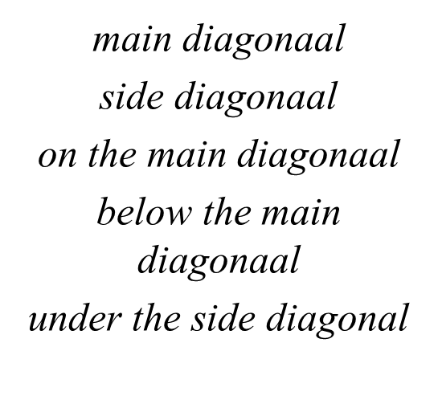

Slide 44
Storing numbers in a computer
• We have already used integers and real numbers.
• When a number is on the screen or gets read from keyboard then it will be in text format – an array of characters.
• For various math tasks this array needs to be converted to binary format.
• We have also used functions such as scanf and printf that can do it. There are other functions such as atoi, atof, strtol, strtof.
• But how do they work? How do they convert from one format to another?
• That brings us to the numeral systems.

Slide 45
Numeral systems
• In everyday use we have the decimal system – a positional numeral system with base 10.
• In a positional system, the positions correspond to powers of the base and the numer in that position is the coefficient, so the value of the number is going to be 𝑣𝑣 = ∑ 𝑎𝑎𝑖𝑖𝑏𝑏𝑖𝑖 where a is coefficient, b is base and i is position.
• For example 147.23 is 1·102 + 4·101 + 7·100 + 2·10-1 + 3·10-2
• In decimal system the allowed coefficients are 0, 1, 2, 3, 4, 5, 6, 7, 8 and 9.
• There are also non-positional numeral systems. For example Roman numerals. I is 1. II is however 2, not 11.

Slide 46
Binary system
• Transistor is a device with two states, it can permit the current to pass or not. These states can be encoded with 1 and 0.
• Since the transistor is the basis of all computing technology, binary system is used in computers.
• The decimal number 147.23 is much longer in binary: 1001 0011.0011 1010 is 1·27 + 1·24 + 1·21 + 1·20 + 1·2-3 + 1·2-4 + 1·2-5 + 1·2-7
• When we add these we get: 128 + 16 + 2 + 1 + 0.125 + 0.0625 + 0.03125 + 0.0078125 = 147.2265625, which isn't equal to 147.23-ga.
• Therefore comparing real numbers in a computer is dangerous, especially if one of them is a result of series of operations.

Slide 47
Number length in various systems
• In a binary system 147 was already 8 digits.
• It may seem that 2 is very inefficcient base.
• However the value of the positions grows exponentially and even with base 2, exponential function grows very fast.
• The number of digits grows logarithmically.
• To represent 1000 we need log21000 ≈ 10 bits.
• To represent 1,000,000 we need log21,000,000 ≈ 20 bits.
• Generlly one decimal place is ≈ 3.3 binary places and 10 binary places are ≈ 3 decimal places.
• 64 bits is therefore ≈ 6*3 + 4/3.3 ≈ slightly over 19 decimal places.

Slide 48
Numeral systems with base larger than 10
• We use following digits 0, 1, 2, 3, 4, 5, 6, 7, 8 ja 9
• As long as the base of another numeral system is smaller than 10 we can use a subset of digits.
• When the base is larger than 10 then digits won't cover all coefficients any more.
• Then letters will be used and they can be encoded as follows: • A – 10 • B – 11 • etc..
• For hexadecimal systems (base 16) the coefficients are 0..9 and A..F
• Hexadecimal system is quite common in computers because one byte corresponds to two symbols.
• Converting is very easy, 1 symbol becomes exactly 4 bits and vice versa

Slide 49
Reading integer of X-system
• When readign an integer we can start from the beginning or the end.
• From the beginning
1.Let's pick 0 for total_value
2.Multiply total_value with base
3. Add current coefficient to total_value
4. Move towards the end
5. If there are more coefficients then go to 2 else total_value has the value
• From the end
1. Let's pick 0 for the totoal_value and 1 for position_value 2. Multiply the coefficient with position_value and add to total_value 3. Move towards the beginning and multiply the position_value with base 4. If there are more coefficients then go to 2 else total_value has the value

Slide 50
Reading fraction of X-system
This is always easier to do from the beginning
Pick 0 for total_value, 1 / base for position_value
2. Let's multiply current coefficient with position_value and add to total_value
3. Move towards the end and divide position_value by base
4. If there are more coefficients then go to 2, else total_value is the answer.

Slide 51
Writing integer in x-system
It is more efficient to do it from the end but then we get the coefficients in reversed order.
Move to beginning of array
Divide source_number by base and find the remainder
Store the remainder in array, move to next position in array
Divide source_number by base
if source_number > 0, then go to 2
Move to previous position and print the coefficient
7. If we're not at the beginning of array then go to 6 else answer has been printed

Slide 52
Writing integer in x-system
Also possible to do from the beginning
1. Set position_value to 1
2. If source_number / position_value is greater than base then go to 3 else go to 4
3. Multiply position_value by base and go to 2
4. Find the coefficient by dividing source_number with position_value, print it
5. Subtract coefficient * position_value from source_number 6. Divide position_value by base.
7. If position_value > 0 then go to 4 else answer has been printed

Slide 53
Writing fraction in x-system
• This is better to do from the beginning
1. Print decimal symbol
2. Multiply source_number by base.
3. Print integer portion
4. Subtract integer portion from the number
5. If the source_number isn't 0 and we have room* then go to 2 else we're done
• Room signifies, how many "decimal places" we want
• For example printing 0.5 in a numeral system with base 3 the source_number will always remain non-zero.

Slide 54
Text (String)
• Text is an array of characters.
• Text length can vary significantly.
• There are two approaches for storing text
• text length stored in first byte (max length 255 characters) • text ends when a forbidden element is encountered '\0'
• C uses the second option, null-terminated string
When declaring a text variable then there must be enough room also for the terminating character. char name[4] = "John"; // This is incorrect, 5 characters are needed. char name[5] = "John"; // Correct size char name[] = "John"; // Let C determine the length itself Text constants are within double quotation marks. 'A' is not the same as "A", in the second case two characters are needed: 'A' and '\0'. Indexes are identical to other arrays

Slide 55
Reading and writing formatted text
• We have already used functions for formatted text: scanf and printf functions.
• The format can imply conversion, let's say we have entered the following stream of charactres: '1', '3', '.', '5' and '\n' (Enter)
• if the format is "%g", then the input will be converted to real number 13.5
• if the format is "%d", then the input will be converted to integer number 13 and ".5" will remain in the buffer.
• if the format is "%s", then there is no conversion, text is stored as "13.5"
• if the format is "%c", then first symbol '1' will be read and "3.5" will remain in the buffer
• In all of these cases the newline character \n will also remain in the buffer.

Slide 56
Reading and writing unformatted text
• If we don't need conversion then functions that operate on stream are enough.
• fgetc(file) reads one character from stream, fputc(character, file) writes a character to file.
• fgets(text variable, max length, file) will read one row of text (including newline character) or max length-1 characters from stream, whichever comes first
• For example fgets(A, 10, stdin) reads upto 9 characters from terminal and stores them in text variable A
• fputs(text variable, file) writes the contents of A upto \0 character to file.
• For example fputs(A, stdout) writes contents of A to terminal

Slide 57
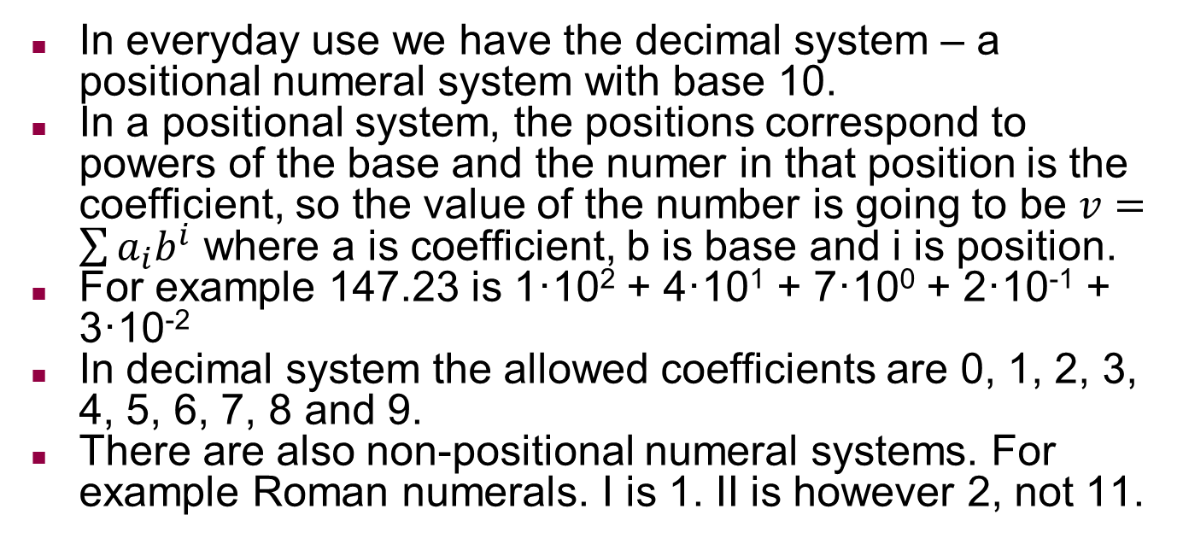
Numeral systems
In everyday use we have the decimal system – a positional numeral system with base 10.
In a positional system, the positions correspond to powers of the base and the numer in that position is the coefficient, so the value of the number is going to be $v=\sum{a_{i}b^{i}}$ where a is coefficient, b is base and i is position.
For example 147.23 is 1·10² + 4·10¹ + 7·10⁰ + 2·10⁻¹ + 3·10⁻²
In decimal system the allowed coefficients are 0, 1, 2, 3, 4, 5, 6, 7, 8 and 9.
There are also non-positional numeral systems. For example Roman numerals. I is 1. II is however 2, not 11.

Slide 58
Binary system
Transistor is a device with two states, it can permit the current to pass or not. These states can be encoded with 1 and 0.
Since the transistor is the basis of all computing technology, binary system is used in computers.
The decimal number 147.23 is much longer in binary:
1001 0011.0011 1010 is 1·2⁷ + 1·2⁴ + 1·2¹ + 1·2⁰ + 1·2⁻³ + 1·2⁻⁴ + 1·2⁻⁵ + 1·2⁻⁷
When we add these we get: 128 + 16 + 2 + 1 + 0.125 + 0.0625 + 0.03125 + 0.0078125 = 147.2265625, which isn't equal to 147.23-ga.
Therefore comparing real numbers in a computer is dangerous, especially if one of them is a result of series of operations. In this case we can again use the text.

Slide 59
Number length in various systems
In a binary system 147 was already 8 digits.
It may seem that 2 is very inefficcient base.
However the value of the positions grows exponentially and even with base 2, exponential function grows very fast.
The number of digits grows logarithmically.
To represent 1000 we need log₂1000 ≈ 10 bits.
To represent 1,000,000 we need log₂1,000,000 ≈ 20 bits.
Generally one decimal place is ≈ 3.3 binary places and 10 binary places are ≈ 3 decimal places.
64 bits is therefore ≈ 6*3 + 4/3.3 ≈ slightly over 19 decimal places.

Slide 60
Numeral systems with base larger than 10
We use following digits 0, 1, 2, 3, 4, 5, 6, 7, 8 ja 9
As long as the base of another numeral system is smaller than 10 we can use a subset of digits.
When the base is larger than 10 then digits won't cover all coefficients any more.
Then letters will be used and they can be encoded as follows:
  A – 10
  B – 11
  etc..
For hexadecimal systems (base 16) the coefficients are 0..9 and A..F
Hexadecimal system is quite common in computers because one byte corresponds to two symbols.
Converting is very easy, 1 symbol becomes exactly 4 bits and vice versa

Slide 61
Reading integer of X-system
When readign an integer we can start from the beginning or the end.
From the beginning
  Let's pick 0 for total_value
  Multiply total_value with base
  Add current coefficient to total_value
  Move towards the end
  If there are more coefficients then go to 2 else total_value has the value
From the end
  Let's pick 0 for the totoal_value and 1 for position_value
  Multiply the coefficient with position_value and add to total_value
  Move towards the beginning and multiply the position_value with base
  If there are more coefficients then go to 2 else total_value has the value

Slide 62
Reading fraction of X-system
This is always easier to do from the beginning
  Pick 0 for total_value, 1 / base for position_value
  Let's multiply current coefficient with position_value and add to total_value
  Move towards the end and divide position_value by base.
  If there are more coefficients then go to 2, else total_value is the answer.

Slide 63
Writing integer in x-system
It is more efficient to do it from the end but then we get the coefficients in reversed order.
  Move to beginning of array
  Divide source_number by base and find the remainder
  Store the remainder in array, move to next position in array
  Divide source_number by base
  if source_number > 0, then go to 2
  Move to previous position and print the coefficient
  If we're not at the beginning of array then go to 6 else answer has been printed

Slide 64
Writing integer in x-system
Also possible to do from the beginning
  Set position_value to 1
  If source_number / position_value is greater than base then go to 3 else go to 4
  Multiply position_value by base and go to 2
  Find the coefficient by dividing source_number with position_value, print it
  Subtract coefficient * position_value from source_number
  Divide position_value by base.
  If position_value > 0 then go to 4 else answer has been printed

Slide 65
Writing fraction in x-system
This is better to do from the beginning
  Print decimal symbol
  Multiply source_number by base.
  Print integer portion
  Subtract integer portion from the number
  If the source_number isn't 0 and we have room* then go to 2 else we're done
Room signifies, how many "decimal places" we want
For example printing 0.5 in a numeral system with base 3 the source_number will always remain non-zero.

Slide 66
Library string.h
• Text and memory processing functions are located in library string.h
• Most useful ones would probably be:
• strlen(S) – retruns the length of S in bytes
• strcmp(A, B) – compares strings A and B, returns 0 if they are identical
• strcpy(A, B) – overwrites A with B

Slide 67
Processing text a character at a time
• There are cases when we need to check all characters in a string (for example: find all vowels)
• This should be done using a loop
• One option is to use while or do-while loops and check if we've reached terminating character '\0‘
• For example: while(S[i] != '\0'){...} do{...}while(S[i] != '\0')
• Strlen is more convenient but it will check for the length of string after each iteration: for(i = 0; i < strlen(S); i++)

Slide 68
Converting text (library stdlib.h)
• Text can be converted using functions:
• atoi(text) – convert text to integer
• atof(text) – convert text to real number
• If we are dealing with our own buffer where there is more data, then strto* functions can be used, as they return a pointer to yet unprocessed text
• strtol(text, pointer, base) – convert to long integer
• strtoul(text, pointer, base) – convert to unsigned long
• strtod(text, pointer, base) – convert to double

Slide 69
Text arrays
• Text is an array of characters. Text array is therefore a twodimensional array of characters.
• Usage is similar to other multidimensional arrays, however each row can be viewed separately. char names[100][30];
// 100 names of upto 29 characters scanf("%s", names[0]);
//read a name from terminal strcpy(names[5], "Janice");
//replace sixth name with Janice names[5][3] = 'e';
// replace fourth character with 'e' names[5][4] = 0;
// replace fifth with zero, names[5] is now "Jane"

Slide 70
ALGORITHM CREATING 6
Finding extremes, and "bubblesort" method

Slide 71
Extremes and sorting
One frequent task when processing data is sorting and finding the maximum and minimum values. Such tasks always include two activities:
“Exchanging places” of two values
Comparing the two values
The first includes one activity, but the second three activities.

Slide 72
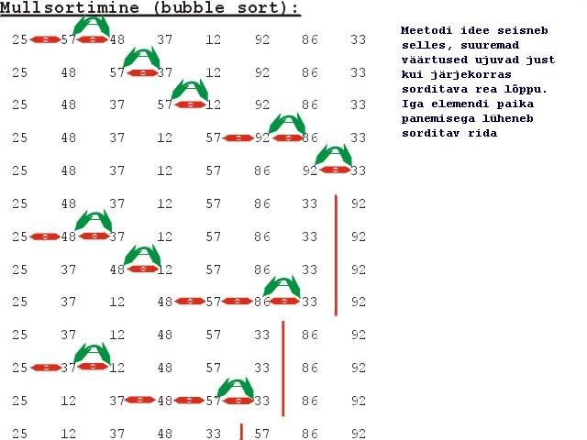
The idea of ​​the method is that "larger ones float" in order to the end of the sorted line. As each element is placed, the sorted line gets shorter
25 57 48 37 12 92 86 33 original - 8 numbers
25 48 37 12 57 86 33 I 92 ---7 comparison 5 exchange
25 12 37 48 57 33 I 86 92 ---- 6 3
25 12 37 48 33 I 57 86 92 ---- 5 2
12 25 37 33 I 48 57 86 92 ---- 4 2
12 25 33 I 37 48 57 86 92 -----3 1
12 25 I 33 37 48 57 86 92 -----2 0
total: 27 13

Slide 73
A simple sorting algorithm, can also be used successfully to find extremes
< MAXIMUM
Analogously can be found MINIMUM

Slide 74
ALGORITHM CREATING 7
Shell sort algorithm

Slide 75
Shell sort algorithm (1)
(has less exchanges, presumes that data is partially sorted)

Slide 76
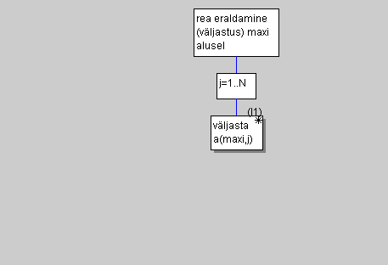
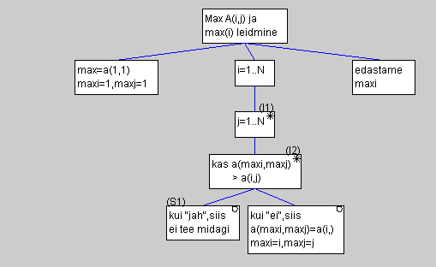
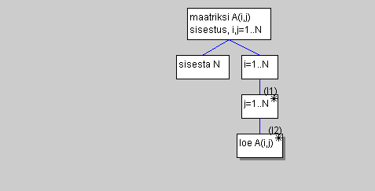
Output matrix row, on the basis of max element
Matrix input A(i,j) i,j=1..N
Max A(i,J) finding, max(i)
Row separation on the base of max(i)
We separate the task into sub-tasks and solve them later!

Slide 80
Questions for the examIAX0583
1.Algorithm concept and presentation methods.
2. Number systems. Converting numbers from one number system to another
3. Languages. The concept of an algorithmic language.
4. Translators, their types and gears.
5. Syntax diagrams to describe a language.
6. Program design strategies: top-down and bottom-up
7. The "life cycle" of the program on the computer. Debugging the programm.
8. Characterization of the C language.
9. General structure of a C program.
10. Static memory allocation. Declarations.
11. Data types. Transition from one type to another.
12. Standard functions.
13. Actions and their priorities. Expression type.
14. Basic statements of the C language.
15. Program branching programming.
16. Programming iterations (cycles).
17. Signs and addresses.
18. Declaring arrays and operating with them.
19. Representing a two-dimensional array as one-dimensional and vice versa.
20. Array sorting algorithm.
21. Functions as Subroutines. Local and global variables.
22. Declaring a function and addressing it
.23. Declaring and Calling a Void Function.
24. Types, names and states of files. File buffer. Working with files.
25. File Sorting Algorithm.
26. External modules. Compilation together and separately.
27. Program Debugging. Error handling.

