Slide 1


Slide 2

Analysis of Programming Languages
Vladimir Viies vladimir.viies@gmail.com,
Lembit Jürimägi lembit.jyrimagi@gmail.com
Tallinna Tehnikaülikool
2019

Slide 3
Subject goals
A student has to be able:
to associate tasks with a suitable algorithmic language;
to design a special purpose algorithmic language and create a compiler for it;

Slide 4
Subject contents I
Classification of algorithmic languages.
Universal and specific languages.
Comparison of the possibilities of data types, sentences and intramodular data exchange in different languages (FORTRAN , PL/1, PASCAL, Assembler etc.).
Assembler.
Translators, their components and work principles.
Art of translator design.

Slide 5
POINTS I(EXAM)

Slide 6
Points II(EXAM & PERMISSION)
Practice(T1+T2) — max20p
Homework (translator) — max15p
Presentation (languages) — max10p
Seminar — max5p
Written examination — max50p
Permission to examination(30p)
min 10pract(max20) + min 20test (max 30)

Slide 7
Course structure
I module: Practice(translator design)
II module: Seminars (Comparison of the possibilities in different languages )
III module:Homeworks

Slide 8
Course timetable
1. 05.09.2019 Introduction
2. 12.09.2019 Regular Languages, Regular Expressions, Flex
3. 19.09.2019 Evolution of Programming Languages
4. 26.09.2019 Context Free Grammar, Bison, Postfix/Infix Calculator
5. 03.10.2019 Practice Task 1
6. 10.10.2019 Abstract Syntax Tree, General Purpose Language
7. 17.10.2019 Functional Language, part 1
8. 24.10.2019 Functional Language, part 2
9. 31.10.2019 Guest lecturer
10. 07.11.2019 Guest lecturer
11. 14.11.2019 Test
12. 21.11.2019 Machine Language, Assembly Language
13. 28.11.2019 Practice Task 2
14. 05.12.2019 Presentation
15. 12.12.2019 Presentation
16. 19.12.2019 Exam

Slide 9
Subject contents II
LET'S BUILD A COMPILER!
By Jack W. Crenshaw, Ph.D.
This file contains all of the installments of Jack Crenshaw's
tutorial on compiler construction.
The intended audience is those folks who are not computer scientists,
but who enjoy computing and have always wanted to know how compilers
work. A lot of compiler theory has been left out, but the practical
issues are covered. By the time you have completed the series, you
should be able to design and build your own working compiler. It will
not be the world's best, nor will it put out incredibly tight code.
Your product will probably never put Borland or MicroSoft out of
business. But it will work, and it will be yours

Slide 10
Presentation (analysis question list)
(analyze different languages)
- field where language is used (general purpose hardware, gpu, vm, web etc), proximity to hardware(What problem is language meant to solve?)...
- compiled or interpreted, comparative speed to other languages...
- strongly typed vs weakly typed, examples, data type conversion?
- single thread vs multithread, handling of parallelism, examples...
- memory handling, explicit memory allocation vs implicit, examples...
- what sort of problems would you use this language for?
- if you could improve on this language what would you add to it or remove from it?
- extending the functionality of language, dlls, apis...
- is the purpose of the code understandable when looking at code (assembler - no, pascal - somewhat, scripting languages – yes)...
- effort needed for learning the language (assembler - high, scripts medium)
- an example program in the language from the field it is used for..

Slide 11

Subject contents III

Slide 12
COMPUTER as a MULTILEVEL MACHINE

Slide 13
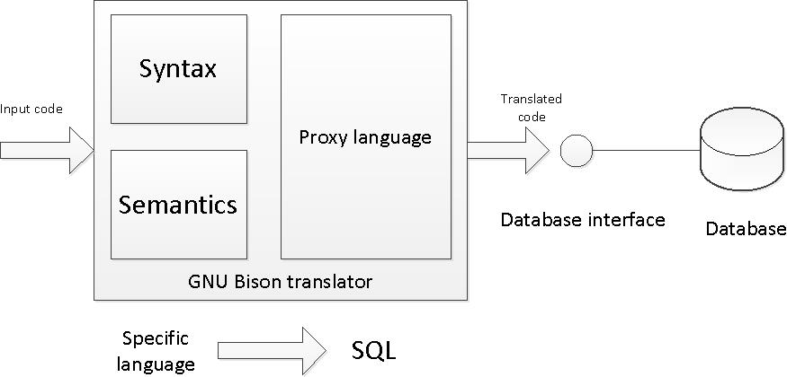
SQL Translator
Make up a language for specific area or task of your choice. An example and a possible choice is a language for managing library.
Create a SQL translator using GNU Bison (or any alternative) to translate your made up language to SQL.
Write a simple database interface for executing the translated SQL queries in a database.
Set up a simple database to demostrate inserting and quering data in the made up language

Slide 14
TRANSLATION VS. INTERPRETATION I
Translation: program written for level n machine translated to level 1 machine
  Advantages: statements decoded ONCE — efficient execution
  Disadvantages: space consumption
Interpretation: program written for level n + 1 is executed on level n machine
  Advantages: space conservation
  Disadvantages: execution speed

Slide 15
TRANSLATION VS. INTERPRETATION II
TRANSLATORS
  Compiler: high level-> machine
  Assembler: one to one, assembly -> machine
  Loader: relocatable version of machine code -> machine code
  Link editor: combines collections of relocatable programs -> single relocatable machine program
  Pre-processor: extended language -> standard language

Slide 16
TRANSLATION VS. INTERPRETATION III
INTERPRETER
  Fetch op code
  De-code op code
  Fetch necessary operands
  Branch to primitive (OP_{k})
  Then repeat until the end of the program

Slide 17
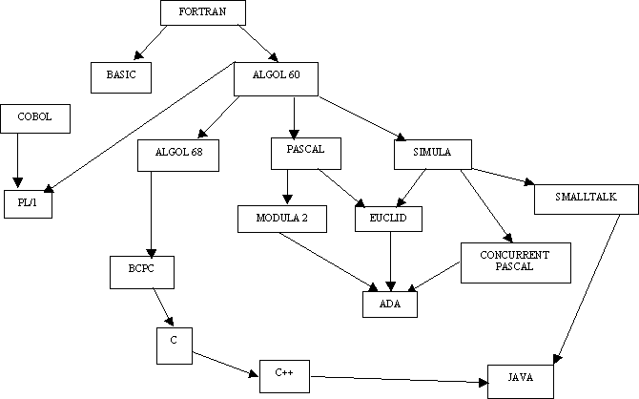
LANGUAGES TREE

Slide 18
Language parts
I part
Alphabet = latin characters + arabic numeral + special symbols(inc. punctuation marks)
II part
Lexic/vocabulary
III part
Syntax rules/Spelling
IV part
Semantics rules

Slide 19
The representation of a grammar
The representation of a grammar is made of a set of syntax diagrams.
Each diagram defines a non-terminal. There is a main diagram which defines the language in the following way:
to belong to the language, a word must describe a path in the main diagram.
Each diagram has an entry point and an end point.
The diagram describes possible paths between these two points by going through other nonterminals and terminals.
Terminals are represented by round boxes while nonterminals are represented by square boxes

Slide 20
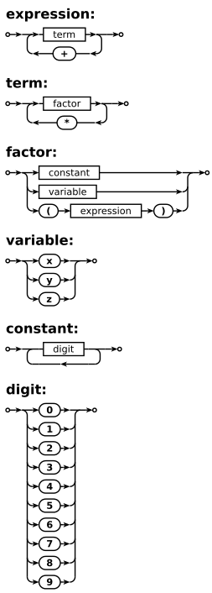
Diagram

Slide 21
Meta language
<expression> ::= <term> | <term> "+" <expression>
<term> ::= <factor> | <term> "*" <factor>
<factor> ::= <constant> | <variable> | "(" <expression> ")"
<variable> ::= "x" | "y" | "z"
<constant> ::= <digit> | <digit> <constant>
<digit> ::= "0" | "1" | "2" | "3" | "4" | "5" | "6" | "7" | "8" | "9"

Slide 22
Significant Language Features I
Simple to learn
Machine Independent
More natural ways to express mathematical functions
Problem orientated language
Remains close to and exploits the available hardware
Efficient execution
Ability to control storage allocation
More freedom in code layout

Slide 23
Significant Language Features II
Loops
Input from the keyboard
Menu Driven Applications
System Commands
Structured Programming
Subroutines
Built-In Functions
User-Defined Functions
Arrays, sorting, and searches

Slide 24
Significant Language Features III
Criteria for Language Design Evaluation
efficiency (translation and execution)
simplicity (readability and writability)
orthogonality
definiteness (syntax and semantics)
reliability
program verification (correctness)
abstraction facilities (data and procedural)
portability

Slide 25
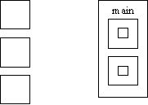
What is an "Algol-like" language?
Algorithmic language for describing
Processes Imperative (most computation
work done in assignment statements)
Block & procedure
Lexical scope
C Algol lexical scope

Slide 26
PSEUDO LANGUAGE I
LANGUAGE ARE ALLOWED TO USE THE FOLLOWING SENTENCES:
x = y; assigment
x = x ○ y; binary
x = □ x; unary
x = x + 1 x = succ(x)
x = x - 1 x = pred(x) simplification

Slide 27
PSEUDO LANGUAGE II
GOTO M BR M
JMP M
IF x◊y THEN GOTO M x,y € {A} A- set of integers
CMP x,y
Bii M
ii € (NE, EQ, GT, LT, GE, LE)
CMPB X,Y X,Y € {C} C- set of alphabetical symbols
Bcc M
cc € (NE, EQ, ..........) special functionality

Slide 28
PSEUDO LANGUAGE III
If you compare the form of the IF statement above with the assembler code that must be produced, you can see that there are certain actions associated with each of the keywords in the statement:
IF: First, get the condition and issue the code for it.
Then, create a unique label and emit a branch if false.
ENDIF: Emit the label.
These actions can be shown very concisely if we write the syntax this way:
IF
<condition> { Condition;
L = NewLabel;
Emit(Branch False to L); }
<block>
ENDIF { PostLabel(L) }

Slide 29
PSEUDO LANGUAGE IV
EXAMPLE 1(Pascal)
IF ( condition)
THEN sentence1;
ELSE sentence2;
if : if !(condition) then goto else;
then : sentence1;
goto endif;
else : sentence2;
endif : program will continue

Slide 30
PSEUDO LANGUAGE V
EXAMPLE 2(C)
DO {sentence1; sentence2; .... sentenceN;}
WHILE expression;
do : sentence1;
sentence2;
...
sentenceN;
check : calculation of expression;
while : if not expression goto do;

Slide 31
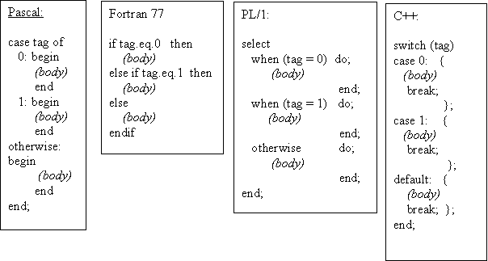
If-then/else or case design issues
· What type of selector expression?
· What types of case labels?
· Can you branch to case labels from outside?
· Mutually exclusive labels?
· Exhaustive label case coverage?

Slide 32
Loop design issues
What type of values may loop variable assume?
Complexity of loop expression?
How often is loop variable checked against final value?
Can loop variable be assignment inside loop body?
When evaluate stopping expression?
Transfer permitted outside loop?
Scope of loop variable?

Slide 33
Excercise 3

Slide 34
Test task example
Write an interpreter for the calculator language defined below. You may assume that there are no operator precedence rules if you wish. expression::= operand [ operator operand]. operand ::= 0 | 1 | 2 | 3 | 4 | 5 | 6 | 7 | 8 | 9 operator ::= + | - | * | /
You may use any language you wish to do this. You will need to turn in a clearly commented source listing of your program.

Slide 35


