Slide 2
Analysis of Programming Language
Vladimir Viies vladimir.viies@gmail.com,
Lembit Jürimägi lembit.jyrimagi@gmail.com
Tallinna Tehnikaülikool
2017
Notes:
Before testing, let's briefly review some of the topics that should be relied on

Slide 3
Course timetable(new)
1. 06.09.2018 Introduction 2. 13.09.2018 Machine Language, Assembly Language 3. 20.09.2018 Regular Languages, Regular Expressions, Flex 4. 27.09.2018 Context Free Grammar, Bison, Postfix/Infix Calculator 5. 04.10.2018 Practice Task 1 6. 11.10.2018 Abstract Syntax Tree, General Purpose Language 7. 18.10.2018 General Purpose Language 2 8. 25.10.2018 Guest lecturer 1 9. 01.11.2018 Guest lecturer 2 + seminar/practice task 10. 08.11.2018 Guest lecture 3 +seminar/practice task 11. 15.11.2018 Evalution of Programming language/Test 12. 22.11.2018 Functional Language /Practice Task 2A 13. 29.11.2018 Practice Task 2B / Consultation 14. 06.12.2018 Seminar 15. 13.12.2018 Seminar/Exam 16. 20.12.2018 Exam

Slide 4
Points (EXAM & PERMISSION)
Practice(T1+T2) ----max20p
Homework(translator) ----max15p
Presentation(languages)---max10p
Seminar—max5p
Written examination--max50p
Permission to examination(30p)
min 10pract(max20) +min 20test (max 30)

Slide 5
Major Requirements of an Operating System
Interleave the execution of several processes to maximize processor utilization while providing reasonable response time
Allocate resources to processes
Support interprocess communication and user creation of processes
Notes:
we know that each programming language acts as a subsystem under the operating system. therefore, the cooperation with the operating system must ensure the independence of the hardware

Slide 6
Modes of Execution
User mode
Less-privileged mode
User programs typically execute in this mode
System mode, control mode, or kernel mode
More-privileged mode
Kernel of the operating system
Notes:
every program must be accept that exist more privileged mode than his

Slide 7
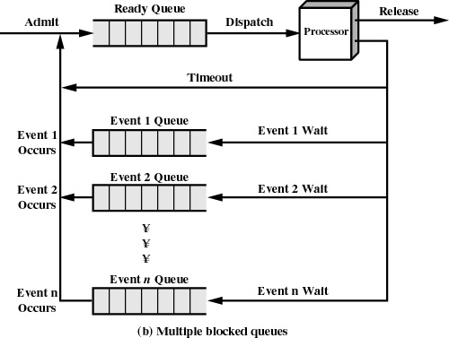
Notes:
here is classical multiple queues system. In what levels OS execute user program?

Slide 8
Reasons for Process Termination
I/O failure
Invalid instruction
happens when try to execute data
Privileged instruction
Data misuse
Operating system intervention
such as when deadlock occurs
Parent terminates so child processes terminate
Parent request
Notes:
If we got execute time, we must know now, that our processes can be terminated if(p.r taotlus)

Slide 9
When to Switch a Process
Clock interrupt
process has executed for the maximum allowable time slice
I/O interrupt
Memory fault
memory address is in virtual memory so it must be brought into main memory
Notes:
every language disigner must be accepted that process switching happen if

Slide 10
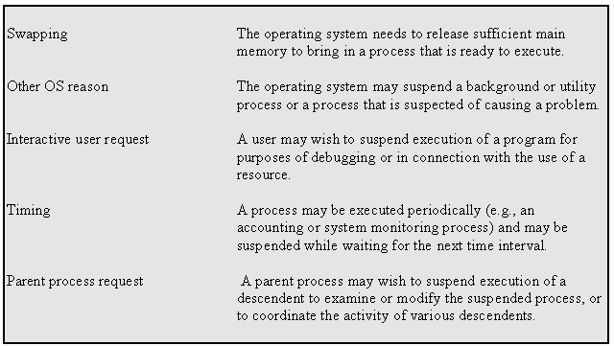
Reasons for Process Suspension
Notes:
every language disigner must be accepted that process suspensioon(peatamine) happen if

Slide 11
State
Instructions- represent state transition via program execution
You have a choice: implement with hardware, (quick yet inflexible)
You have a choice: implement with software, (slow and flexible)
Notes:
every procces has three sätteis in order; Under execute; termination status

Slide 12
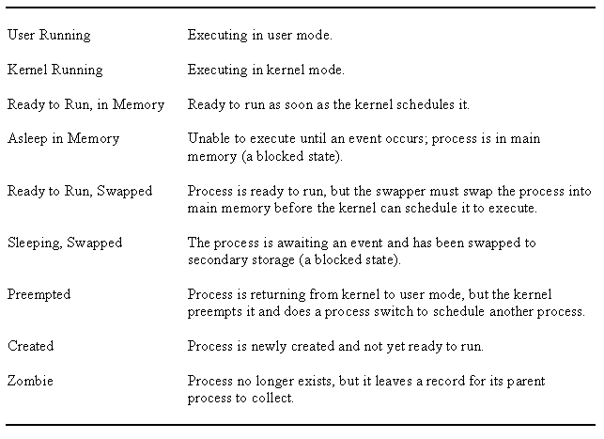
UNIX Process States

Slide 13
Memory Tables
Allocation of main memory to processes
Allocation of secondary memory to processes
Protection attributes for access to shared memory regions
Information needed to manage virtual memory
Notes:
for successful execute we must know how system realize memory management

Slide 14
File Concept
Contiguous logical address space
Types:
Data
numeric
character
binary
Program
Notes:
what kind of file concepts we can used

Slide 15
File Attributes
Name – only information kept in human-readable form
Identifier – unique tag (number) identifies file within file system
Type – needed for systems that support different types
Location – pointer to file location on device
Size – current file size
Protection – controls who can do reading, writing, executing
Time, date, and user identification – data for protection, security, and usage monitoring
Information about files are kept in the directory structure, which is maintained on the disk
Notes:
there are much file attributes exist and we can used them or not

Slide 16
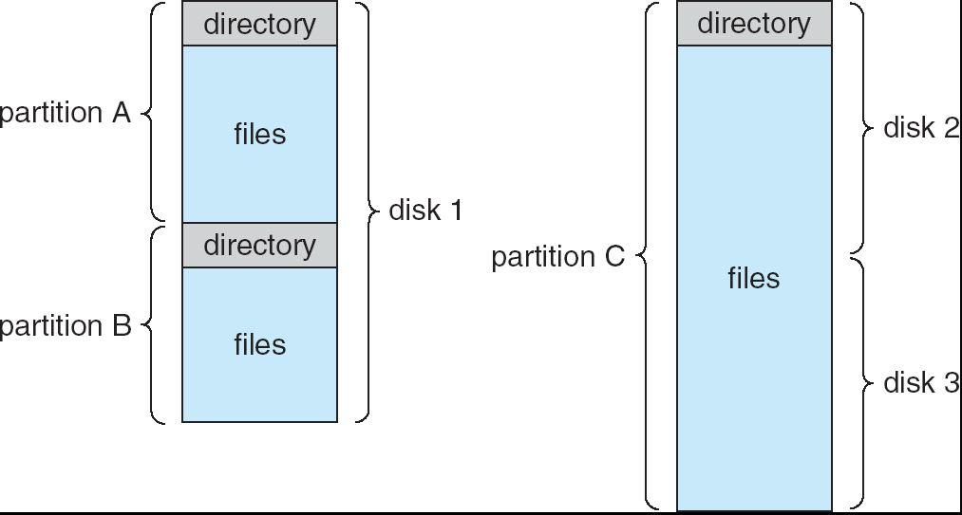
A Typical File-system Organization

Slide 17
File Structure
None - sequence of words, bytes
Simple record structure
Lines
Fixed length
Variable length
Complex Structures
Formatted document
Relocatable load file
Can simulate last two with first method by inserting appropriate control characters
Who decides:
Operating system
Program
Notes:
again it is very important for language what kind of file structure it accept

Slide 18
Operations Performed on Directory
Search for a file
Create a file
Delete a file
List a directory
Rename a file
Traverse the file system
Notes:
läbima

Slide 19
Access Methods
Sequential Access
read next
write next
reset
no read after last write
(rewrite)
Direct Access
read n
write n
position to n
read next
write next
rewrite n
n = relative block number
Notes:
Most of languages have both possibilities

Slide 20
File Operations
File is an abstract data type
Create
Write
Read
Reposition within file
Delete
Truncate
Open(F_{i}) – search the directory structure on disk for entry F_{i}, and move the content of entry to memory
Close (F_{i}) – move the content of entry F_{i} in memory to directory structure on disk
Notes:
and traditionally Os give users to system functions to be operating with files

Slide 21
Open File Locking
Mandatory or advisory:
Mandatory – access is denied depending on locks held and requested
Advisory – processes can find status of locks and decide what to do
Notes:
Os meediates file locking vahendab juurdepääsu

Slide 22
Open Files
Several pieces of data are needed to manage open files:
File pointer: pointer to last read/write location, per process that has the file open
File-open count: counter of number of times a file is open – to allow removal of data from open-file table when last processes closes it
Disk location of the file: cache of data access information
Access rights: per-process access mode information
Notes:
All this must be taken into account when programming language is being developed

Slide 23
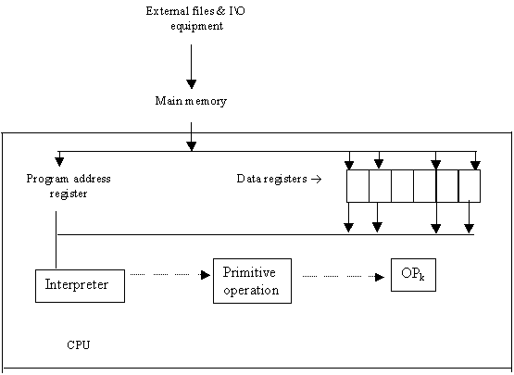
COMPUTER ORGANIZATION
Notes:
At the first level, we can look at the computer in a simplified way, but this is not enough for developing the language

Slide 24
Evaluation of program language
Efficient translation
Efficient execution
Writeability
Simplicity- all features of the language should be easy to learn and master
Expressiveness
Definiteness
Readability
Reliability- static and dynamic checking
Static during compile
Dynamic during execution
Notes:
scientists of programming language design at last century thinking that .. going this way

Slide 25
Language evalution A
Expressivity- readability
Well defined- syntax, semantics
I/O facilities
Portability
Efficiency
Pedagogy- easy to teach & learn
Generality- useful in wide range of applications

Slide 26
Language evalution B
Readability :
- Simplicity
- Orthogonality
- Control statements
- Data structures
- Syntax

Slide 27
Language evalution C
Writeability:
- Simplicity
- Orthogonality
- Support for abstraction
Reliability:
- Type checking
- Exception handling
- Readability/ writeability
- Aliasing – 2 different ways to refer to the same spot in memory/storage

Slide 28
Language evalution D
Cost:
- Training
- Code development
- Compilation
- Execution
- Maintenance

Slide 29
ESSENTIAL CHARACTERISTICS
Well defined syntactic and semantic definition of language
Reliability
Fast translation
Efficient object code
Orthogonality
Machine independence

Slide 30
DESIRABLE CHARACTERISTICS
Provability
Generality
Consistency with commonly used notations
Subsets
Uniformity
Extensibility (ease to add features)

Slide 31
Significant Language Features I
Simple to learn
Machine Independent
More natural ways to express mathematical functions
Problem orientated language
Remains close to and exploits the available hardware
Efficient execution
Ability to control storage allocation
More freedom in code layout

Slide 32
Significant Language Features II
Loops
Input from the keyboard
Menu Driven Applications
System Commands
Structured Programming
Subroutines
Built-In Functions
User-Defined Functions
Arrays, sorting, and searches

Slide 33
Language design I
A:
Focus on one well known feature at a time, (could be basic as data type)
Examine many alternative features designed by others & choose the best, rejecting those that are inconsisten
Notes:
Here are some practical suggestions for language developers

Slide 34
Language design II
B:
· Choose specific application (logic, financial, etc.)
· Keep design committee small
· Choose precise design goals
· Release versions to small sets of interested people
· Revise language definition
· Attempt to build compiler & write formal language
definition-semantics
· Produce clear and concise manual
· Provide "production quality" compiler and wide
distribution
· Write primers explaining language
·
Notes:
Vali täpne eesmärkide hulk, vaataüle

Slide 35
Language design III
Release versions to small sets of interested people
Revise language definition
Attempt to build & write formal language definition- semantics
Revise language definition
Produce clear and concise manual
Provide "production quality" compiler and wide distribution
Write primers explaining language

Slide 36
Language processors
Computers- integrated set of algorithms & data structures capable of storing and executing programs
Composite ® actual (hardware) computer-wires and circuits
Computer ® software simulated computer
programming language is implemented by developing a translator capable of transforming programs in one language into machine language of some computer where it can be executed correctly

Slide 37
COMPUTER AS A MULTI-LEVEL MACHINE
Each level supported by the level below it!
level 5 => problem oriented language translated (by compiler)
level 4 =>assembly language level (translated by assembly)
level 3 =>operating system (partial interpretation by OS)
level 2 =>conventional machine language( interpreted by micro-program)
level 1 =>micro-programming ( directly executed by hardware)
level 0 =>digital logic (gates & transistors program address registers)
Notes:
Some times it is OK to lock to computers as to multilevel machine

Slide 38
Interpreter
Fetch op code
De-code op code
Fetch necessary operands
Branch to primitive (OP_{k})
Then repeat until the end of the program
Notes:
Võtab,sisestab

Slide 39
TRANSLATION VS. INTERPRETATION I
Translation: program written for level n machine translated to level 1 machine
Advantages: -statements decoded ONCE -efficient execution
Disadvantages: -space consumption
Interpretation: program written for level n + 1 is executed on level n machine
Advantages: -space conservation
Disadvantages: -execution

Slide 40
TRANSLATION VS. INTERPRETATION II
TRANSLATORS
Compiler: high level-> machine
Assembler: one to one, assembly -> machine
Loader: relocatable version of machine code -> machine code
Link editor: combines collections of relocatable programs -> single relocatable machine program
Pre-processor: extended language -> standard language

Slide 41
TRANSLATION VS. INTERPRETATION III
INTERPRETER
Fetch op code
De-code op code
Fetch necessary operands
Branch to primitive (OP_{k})
Then repeat until the end of the program

Slide 42
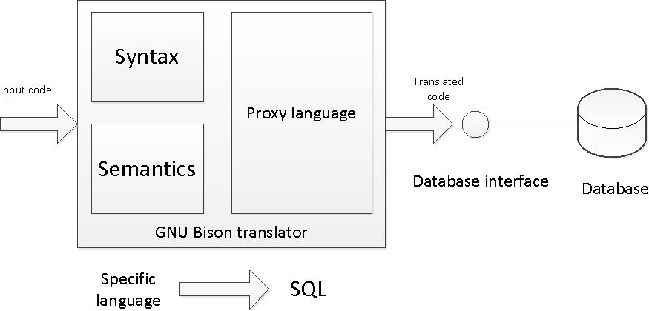
SQL Translator
Make up a language for specific area or task of your choice. An example and a possible choice is a language for managing library.
Create a SQL translator using GNU Bison (or any alternative) to translate your made up language to SQL.
Write a simple database interface for executing the translated SQL queries in a database.
Set up a simple database to demostrate inserting and quering data in the made up language

Slide 43
Fortran
Compiler completed 1957
Mostly using assembly languages
Fortran 1 & 2 designed while the Fortran 0 compiler was in development stage
1960 Fortran IV
Fixed fields in source code (columns 1-5 labels, 6 'continue', 7-72 source, 73-80 sequence fields)
Implicit typing (I-N was integer variable types, all else was floating point)
Arithmetic 'if' Å, q , Æ (>0, <0, =0)
'Do' iterator
Formatted i/o
Comments

Slide 44
1963 Naur developed Algol 60 ('root' for Pascal, PL/1, Ada)
'Free' format (freedom of indentation, spacing, etc)
Reserved words (certain words could not be variable names)
Explicit typing (variable type had to be explicitly defined)
General iterator (similar to 'while')
Block structure
Recursive procedures
Dynamic array bounds
Value parameters

Slide 45
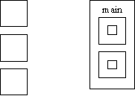
What is an "Algol-like" language?
Algorithmic language for describing
Processes Imperative (most computation
work done in assignment statements)
Block & procedure
Lexical scope
C Algol lexical scope

Slide 46
An "Algol-like" language
Lexical scope is where the variable is visible and allows nested subroutines, need order
Type checking
Compilation used
IBM in its wisdom gave away FORTRAN with all its new computers creating wide spread support for FORTRAN and undermining Algol support
Both type-checking and scope was not so good in Algol, this resulted in reduced reliability
Industry preferred Fortran, academics preferred Algol

Slide 47
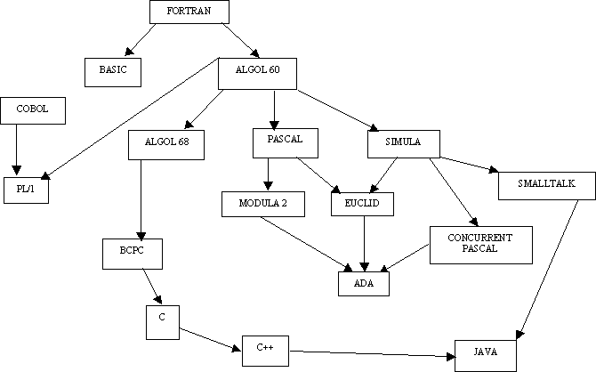
CLASSICAL LANGUAGES TREE

Slide 48
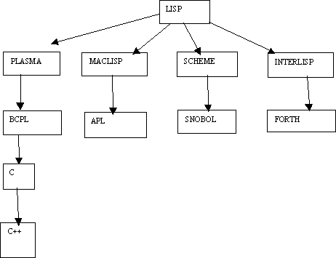
Applicative language- functional

Slide 49
COBOL
1959 Dept. of Defense wanted a single language
1960 Remington (Rand) developed the first compilers
Machine independent
General if/then else
'Noise' words (almost English-like, so lowly accountants could follow programs i.e. they didn’t have to know how to program to know what the code represented)

Slide 50
APL
IBM 1960 (Ken Iverson)
http://www.engin.umd.umich.edu/CIS/course.des/cis400/apl/apl.html
Very compact notation for computation
Provided for much matrix manipulation
NOT Algol-like in nature
Originally built to describe specifications of IBM360

Slide 51
LISP
Developed at MIT John McCarthy-MIT 1960
Symbolic expression, able to manipulate variable names like variable values (i.e. pointer arithmetic)
Uniform representation for expression (dataºcode) executable data structures.
New form of conditional expression (similar to "switch" statements)
Pre-fix expressions- operator followed by arguments
Recursion more widely used
"Garbage collection" used for data management
A "linked-list" type of structure is the basic structure in LISP

Slide 52
Lisp II
Lisp: John McCarthy-MIT 1960
Distinctive features of Lisp:
Equivalence of form for data and program
Heavy reliance on recursion over iteration
Use of linked list as intrinsic data structure

Slide 53
Data objects in Lisp
"Atoms", (either literal or numeric, i.e. 'sam or 3)
· List- groups of atoms or lists nested list representation is ((1 2 ) (3 4 ))
Expression- atoms and lists together
There are no reserved words for literal except:
The literal T is for boolean true
The literal NIL º '( ) or falseIn Lisp
; is for commenting like // for C++. So ; this comment is not recognized by interpreter
' is to read "as is" and not for interpretation

Slide 54
Functional programming
Sequence control
Used in expressions, (e.g. Precedence rules, parenthesis)
Between statements or blocks, (e.g. Iteration and conditionals)
Between sub-programs, (e.g. Calls)
Control sequences
Implied, (physical statement order)
Explicit, (parenthesis or goto's)

Slide 55
Functional programming ... applicative languages
f(x) = x * x
f(2) = 2 * 2
f(z + 1) = (z + 1) * (z + 1)
"lambda" notation:
((la)x x*x)2 = 2 * 2 = 4
f = (la)x.x*x
global .. non-lambda variable
f .. g o h = g(h(x)) functional languages permit this imperative do not

Slide 56
Parsing formulas
Root = -b ± (b²-4ac)^{1/2}
2a
In Fortran:
Root = ( -b + Sqrt ( b**2 - 4*a*c))/2*a
In some instances, parenthesis are essential, in others they are not.
(a + b)*(c - a) in-fix notation
* + a b - c a pre-fix notation
a b + c a - * post-fix notation
What is the difference between unary and binary minus?
(i.e. how does "-b" and "b²-4ac" in the quadratic formula differ in terms of language definition?)

Slide 57
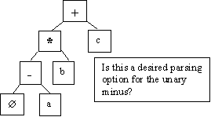
Tree representation issues
-a * b + c in-fix notation
Binary vs. unary operator confusion
Precedence rules
Associativity
left to right
right to left, (eliminates the need for parenthesis for the "2a" in the denominator of the quadratic)
Operators with varying number of operands, ( i.e. (+ 2 3 4))

Slide 58
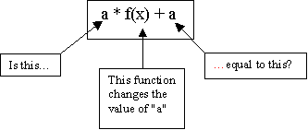
Problem areas
Uniform evaluation-once a tree is formed, all operands are treated equally
Side effects:
Error conditions: arithmetic over- or under-flow, (i.e. 4/ (200 * 10,000,000))
Short circuited boolean evaluation:
(a = 0) OR (b / a > c) in short circuit evaluation, the "OR" is evaluated until a "true" is found.
With full boolean evaluation, the "b/a", where a = 0, is evaluated first. This results in a run-time error.

Slide 59
Alternating (conditional statements)
„Dangling else" issue:
if x = 3 then
y = 5
if x = 5 then
y = 6
else y = 7 // WHICH "IF" GETS THE "ELSE"?
in C++ {} is used to define where the else belongs

Slide 60
Functional/ applicative languages
Set of "primitives"
Set of functional forms, (for new functions)
Application operation, (apply function to arguments)
Set of data objects

Slide 61
How math functions differ form computational functions
Modifiable variable in computing
Program functions have side effects
Programming functions define procedurally in steps-math functions typically done in terms of other functions
Both can be recursive

Slide 62
Functional languages
More expressive, the expression is more important than assignment or control statement
in C:
max = x > y? x : y;
OR
if x > y then
max = x;
else max = y;
But what is "x" in the following expression?
f(x) + (x) = 2 * f(x)
"side effect" or referential transparency

Slide 63
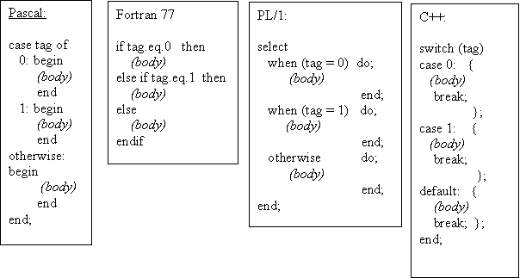
If-then/else or case design issues
· What type of selector expression?
· What types of case labels?
· Can you branch to case labels from outside?
· Mutually exclusive labels?
· Exhaustive label case coverage?

Slide 64
Loop design issues
What type of values may loop variable assume?
Complexity of loop expression?
How often is loop variable checked against final value?
Can loop variable be assignment inside loop body?
When evaluate stopping expression?
Transfer permitted outside loop?
Scope of loop variable?

Slide 65
PSEUDO LANGUAGE I
LANGUAGE ARE ALLOWED TO USE THE FOLLOWING SENTENCES:
x = y; assigment
x = x○y; binary
x = □x; unary
x=x+1 x= succ(x)
x=x -1 x= pred (x) simplification

Slide 66
PSEUDO LANGUAGE II
GOTO M BR M
JMP M
IF x◊y THEN GOTO M x,y € {A} A- set of integers
CMP x,y ◊€(<,>,=,!=,>=,<=)
B ii M
ii€(NE,EQ,GT,LT,GE,LE)
CMPB X,Y X,Y € {C} C- set of alphabetical symbols
B cc M
cc€(NE,EQ,..........) special functionality

Slide 67
PSEUDO LANGUAGE III
If you compare the form of the IF statement above with the as-
sembler code that must be produced, you can see that there are certain actions associated with each of the keywords in the statement:
IF: First, get the condition and issue the code for it.
Then, create a unique label and emit a branch if false.
ENDIF: Emit the label.
These actions can be shown very concisely if we write the syntax this way:
IF
<condition> { Condition;
L = NewLabel;
Emit(Branch False to L); }
<block>
ENDIF { PostLabel(L) }

Slide 68
PSEUDO LANGUAGE IV
EXAMPLE 1(Pascal)
IF ( condition) THEN sentence1;
ELSE; sentence2;
if: if !(condition) then goto else;
then: sentence1;
goto endif;
endif: program will continue

Slide 69
PSEUDO LANGUAGE V
EXAMPLE 2(C)
DO sentence1; sentence2;.... sentenceN;
WHILE expression;
do : sentence1;sentence2;... sentenceN;
check : calculation of expression;
while : if not expression goto do;

Slide 70
Exercise 1
Your assignment are to select 3 of the languages (set of languages) and evaluate its standard implementation. You are to assign the language a grade (1 through 8) for each criterion point listed below and to provide written justification for your rating. This set of languages is to include at least the following: Fortran, Cobol, PL/I, Pascal, C, C++, Ada, Lisp, Smalltalk, Basic, Modula-2, Algol, APL, Snobol, Icon, Prolog, Simula, Scheme, Eifel, Oberon, Visual Basic, Visual C++, Perl, Java, Delphi, HTML

Slide 71
Excercise 2
LOOP: DO WHILE (FLAG = 0); PUT SKIP DATA('HELLO WORLD!'); END LOOP; END HELLO;
******Ouput for Hellow World
WRITE(6,*)'Hello world' STOP END
class HelloWorld { public static void main(String args[]) { System.out.println("Hello world!"); }}
#include<stdio.h>
main()
{ printf("Hello World"); }

Slide 72
Test task example
Write an interpreter for the calculator language defined below. You may assume that there are no operator precedence rules if you wish. expression::= operand [ operator operand]. operand ::= 0 | 1 | 2 | 3 | 4 | 5 | 6 | 7 | 8 | 9 operator ::= + | - | * | / You may use any language you wish to do this . You will need to turn in a clearly commented source listing of your program.
Tagasi

Slide 73
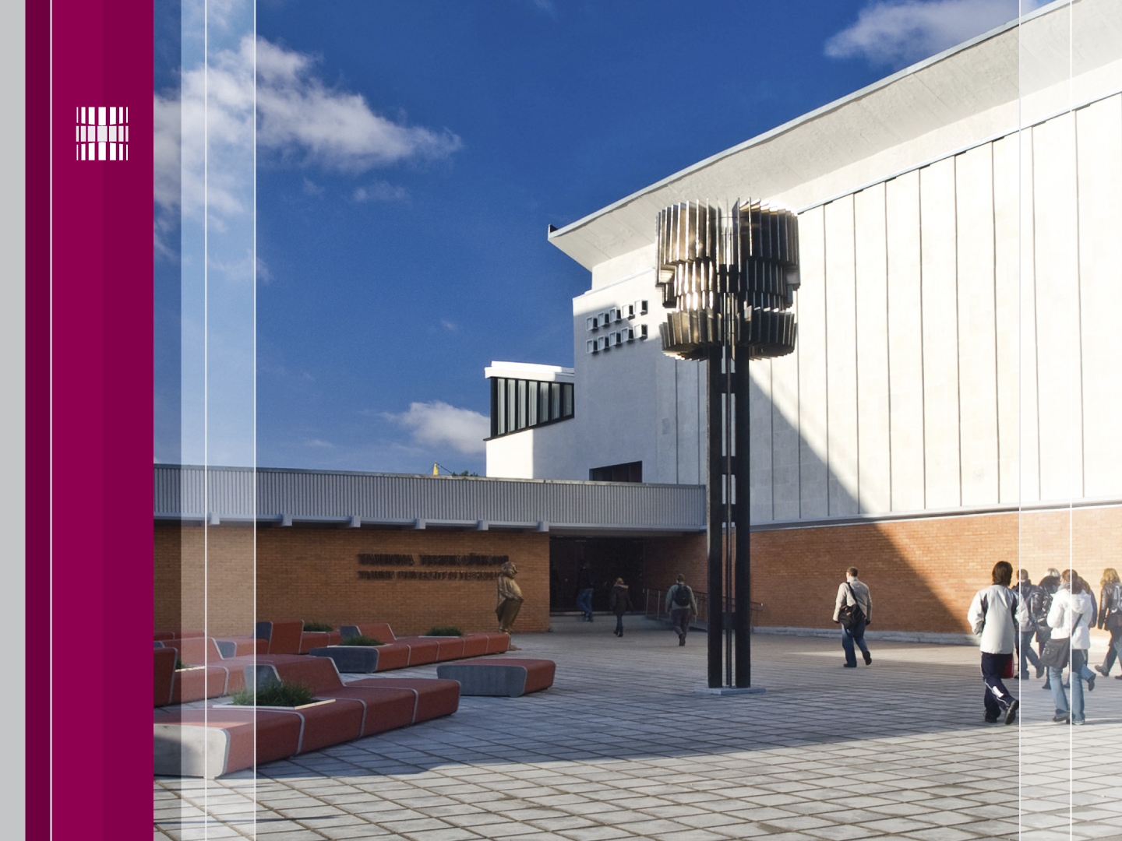
Täname, et läbisid kursuse!
Jätka ainete omandamist tarkvaraainete plokist!
Thanks for Your attention!
Tutvu ainetega Infotehnoloogia teaduskonna õppematerjalide kodulehel
Look at www.tud.ttu.ee

