Slide 2
Analysis of Programming Language
Vladimir Viies viis@ati.ttu.ee,
Lembit Jürimägi lembit.jyrimagi@gmail.com Hannes Kinks hkinks@gmail.com
Tallinna Tehnikaülikool
2016

Slide 3
Subject goals
A student has to be able: - to associate tasks with a suitable
algorithmic language;
-to design a special purpose
algorithmic language and create
a compiler for it;

Slide 4
POINTS

Slide 5
Points
max
Essay -----------10p
Seminar x 2 -----------10p
Homework -----------30p(translater)
Written examination--50p
(include test max10p)
Permission to examination => min(20p)
Practice x 10------------max 25p(10+15)
Test -----------max 15p

Slide 6
Course structure
I module: Practice(translator design)
II module: Seminars(Comparison of the possibilities in different languages, include essay )
III module:Homework (create a translator )

Slide 7
Course timetable
1. 09.09.2016 Introduction
2. 16.09.2016 Regular Languages, Regular Expressions, Flex
3. 23.09.2016 Context Free Grammar, Bison, Postfix/Infix Calculator
4. 30.09.2016 Practice Task 1 – pre-exam chance
5. 07.10.2016 Abstract Syntax Tree, General Purpose Language
6. 14.10.2016 General Purpose Language, cont
7. 21.10.2016 Practice Task 2
8. 28.10.2016 Evolution of Programming Languages
9. 04.11.2016 Test
10. 11.11.2016 Assembly language (PIC)
11. 18.11.2016 ANTLR
12. 25.11.2016 Practice Task 3-Using ANTLR to build assembly compiler
13. 02.11.2016 Seminar
14. 09.12.2016 Seminar
15. 16.12.2016 Exam

Slide 8
Subject contents I
Classification of algorithmic languages. Universal and specific languages. Comparison of the possibilities of data types, sentences and intramodular data exchange in different languages (FORTRAN , PL/1, PASCAL,Assembler etc.).Assembler. Translators, their components and work principles. Art of translator design.

Slide 9
Subject contents II
LET'S BUILD A COMPILER!
By Jack W. Crenshaw, Ph.D.
This file contains all of the installments of Jack Crenshaw's
tutorial on compiler construction.
The intended audience is those folks who are not computer scientists,
but who enjoy computing and have always wanted to know how compilers
work. A lot of compiler theory has been left out, but the practical
issues are covered. By the time you have completed the series, you
should be able to design and build your own working compiler. It will
not be the world's best, nor will it put out incredibly tight code.
Your product will probably never put Borland or MicroSoft out of
business. But it will work, and it will be yours

Slide 10
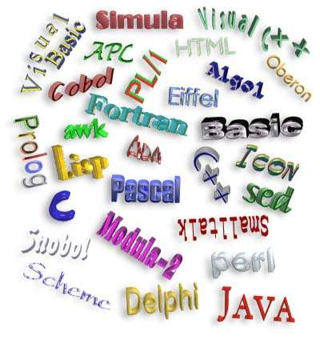
Subject contents III

Slide 11
Home task
Translator
Choose any procedural or object oriented programming language (except C) or make up your own syntax.
Define vocabulary for the language using Flex (or any alternative)
Define grammar rules for the chosen language using GNU Bison (or any alternative). Example on C can be seen here: http://www.lysator.liu.se/c/ANSI-C-grammar-y.html
Write enough functionality to be able to run one of the final tasks.
To demostrate the newly created language, realize one of the given algorithms:
For maximum points: Bubblesort
99-bottles-of-beer http://www.99-bottles-of-beer.net/

Slide 12
Language design I
A:
· Focus on one well known feature at a time, (could be basic as data type)
· Examine many alternative features designed by others & choose the best, rejecting those that are inconsisten
B:
· Choose specific application (logic, financial, etc.)
· Keep design committee small
· Choose precise design goals

Slide 13
Language design II
· Release versions to small sets of interested people
· Revise language definition
· Attempt to build & write formal language definition- semantics
· Revise language definition
· Produce clear and concise manual
· Provide "production quality" compiler and wide distribution
· Write primers explaining language

Slide 14
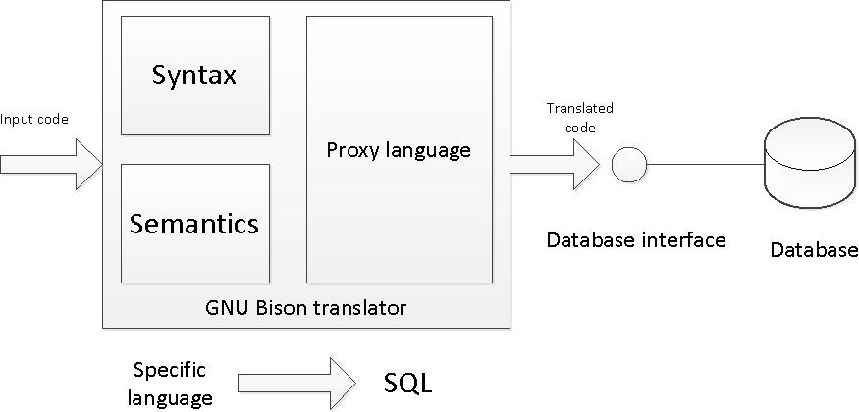
SQL Translator
Make up a language for specific area or task of your choice. An example and a possible choice is a language for managing library.
Create a SQL translator using GNU Bison (or any alternative) to translate your made up language to SQL.
Write a simple database interface for executing the translated SQL queries in a database.
Set up a simple database to demostrate inserting and quering data in the made up language

Slide 15
TRANSLATION VS. INTERPRETATION I
· Translation: program written for level n machine translated to level 1 machine
· Advantages: -statements decoded ONCE -efficient execution
· Disadvantages: -space consumption
· Interpretation: program written for level n + 1 is executed on level n machine
· Advantages: -space conservation
· Disadvantages: -execution

Slide 16
TRANSLATION VS. INTERPRETATION II
TRANSLATORS
· Compiler: high level-> machine
· Assembler: one to one, assembly -> machine
· Loader: relocatable version of machine code -> machine code
· Link editor: combines collections of relocatable programs -> single relocatable machine program
· Pre-processor: extended language -> standard language

Slide 17
TRANSLATION VS. INTERPRETATION III
INTERPRETER
· Fetch op code
· De-code op code
· Fetch necessary operands
· Branch to primitive (OP_{k})
· Then repeat until the end of the program

Slide 18
Criteria for Language ( seminar)
Criteria for Language Design Evaluation
1. efficiency (translation and execution) 2. simplicity (readability and writability) 3. orthogonality
4. definiteness (syntax and semantics) 5. reliability
6. program verification (correctness)
7. abstraction facilities (data and procedural) 8. portability

Slide 19
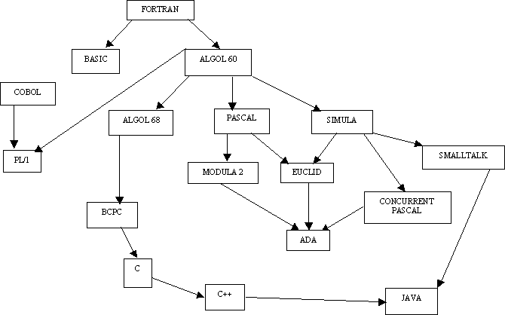
LANGUAGES TREE

Slide 20
Significant Language Features I
Simple to learn
Machine Independent
More natural ways to express mathematical functions
Problem orientated language
Remains close to and exploits the available hardware
Efficient execution
Ability to control storage allocation
More freedom in code layout

Slide 21
Significant Language Features II
· Loops
· Input from the keyboard
· Menu Driven Applications
· System Commands
· Structured Programming
· Subroutines
· Built-In Functions
· User-Defined Functions
· Arrays, sorting, and searches

Slide 22
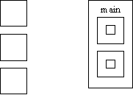
What is an "Algol-like" language?
Algorithmic language for describing
Processes Imperative (most computation
work done in assignment statements)
Block & procedure
Lexical scope
C Algol lexical scope

Slide 23
PSEUDO LANGUAGE I
LANGUAGE ARE ALLOWED TO USE THE FOLLOWING SENTENCES:
x = y; assigment
x = x○y; binary
x = □x; unary
x=x+1 x= succ(x)
x=x -1 x= pred (x) simplification

Slide 24
PSEUDO LANGUAGE II
GOTO M BR M
JMP M
IF x◊y THEN GOTO M x,y € {A} A- set of integers
CMP x,y
B ii M
ii€(NE,EQ,GT,LT,GE,LE)
CMPB X,Y X,Y € {C} C- set of alphabetical symbols
B cc M
cc€(NE,EQ,..........) special functionality

Slide 25
PSEUDO LANGUAGE III
If you compare the form of the IF statement above with the as-
sembler code that must be produced, you can see that there are certain actions associated with each of the keywords in the statement:
IF: First, get the condition and issue the code for it.
Then, create a unique label and emit a branch if false.
ENDIF: Emit the label.
These actions can be shown very concisely if we write the syntax this way:
IF
<condition> { Condition;
L = NewLabel;
Emit(Branch False to L); }
<block>
ENDIF { PostLabel(L) }

Slide 26
PSEUDO LANGUAGE IV
EXAMPLE 1(Pascal)
IF ( condition) THEN sentence1;
ELSE; sentence2;
if: if !(condition) then goto else;
then: sentence1;
goto endif;
endif: program will continue

Slide 27
PSEUDO LANGUAGE V
EXAMPLE 2(C)
DO sentence1; sentence2;.... sentenceN;
WHILE expression;
do : sentence1;sentence2;... sentenceN;
check : calculation of expression;
while : if not expression goto do;

Slide 28
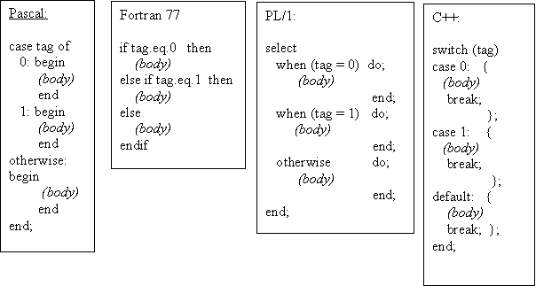
If-then/else or case design issues
· What type of selector expression?
· What types of case labels?
· Can you branch to case labels from outside?
· Mutually exclusive labels?
· Exhaustive label case coverage?

Slide 29
Loop design issues
What type of values may loop variable assume?
· Complexity of loop expression?
· How often is loop variable checked against final value?
· Can loop variable be assignment inside loop body?
· When evaluate stopping expression?
· Transfer permitted outside loop?
· Scope of loop variable?

Slide 30
Exercise 1
Your assignment are to select 3 of the languages (set of languages) and evaluate its standard implementation. You are to assign the language a grade (1 through 8) for each criterion point listed below and to provide written justification for your rating. This set of languages is to include at least the following: Fortran, Cobol, PL/I, Pascal, C, C++, Ada, Lisp, Smalltalk, Basic, Modula-2, Algol, APL, Snobol, Icon, Prolog, Simula, Scheme, Eifel, Oberon, Visual Basic, Visual C++, Perl, Java, Delphi, HTML

Slide 31
Excercise 2
LOOP: DO WHILE (FLAG = 0); PUT SKIP DATA('HELLO WORLD!'); END LOOP; END HELLO;
******Ouput for Hellow World
WRITE(6,*)'Hello world' STOP END
class HelloWorld { public static void main(String args[]) { System.out.println("Hello world!"); }}
#include<stdio.h>
main()
{ printf("Hello World"); }

Slide 32
Test task example
Write an interpreter for the calculator language defined below. You may assume that there are no operator precedence rules if you wish. expression::= operand [ operator operand]. operand ::= 0 | 1 | 2 | 3 | 4 | 5 | 6 | 7 | 8 | 9 operator ::= + | - | * | / You may use any language you wish to do this . You will need to turn in a clearly commented source listing of your program.
Tagasi

Slide 33
Täname, et läbisid kursuse!
Jätka ainete omandamist tarkvaraainete plokist!
Thanks for Your attention!
Tutvu ainetega Infotehnoloogia teaduskonna õppematerjalide kodulehel
Look at www.tud.ttu.ee

