Slide 2
Analysis of Programming Language
Vladimir Viies viis@ati.ttu.ee,
Lembit Jürimägi lembit.jyrimagi@gmail.com
Tallinna Tehnikaülikool
2015

Slide 3
Subject goals
A student has to be able: - to associate tasks with a suitable
algorithmic language;
-to design a special purpose
algorithmic language and create
a compiler for it;

Slide 4
Subject contents I
Classification of algorithmic languages. Universal and specific languages. Comparision of the possibilities of data types, sentences and intramodular data exchange in different languages (FORTRAN , PL/1, PASCAL,Assembler etc.).Assembler. Translators, their components and work principles. Art of translator design.

Slide 5
Subject contents II
LET'S BUILD A COMPILER!
By Jack W. Crenshaw, Ph.D.
This file contains all of the installments of Jack Crenshaw's
tutorial on compiler construction.
The intended audience is those folks who are not computer scientists,
but who enjoy computing and have always wanted to know how compilers
work. A lot of compiler theory has been left out, but the practical
issues are covered. By the time you have completed the series, you
should be able to design and build your own working compiler. It will
not be the world's best, nor will it put out incredibly tight code.
Your product will probably never put Borland or MicroSoft out of
business. But it will work, and it will be yours
http://groups.engin.umd.umich.edu/CIS/course.des/cis400/maxim/

Slide 6
Course structure I
I moodul: Practice(translator design)
II moodul: Seminars(Comparision of the possibilities in different languages, include essay )
III moodul:Homework (create a translator )

Slide 7
Course structure II
1. | 03.09.2015 | Introduction, some examples of what we're going to do - short lecture
2. | 10.09.2015 | Regular Languages, Regular Expressions, Flex
3. | 17.09.2015 | Context Free Grammar, Bison, Postfix/Infix Calculator
4. | 24.09.2015 | Practice Task 1
5. | 01.10.2015 | Abstract Syntax Tree, General Purpose Language
6. | 08.10.2015 | General Purpose Language, cont
7. | 15.10.2015 | Practice Task 2
8. | 22.10.2015 | Evolution of Programming Languages-lecture+ exercise+essay explanation
9. | 29.10.2015 | Test
10. | 05.11.2015 | PICkit/TI Launchpad Assembler
11. | 12.11.2015 | PIC/TI Specific Language
12. | 19.11.2015 | ANTLR (guest lecturer - HK)
13. | 26.11.2015 | ANTLR + custom CPU assembler (guest lecturer - HK / KJ)
14. | 03.12.2015 | Seminar
15. | 10.12.2015 | Seminar
16. | 17.12.2015 | Exam

Slide 8
POINTS I
http://www.tud.ttu.ee/im/Vladimir.Viies/IAG0450.html

Slide 9
POINTS II
max
Practice x 10 ----------25p(10 + 15)
Seminar x 2 -----------10p(inc. essay)
Homework 1 -----------15p(translater)
Test ----------------------- 20p
Written examination--50p
(include test max10p)
Permission to examination(30p)

Slide 10
Language components
1.Alphabet(Latin letters, Arabic numerals and special symbols);
L={ “ A“, “a“...“Z“,“z“} S={“ <“, “>“...“:=“,“#“}
N={“ 0“, “1“...“8“,“9“} A={L,N,S}
2. Number of lexical words;
3. Spelling Rules;
4. Syntax rules.

Slide 11
FORTRAN, FORTRAN IV, FORTRAN 77, FORTRAN 2008.....
IComponents
*Main PROGRAM
*Sub-prougram SUBROUTINE
Expression-FUNCTIONE
*BLOCK DATA (COMMON)
IIPhrases
*Activity phrases
*Descriptions phrases

Slide 12
for(int i=1; i<=n; i++)
:
,
,
for
expression
(initial value)
(
date type
expression
(final value)
logical expression
;
;
,
)
sentence (reapeat)
;
;

Slide 13
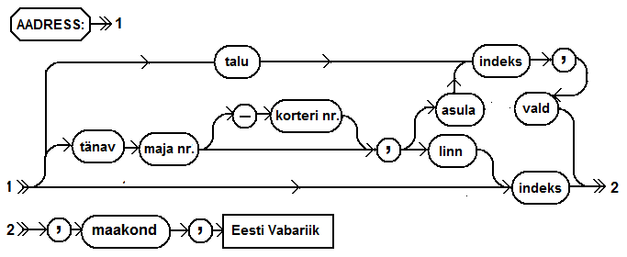
SQL meta-language

Slide 14
TRANSLATION VS. INTERPRETATION I
Translation: program written for level n machine translated to level 1 machine
Advantages: -statements decoded ONCE -efficient execution
Disadvantages: -space consumption
Interpretation: program written for level n + 1 is executed on level n machine
Advantages: -space conservation
Disadvantages: -execution

Slide 15
TRANSLATION VS. INTERPRETATION II
TRANSLATORS
Compiler: high level-> machine
Assembler: one to one, assembly -> machine
Loader: relocatable version of machine code -> machine code
Link editor: combines collections of relocatable programs -> single relocatable machine program
Pre-processor: extended language -> standard language

Slide 16
TRANSLATION VS. INTERPRETATION III
INTERPRETER
Fetch op code
De-code op code
Fetch necessary operands
Branch to primitive (OP_{k})
Then repeat until the end of the program

Slide 17
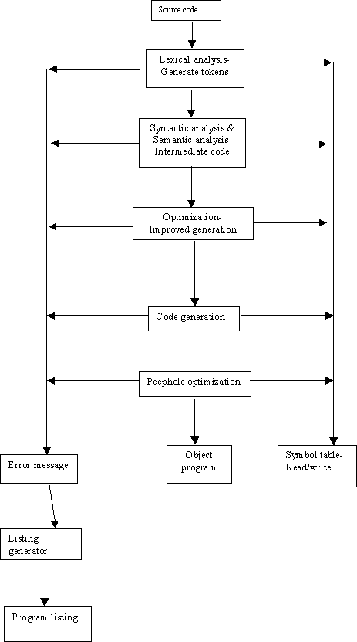
TRANSLATION VS. INTERPRETATION II
Compiler organization phases
• Lexical analysis
• Syntactical analysis
• Semantic analysis
• Optimization
• Code generation

Slide 18
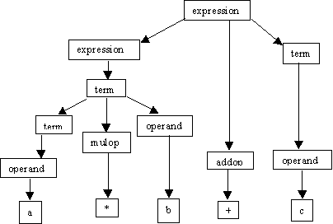
TRANSLATION VS. INTERPRETATION III
Expression ::= term | expression addop term
Term ::= operand | term mulop operand
Operand ::= a | b | c
Addop ::= + | -
Mulop ::= * | /
Natural ::= digit
Integer ::= [ +|- ] natural
Digit ::= 0 | 1 | 2 | 3 | 4 | … Top down parsing: a*b+c

Slide 19
TRANSLATION VS. INTERPRETATION III
Lexical analyzer (or scanner")
• Looks for variables and special words
• Creates spaces in symbol table
• "Lex" is a UNIX tool, (scanner)
Syntactic analyzer
• Parser, (generates parsing tree)
• In UNIX, "yacc" takes output from
"lex" for generating a parse tree
Optimizer
• Performs sub-expression elimination (i.e. in expression: a[i+j] = b[i+j] * c[i+j], the (i+j) will be calculated to a new variable, d, such that: a[d] = b[d] * c[d])
• Strength reduction (i.e. L = Length(str1 || str2) is changed to the simpler to compute expression L = Length(str1) || Length(str2))
• Loop optimization

Slide 20
Home task
Translator
Choose any procedural or object oriented programming language (except C) or make up your own syntax.
Define vocabulary for the language using Flex (or any alternative)
Define grammar rules for the chosen language using GNU Bison (or any alternative). Example on C can be seen here: http://www.lysator.liu.se/c/ANSI-C-grammar-y.html
Write enough functionality to be able to run one of the final tasks.
To demostrate the newly created language, realize one of the given algorithms:
For maximum points: Bubblesort
99-bottles-of-beer http://www.99-bottles-of-beer.net/

Slide 21
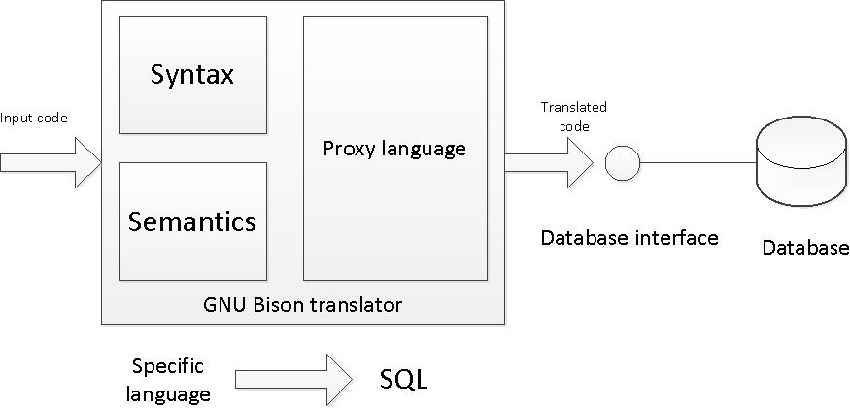
SQL Translator
Make up a language for specific area or task of your choice. An example and a possible choice is a language for managing library.
Create a SQL translator using GNU Bison (or any alternative) to translate your made up language to SQL.
Write a simple database interface for executing the translated SQL queries in a database.
Set up a simple database to demostrate inserting and quering data in the made up language

Slide 22
Language design I
A:
Focus on one well known feature at a time, (could be basic as data type)
Examine many alternative features designed by others & choose the best, rejecting those that are inconsisten
B:
Choose specific application (logic, financial, etc.)
Keep design committee small
Choose precise design goals

Slide 23
Language design II
Release versions to small sets of interested people
Revise language definition
Attempt to build & write formal language definition- semantics
Revise language definition
Produce clear and concise manual
Provide "production quality" compiler and wide distribution
Write primers explaining language

Slide 24
Criteria for Language ( seminar)
Criteria for Language Design Evaluation
1. efficiency (translation and execution) 2. simplicity (readability and writability) 3. orthogonality
4. definiteness (syntax and semantics) 5. reliability
6. program verification (correctness)
7. abstraction facilities (data and procedural) 8. portability

Slide 25
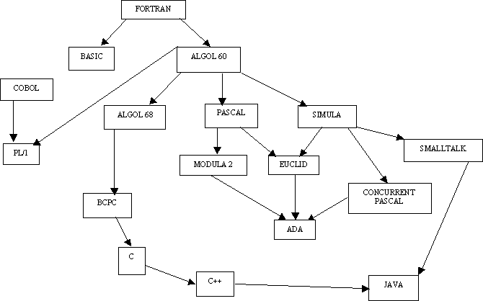
LANGUAGES TREE

Slide 26
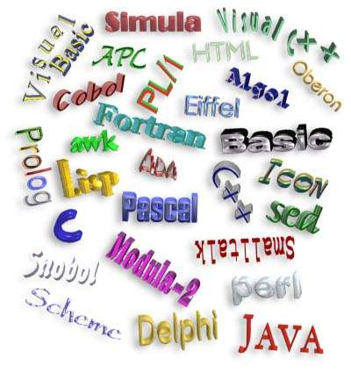
Amount of Languages

Slide 27
Significant Language Features I
Simple to learn
Machine Independent
More natural ways to express mathematical functions
Problem orientated language
Remains close to and exploits the available hardware
Efficient execution
Ability to control storage allocation
More freedom in code layout

Slide 28
Significant Language Features ( www.fortran.com)
Some of the more significant features of the language are as listed below:
Simple to learn - when FORTRAN was design one of the objectives was to write a language that was easy to learn and understand.
Machine Independent - allows for easy transportation of a program from one machine to another.
More natural ways to express mathematical functions - FORTRAN permits even severely complex mathematical functions to be expressed similarly to regular algebraic notation.
Problem orientated language
Remains close to and exploits the available hardware
Efficient execution - there is only an approximate 20% decrease in efficiency as compared to assembly/machine code.
Ability to control storage allocation -programmers were able to easily control the allocation of storage (although this is considered to be a dangerous practice today, it was quite important some time ago due to limited memory.
More freedom in code layout - unlike assembly/machine language, code does not need to be laid out in rigidly defined columns, (though it still must remain within the parameters of the FORTRAN source code form).

Slide 29
Significant Language Features II
· Loops
· Input from the keyboard
· Menu Driven Applications
· System Commands
· Structured Programming
· Subroutines
· Built-In Functions
· User-Defined Functions
· Arrays, sorting, and searches

Slide 30
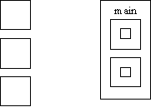
What is an "Algol-like" language?
Algorithmic language for describing
Processes Imperative (most computation
work done in assignment statements)
Block & procedure
Lexical scope
C Algol lexical scope

Slide 31
PSEUDO LANGUAGE I
LANGUAGE USE ALLOWED
x = y; assignment
x = x○y; binary
x = □x; unary
x=x+1 x= succ(x) pred (x) simplification

Slide 32
PSEUDO LANGUAGE II
GOTO M BR M
JMP M
IF x◊y THEN GOTO M x,y € {A} A- number of integers
CMP x,y
B ii M
ii€(NE,EQ,GT,LT,GE,LE) specifications
CMPB X,Y X,Y € {C} C-amount of symbols of the alphabet
B cc M
cc€(NE,EQ,..........) specifications

Slide 33
PSEUDO LANGUAGE III
If you compare the form of the IF statement above with the as-
sembler code that must be produced, you can see that there are
certain actions associated with each of the keywords in the
statement:
IF: First, get the condition and issue the code for it.
Then, create a unique label and emit a branch if false.
ENDIF: Emit the label.
These actions can be shown very concisely if we write the syntax this way:
IF
<condition> { Condition;
L = NewLabel;
Emit(Branch False to L); }
<block>
ENDIF { PostLabel(L) }

Slide 34
PSEUDO LANGUAGE IV
EXAMPLE 1(Pascal)
IF (condition) THEN sentence1;
ELSE; sentence2;
if: if !(condition) then goto else;
then: sentence1;
goto endif;
endif: the program will continue

Slide 35
PSEUDO LANGUAGE V
EXAMLE 2(C)
DO sentence1; sentence2;....sentenceN;
WHILE expression ;
do : sentence1; sentence2;..sentenceN;
check : expression computing;
while : if not expression goto do;

Slide 36
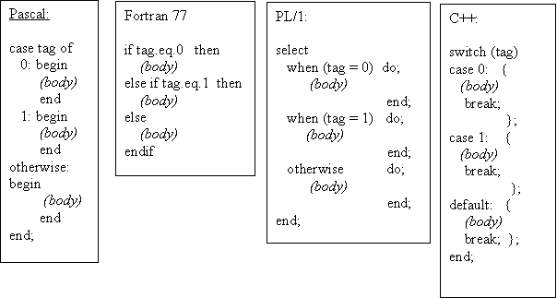
If-then/else or case design issues
· What type of selector expression?
· What types of case labels?
· Can you branch to case labels from outside?
· Mutually exclusive labels?
· Exhaustive label case coverage?

Slide 37
Loop design issues
What type of values may loop variable assume?
Complexity of loop expression?
How often is loop variable checked against final value?
Can loop variable be assignment inside loop body?
When evaluate stopping expression?
Transfer permitted outside loop?
Scope of loop variable?

Slide 38
Exercise 1
Your assignment are to select 3 of the languages (set of languages) and evaluate its standard implementation. You are to assign the language a grade (1 through 8) for each criterion point listed below and to provide written justification for your rating. This set of languages is to include at least the following: Fortran, Cobol, PL/I, Pascal, C, C++, Ada, Lisp, Smalltalk, Basic, Modula-2, Algol, APL, Snobol, Icon, Prolog, Simula, Scheme, Eifel, Oberon, Visual Basic, Visual C++, Perl, Java, Delphi, HTML, ...

Slide 39
Excercise 2
LOOP: DO WHILE (FLAG = 0); PUT SKIP DATA('HELLO WORLD!'); END LOOP; END HELLO;
******Ouput for Hellow World
WRITE(6,*)'Hello world' STOP END
class HelloWorld {
public static void main(String args[])
{ System.out.println("Hello world!"); }}
#include<stdio.h>
main()
{ printf("Hello World"); }

Slide 40
Test task example
Write an interpreter for the calculator language defined below. You may assume that there are no operator precedence rules if you wish. expression::= operand [ operator operand]. operand ::= 0 | 1 | 2 | 3 | 4 | 5 | 6 | 7 | 8 | 9 operator ::= + | - | * | / You may use any language you wish to do this . You will need to turn in a clearly commented source listing of your program.

Slide 41
Täname, et läbisid kursuse!
Jätka ainete omandamist tarkvaraainete plokist!
Thanks for Your attention!
Tutvu ainetega Infotehnoloogia teaduskonna õppematerjalide kodulehel
Look at www.tud.ttu.ee

