Slide 1

Analysis of Programming Languages 2
Lembit Jürimägi lembit.jyrimagi@gmail.com
Vladimir Viies vladimir.viies@gmail.com
Tallinna Tehnikaülikool

Slide 2
Major Requirements of an Operating System
Interleave the execution of several processes to maximize processor utilization while providing reasonable response time
Allocate resources to processes
Support interprocess communication and user creation of processes

Slide 3
Modes of Execution
User mode
  Less-privileged mode
  User programs typically execute in this mode
System mode, control mode, or kernel mode
  More-privileged mode
  Kernel of the operating system

Slide 4
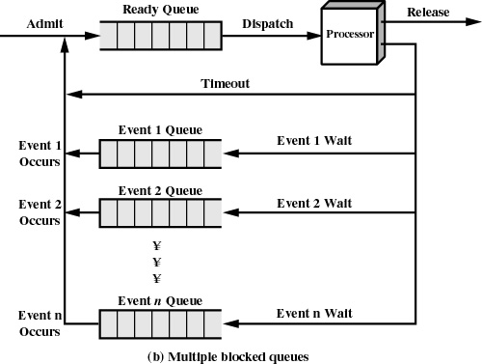

Slide 5
Reasons for Process Termination
I/O failure
Invalid instruction
  happens when try to execute data
Privileged instruction
Data misuse
Operating system intervention
  such as when deadlock occurs
Parent terminates so child processes terminate
Parent request

Slide 6
When to Switch a Process
Clock interrupt
  process has executed for the maximum allowable time slice
I/O interrupt
Memory fault
  memory address is in virtual memory so it must be brought into main memory

Slide 7
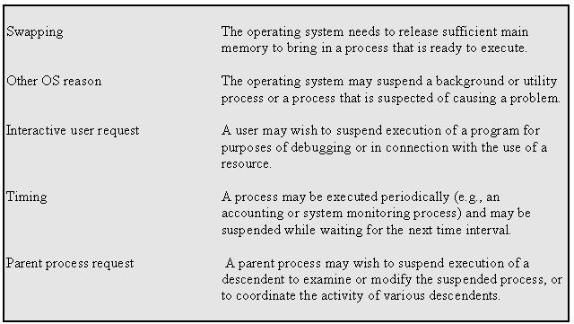
Reasons for Process Suspension

Slide 8
Memory Tables
Allocation of main memory to processes
Allocation of secondary memory to processes
Protection attributes for access to shared memory regions
Information needed to manage virtual memory

Slide 9
State
Instructions - represent state transition via program execution
You have a choice:
  implement with hardware, (quick yet inflexible)
  implement with software, (slow and flexible)

Slide 10
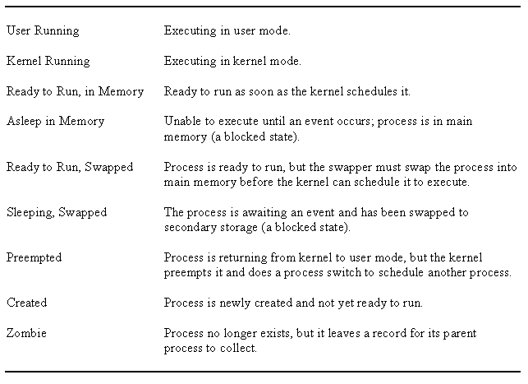
UNIX Process States

Slide 11
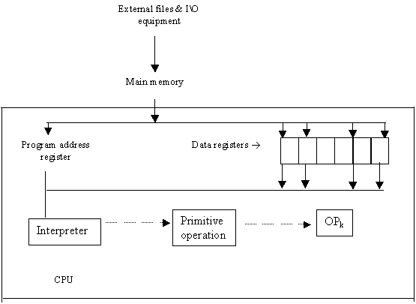
COMPUTER ORGANIZATION

Slide 12
Evaluation of program language
Efficient translation
Efficient execution
Writeability
Simplicity- all features of the language should be easy to learn and master
Expressiveness
Definiteness
Readability
Reliability- static and dynamic checking
Static during compile
Dynamic during execution

Slide 13
Language evaluation I
Expressivity- readability
Well defined- syntax, semantics
I/O facilities
Portability
Efficiency
Pedagogy - easy to teach & learn
Generality - useful in wide range of applications

Slide 14
Language evaluation II
Readability :
  Simplicity
  Orthogonality
  Control statements
  Data structures
  Syntax

Slide 15
Language evaluation III
Writeability:
  Simplicity
  Orthogonality
  Support for abstraction
Reliability:
  Type checking
  Exception handling
  Readability / writeability
  Aliasing – 2 different ways to refer to the same spot in memory / storage

Slide 16
Language evaluation IV
Cost:
  Training
  Code development
  Compilation
  Execution
  Maintenance

Slide 17
ESSENTIAL CHARACTERISTICS
Well defined syntactic and semantic definition of language
Reliability
Fast translation
Efficient object code
Orthogonality
Machine independence

Slide 18
DESIRABLE CHARACTERISTICS
Provability
Generality
Consistency with commonly used notations
Subsets
Uniformity
Extensibility (ease to add features)

Slide 19
Significant Language Features I
Simple to learn
Machine Independent
More natural ways to express mathematical functions
Problem orientated language
Remains close to and exploits the available hardware
Efficient execution
Ability to control storage allocation
More freedom in code layout

Slide 20
Significant Language Features II
Loops
Input from the keyboard
Menu Driven Applications
System Commands
Structured Programming
Subroutines
Built-In Functions
User-Defined Functions
Arrays, sorting, and searches

Slide 21
Language design I
Focus on one well known feature at a time, (could be basic as data type)
Examine many alternative features designed by others & choose the best, rejecting those that are inconsistent

Slide 22
Language design II
Choose specific application (logic, financial, etc.)
Keep design committee small
Choose precise design goals
Choose precise design goals
Release versions to small sets of interested people
Revise language definition
Attempt to build compiler & write formal language definition- semantics
Produce clear and concise manual
Provide "production quality" compiler and wide distribution
Write primers explaining language

Slide 23
Language design III
Release versions to small sets of interested people
Revise language definition
Attempt to build & write formal language definition- semantics
Revise language definition
Produce clear and concise manual
Provide "production quality" compiler and wide distribution
Write primers explaining language

Slide 24
Language processors
Computers - integrated set of algorithms & data structures capable of storing and executing programs
Composite - actual (hardware) computer-wires and circuits
Computer - software simulated computer
Programming language is implemented by developing a translator capable of transforming programs in one language into machine language of some computer where it can be executed correctly

Slide 25
COMPUTER AS A MULTI-LEVEL MACHINE
Each level supported by the level below it
level 5 => problem oriented language translated (by compiler)
level 4 => assembly language level (translated by assembly)
level 3 => operating system (partial interpretation by OS)
level 2 => conventional machine language (interpreted by micro-program)
level 1 => micro-programming (directly executed by hardware)
level 0 => digital logic (gates & transistors program address registers)

Slide 26
TRANSLATION VS. INTERPRETATION I
Translation: program written for level n machine translated to level 1 machine
Advantages: - statements decoded ONCE -efficient execution
Disadvantages: - space consumption
Interpretation: program written for level n + 1 is executed on level n machine
Advantages: - space conservation
Disadvantages: - execution

Slide 27
TRANSLATION VS. INTERPRETATION II
TRANSLATOR
Compiler: high level -> machine
Assembler: one to one, assembly -> machine
Loader: relocatable version of machine code -> machine code
Link editor: combines collections of relocatable programs -> single relocatable machine program
Pre-processor: extended language -> standard language

Slide 28
TRANSLATION VS. INTERPRETATION III
INTERPRETER
Fetch op code
De-code op code
Fetch necessary operands
Branch to primitive (OP_{k})
Then repeat until the end of the program

Slide 29
Fortran
Compiler completed 1957
Mostly using assembly languages
Fortran 1 & 2 designed while the Fortran 0 compiler was in development stage
Fixed fields in source code (columns 1-5 labels, 6 'continue', 7-72 source, 73-80 sequence fields)
Implicit typing (I-N was integer variable types, all else was floating point)
Arithmetic 'if' (<0, =0, >0)
'Do' iterator
Formatted I/O
Comments

Slide 30
Algol
1963 Naur developed Algol 60 ('root' for Pascal, PL/1, Ada)
'Free' format (freedom of indentation, spacing, etc)
Reserved words (certain words could not be variable names)
Explicit typing (variable type had to be explicitly defined)
General iterator (similar to 'while')
Block structure
Recursive procedures
Dynamic array bounds
Value parameters

Slide 31
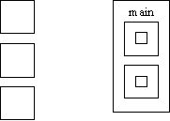
What is an "Algol-like" language?
Algorithmic language for describing processes
Imperative (most computation work done in assignment statements)
Block & procedure
Lexical Scope
C Algol

Slide 32
An "Algol-like" language
Lexical scope is where the variable is visible and allows nested subroutines, need order
Type checking
IBM in its wisdom gave away FORTRAN with all its new computers creating wide spread support for FORTRAN and undermining Algol support
Both type-checking and scope was not so good in Algol, this resulted in reduced reliability
Industry preferred Fortran, academics preferred Algol

Slide 33
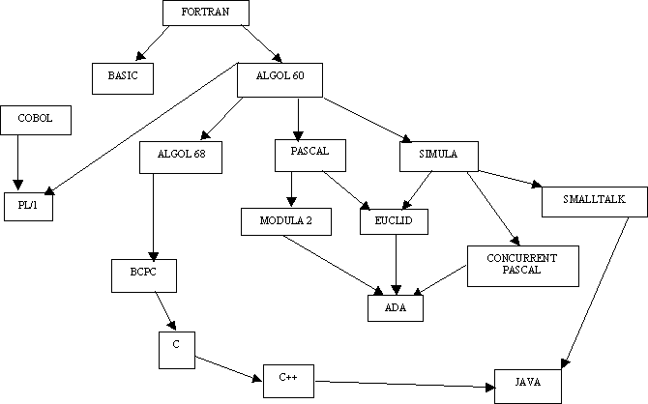
LANGUAGES TREE

Slide 34
COBOL
1959 Dept. of Defense wanted a single language
1960 Remington (Rand) developed the first compilers
Machine independent
General if/then else
'Noise' words (almost English-like, so lowly accountants could follow programs i.e. they didn’t have to know how to program to know what the code represented)

Slide 35
APL
IBM 1960 (Ken Iverson)
Very compact notation for computation
Provided for much matrix manipulation
NOT Algol-like in nature
Originally built to describe specifications of IBM360

Slide 36
LISP
Developed at MIT, (and others) by John McCarthy, AI is its application domain
Symbolic expression, able to manipulate variable names like variable values (i.e. pointer arithmetic)
Uniform representation for expression (data=code) executable data structures.
New form of conditional expression (similar to "switch" statements)
Pre-fix expressions - operator followed by arguments
Recursion more widely used
"Garbage collection" used for data management
A "linked-list" type of structure is the basic structure in LISP

Slide 37
Data objects in Lisp
"Atoms", (either literal or numeric, i.e. 'sam or 3)
List- groups of atoms or lists nested list representation is ((1 2) (3 4))
Expression - atoms and lists together
There are no reserved words for literal except:
The literal T is for boolean true
The literal NIL = '( ) or false
In Lisp
; is for commenting like // for C++. So ; this comment is not recognized by interpreter
' is to read "as is" and not for interpretation

Slide 38
Functional programming
Sequence control
  Used in expressions, (e.g. Precedence rules, parenthesis)
  Between statements or blocks, (e.g. Iteration and conditionals)
  Between sub-programs, (e.g. Calls)
Control sequences
  Implied, (physical statement order)
  Explicit, (parenthesis or goto's)

Slide 39
Parsing formulas
Root = -b ± (b²-4ac)^{1/2}
2a
In Fortran:
Root = ( -b + Sqrt ( b**2 - 4*a*c))/2*a
In some instances, parenthesis are essential, in others they are not.
(a + b)*(c - a) in-fix notation
* + a b - c a pre-fix notation
a b + c a - * post-fix notation
What is the difference between unary and binary minus?
(i.e. how does "-b" and "b²-4ac" in the quadratic formula differ in terms of language definition?)

Slide 40
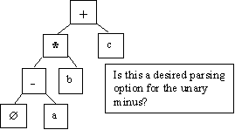
Tree representation issues
-a * b + c in-fix notation
Binary vs. unary operator confusion
Precedence rules
Associativity
  left to right
  right to left, (eliminates the need for parenthesis for the "2a" in the denominator of the quadratic)
Operators with varying number of operands, ( i.e. (+ 2 3 4))

Slide 41
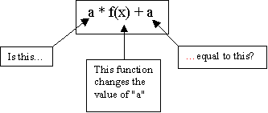
Problem areas
Uniform evaluation-once a tree is formed, all operands are treated equally
Side effects:
Error conditions: arithmetic over- or under-flow, (i.e. 4/ (200 * 10,000,000))
Short circuited boolean evaluation:
  (a = 0) OR (b / a > c) in short circuit evaluation, the "OR" is evaluated until a "true" is found.
  With full boolean evaluation, the "b/a", where a = 0, is evaluated first. This results in a run-time error.

Slide 42
Alternating (conditional statements)
„Dangling else" issue:
if x = 3 then
y = 5
if x = 5 then
y = 6
else y = 7 // WHICH "IF" GETS THE "ELSE"?
in C++ {} is used to define where the else belongs

Slide 43
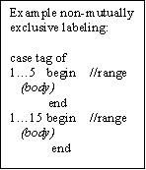
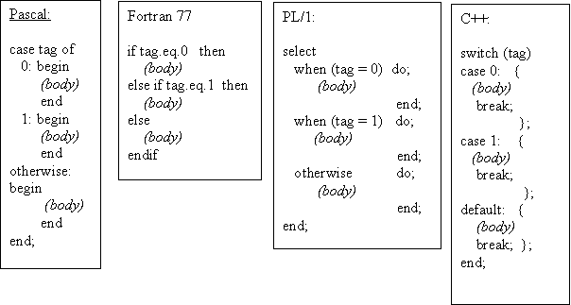
Case design issues
What type of selector expression?
What types of case labels?
Can you branch to case labels from outside?
Mutually exclusive labels?
Exhaustive label case coverage?

Slide 44
Loop design issues
What type of values may loop variable assume?
Complexity of loop expression?
How often is loop variable checked against final value?
Can loop variable be assigned to inside loop body?
When to evaluate stopping expression?
Transfer permitted outside loop?
Scope of loop variable?
Multiple loop exits
"Loop and a half", (test in middle of loop)

Slide 45
Functional programming ... applicative languages
f(x) = x * x
f(2) = 2 * 2
f(z + 1) = (z + 1) * (z + 1)
"lambda" notation:
in Pyton adder = lambda x, y: x + y
print (adder (1, 2))
(λx x*x)2 = 2 * 2 = 4
f = λx.x*x
global = non-lambda variable
f = g • h = g(h(x)) functional languages permit this

Slide 46
Functional / applicative languages
Set of "primitives"
Set of functional forms, (for new functions)
Application operation, (apply function to arguments)
Set of data objects

Slide 47
How math functions differ form computational functions
Modifiable variable in computing
Program functions have side effects
Programming functions defined procedurally in steps - math functions typically done in terms of other functions
Both can be recursive

Slide 48
Functional languages
More expressive, the expression is more important than assignment or control statement
i.e. in C:
max = x > y ? x : y;
OR
if x > y then
max = x;
else max = y;
But what is "x" in the following expression?
f(x) + (x) = 2 * f(x)
"side effect" or referential transparency

Slide 49
PSEUDO LANGUAGE I
LANGUAGE ARE ALLOWED TO USE THE FOLLOWING SENTENCES:
x = y; assigment
x = x○y; binary
x = □x; unary
x = x + 1 x = succ(x)
x = x - 1 x = pred(x)

Slide 50
PSEUDO LANGUAGE II
GOTO M BR M
JMP M
IF x◊y THEN GOTO M x,y € {A} A- set of integers
CMP x,y ◊€(<,>,=,!=,>=,<=)
B ii M
ii€(NE,EQ,GT,LT,GE,LE)
CMPB X,Y X,Y € {C} C- set of alphabetical symbols
B cc M
cc€(NE,EQ,..........) special functionality

Slide 51
PSEUDO LANGUAGE III
If you compare the form of the IF statement above with the assembler code that must be produced, you can see that there are certain actions associated with each of the keywords in the statement:
IF: First, get the condition and issue the code for it.
Then, create a unique label and emit a branch if false.
ENDIF: Emit the label.
These actions can be shown very concisely if we write the syntax this way:
IF
<condition> { Condition;
L = NewLabel;
Emit(Branch False to L); }
<block>
ENDIF { PostLabel(L) }

Slide 52
PSEUDO LANGUAGE IV
EXAMPLE 1(Pascal)
IF ( condition) THEN sentence1;
ELSE sentence2;
if: if !(condition) then goto else;
then: sentence1;
goto endif;
else: sentence2;
endif: program will continue

Slide 53
PSEUDO LANGUAGE V
EXAMPLE 2(C)
DO sentence1; sentence2;... sentenceN;
WHILE expression;
do : sentence1;sentence2;... sentenceN;
check : calculation of expression;
while : if not expression goto do;

Slide 54
Exercise 1
Your assignment are to select 3 of the languages (set of languages) and evaluate its standard implementation.
You are to assign the language a grade (1 through 8) for each criterion point listed below and to provide written justification for your rating.
This set of languages is to include at least the following: Fortran, Cobol, PL/I, Pascal, C, C++,C#, Ada, Lisp, Smalltalk, Basic, Modula-2, Algol, APL, Snobol, Icon, Prolog, Simula, Scheme, Eifel, Oberon, Visual Basic, Visual C++, Perl, Java, Delphi, HTML,Pyton…

Slide 55
Exercise 2
HELLO: PROCEDURE OPTIONS (MAIN); FLAG = 0;LOOP: DO WHILE (FLAG = 0); PUT SKIP DATA('HELLO WORLD!'); END LOOP;END HELLO;
******Output for Hello World
WRITE(6,*)'Hello world' STOP END
class HelloWorld { public static void main(String args[]) { System.out.println("Hello world!"); }}
#include<stdio.h>
main()
{ printf("Hello World"); }

Slide 56
Test task example
Write an interpreter for the calculator language defined below. You may assume that there are no operator precedence rules if you wish.
expression ::= operand [ operator operand]
operand ::= 0 | 1 | 2 | 3 | 4 | 5 | 6 | 7 | 8 | 9
operator ::= + | - | * | /
You may use any language you wish to do this.
You will need to turn in a clearly commented source listing of your program.

