Slide 1
Malware Hunting with the Sysinternals Tools
SIA302
Mark Russinovich
Technical Fellow
Windows Azure

Slide 2
“During 4Q11, 33 percent of Web malware encountered was zero-day malware not detectable by traditional signature-based methodologies at the time of encounter”
Cisco 4Q11 Global Threat Report

Slide 3
About this Talk
Learn about Sysinternals tools and techniques for analyzing and cleaning malware
  Professional antimalware analysis requires years of deep training
  But even for professionals, Sysinternals tools can prove useful
Analyzing:
  Understanding the impact of malware
  Can be used to understand malware operation
  Generates road map for cleaning infestations
Cleaning:
  Removing an infestation of a compromised system
  Attempting a clean can also reveal more information about malware’s operation

Slide 4
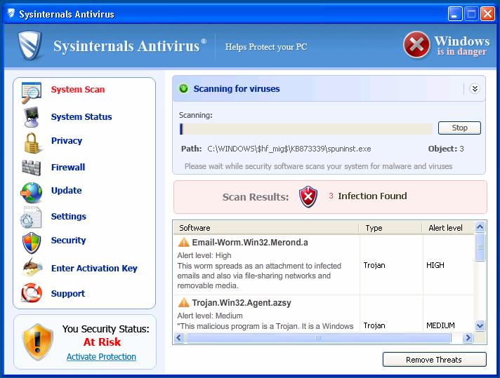
Sysinternals Antivirus
Don’t use it!
  I didn’t write it!
  It’s not very good (actually,
  it’s malware)
  They don’t even link to
  Sysinternals.com ☹

Slide 5
Malware Cleaning Steps
Disconnect from network
Identify malicious processes and drivers
Terminate identified processes
Identify and delete malware autostarts
Delete malware files
Reboot and repeat

Slide 6
Identifying Malware Processes

Slide 7
What Are You Looking For?
Investigate processes that…
…have no icon
…have no description or company name
…unsigned Microsoft images
…live in Windows directory or user profile
…are packed
…include strange URLs in their strings
…have open TCP/IP endpoints
…host suspicious DLLs or services

Slide 8
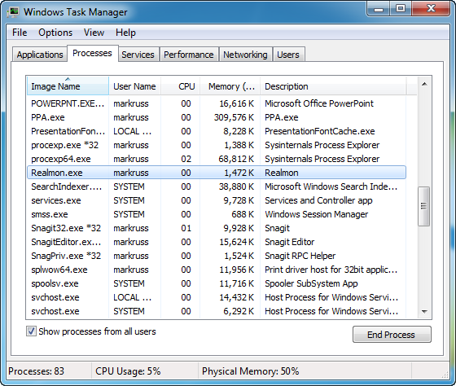
What About Task Manager?
Task Manager provides little information about images that are running

Slide 9
Process Explorer
Process Explorer is “Super Task Manager”
Has lots of general troubleshooting capabilities:
  DLL versioning problems
  Handle leaks and locked files
  Performance troubleshooting
  Hung processes
We’re going to focus on its malware cleaning capabilities

Slide 10
The Process View
The process tree shows parent-child relationships
Icon, description, and company name are pulled from image version information
  Most malware doesn’t have version information
  What about malware pretending to be from Microsoft?
    We’ll deal with that shortly…
Use the Window Finder (in the toolbar) to associate a window with its owning process
Use the Search Online menu entry to lookup unknown processes
  But malware often uses totally random or pseudo-random names

Slide 11
Refresh Highlighting
Refresh highlighting highlights changes
  Red: process exited
  Green: new process
Change duration (default 1 second) in Options
Press space bar to pause and F5 to refresh
Cause display to scroll to make new processes visible with Show New Processes option
We’ll see how to spot short-lived processes later…

Slide 12
Process-type Highlights
Blue processes are running in the same security context as Process Explorer
Pink processes host Windows services
Purple highlighting indicates an image is “packed”
  Packed can mean compressed or encrypted
  Malware commonly uses packing (e.g. UPX) to make antivirus signature matching more difficult
  Packing and encryption also hides strings from view
There are a few other colors, but they’re not important for malware hunting

Slide 13
Tooltips
Process tooltips show the full path to the process image
Malware more often hides behind Svchost, Rundll32 and Dllhost
  Tooltip for Rundll32 processes shows hosted DLL
  Dllhost tooltip shows hosted COM server
  Tooltip for service processes shows hosted services
    Services covered in detail shortly…

Slide 14
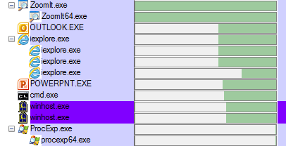
New in v15.2
Autostart locations
  Reports where image is registered for autostart or loading
  Not necessarily what caused the process to execute, though
Process timeline:

Slide 15
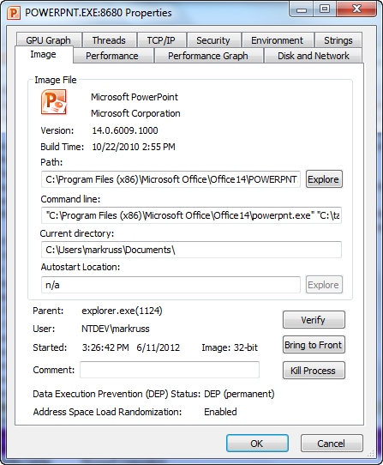
Detailed Process Information
Double-click on a process to see detailed information
Pages relevant to malware analysis:
  Image: signing status, start time, version
  TCP/IP: open endpoints
  Strings: printable strings in main executable

Slide 16
Image Verification
All (well, most) Microsoft code is digitally signed
  Hash of file is signed with Microsoft’s private key
  Signature is checked by decrypting signed hash with the public key
You can selectively check for signatures with the Verify button on the process image tab
  Select the Verify Image Signatures option to check all
  Add the Verified Signer column to see all
Note that verification will connect to the Internet to check Certificate Revocation List (CRL) servers

Slide 17
Sigcheck and ListDlls
Scan the system for suspicious executable images
Look for same characteristics as suspicious processes
  Be especially wary of items in the \Windows directory and the \Users\<username>\Appdata directories
  Investigate all unsigned images
ListDlls will scan running processes for unsigned DLLs
sigcheck -e -u -s c:\
listdlls -u

Slide 18
Strings
On-disk and in-memory process strings are visible on the Strings tab
  There’s only a difference if the image is compressed or encrypted
Strings can help provide clues about unknown processes
  Look for URLs, names and debug strings
You can also dump strings with the command-line Strings utility from Sysinternals
strings <file>

Slide 19
The DLL View
Malware can hide as a DLL inside a legitimate process
  We’ve already seen this with Rundll32 and Svchost
  Typically loads via an autostart
  Can load through “dll injection”
  Packing highlight shows in DLL view as well
Open the DLL view by clicking on the DLL icon in the toolbar
  Shows more than just loaded DLLs
  Includes .EXE and any “memory mapped files”
Can search for a DLL with the Find dialog
DLL strings are also viewable on the DLL properties

Slide 20
Terminating Malicious Processes
Don’t kill the processes
  Malware processes are often restarted by watchdogs
Instead, suspend them
  Note that this might cause a system hang for Svchost processes
  Record the full path to each malicious EXE and DLL
After they are all asleep then kill them
  Watch for restarts with new names…

Slide 21
Cleaning Autostarts

Slide 22
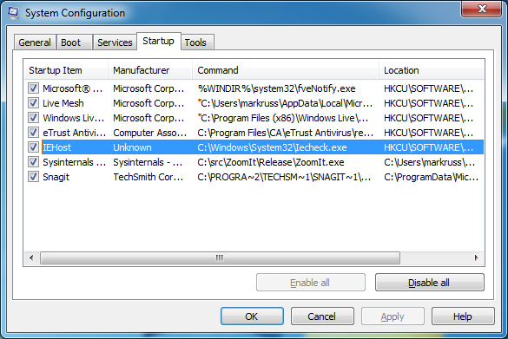
Investigating Autostarts
Windows Msconfig (Start->Run->Msconfig) falls short when it comes to identifying autostarting applications
  It knows about few locations
  It provides little information

Slide 23
Autoruns
Shows every place in the system that can be configured to run something at boot & logon
  Standard Run keys and Startup folders
  Shell, userinit
  Services and drivers
  Tasks
  Winlogon notifications
  Explorer and IE addins (toolbars, Browser Helper Objects, …)
  More and ever growing…
Each startup category has its own tab and all items display on the Everything tab
  Startup name, image description, company and path

Slide 24
Identifying Malware Autostarts
Zoom-in on add-ons (including malware) by selecting these filter options:
  Verify Code Signatures
  Hide Microsoft Entries
Select an item to see more in the lower window
  Online search unknown images
  Double-click on an item to look at where its configured in the Registry or file system
Has other features:
  Can display other profiles
  Can also show empty locations (informational only)
  Includes compare functionality
  Includes equivalent command-line version, Autorunsc.exe

Slide 25
Deleting Autostarts
Delete suspicious autostarts
  You can disable them if you’re not sure
After you’re done do a full refresh
If they come back, run Process Monitor to see who’s putting them back
  You might have misidentified a malware process
  It might be a hidden, system, or legitimate process

Slide 26
Tracing Malware Activity

Slide 27
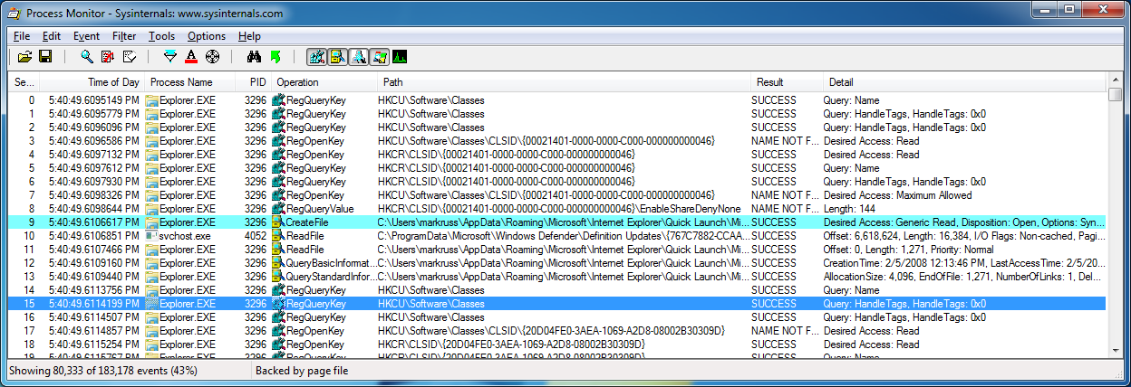
Tracing Malware
Tracing activity can reveal the system impact of malware
  Tracing shows initial infection, before cloaking is applied
  Can reveal the internals of “buddy system” and other infection-protection mechanisms
Process Monitor makes tracing easy
  A simple filter can identify all system modifications
  Investigating stacks can distinguish legitimate activity from malicious activity

Slide 28
Process Monitor
Process Monitor is a real-time file, registry, process and thread monitor
It replaces Filemon and Regmon
  More advanced filtering
  Operation call stacks
  Boot-time logging
  Data mining views
  Process tree to see short-lived processes
When in doubt, run Process Monitor!
  It will often show you the cause for error messages
  It many times tells you what is causing sluggish performance

Slide 29
Event Classes
File system (Filemon)
  Includes I/O command input and output details
Registry (Regmon)
  Includes all data (First 16-bytes part of REG_BINARY and first 2048-bytes for other types)
Process
  Process create and exit
  Thread create and exit
  Image loads, including drivers
Network
  ETW network tracing
Profiling
  Toolhelp thread snapshots

Slide 30
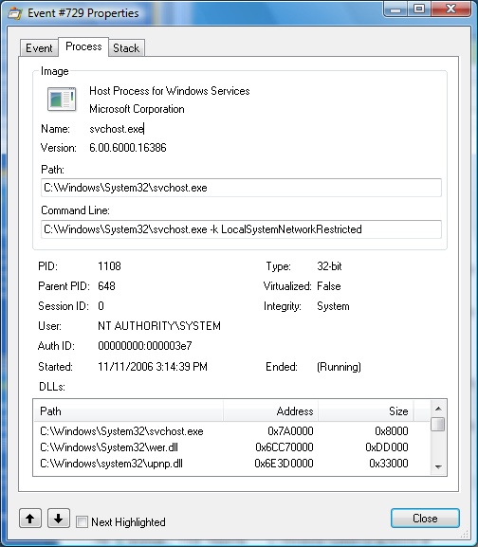
Event Properties
Event details
  Duration, process, thread,
  details, etc.
Process information
  Command line
  User
  Session and logon session
  Image information
  Start time
Thread stack at time of event

Slide 31
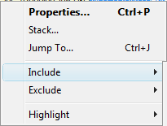
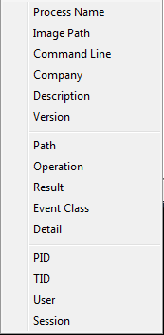

Filtering
To filter on a value, right-click on the line and select the attribute from the Include, Exclude or Highlight submenus
  You can select multiple
  values simultaneously
When you set a highlight
filter you can move
through highlighted event
properties

Slide 32
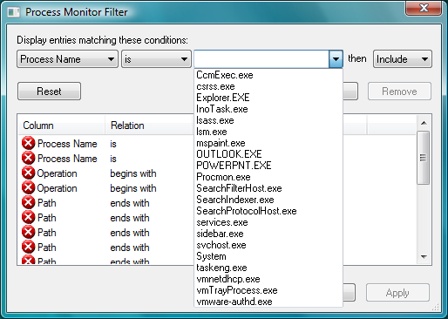
Advanced Filters
Multiple-filter behavior:
  Values from different attributes are AND’d
  Values for the same attribute are OR’d
More complex filtering is available in the Filter dialog
  Outlook-style rule definition
You can save and restore
filters
Filter for watching
malware impact:
“Category is Write”

Slide 33
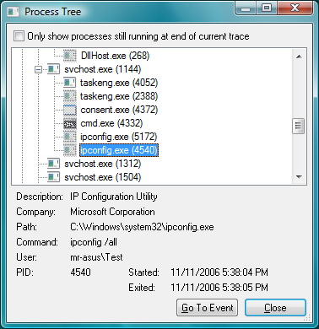
The Process Tree
Tools->Process Tree
  Shows all processes that have been seen in the trace (including parents)
  Can toggle on and off terminated processes
The process tree provides an easy way to see process relationships
  Short-lived processes
  Command lines
  User names

Slide 34
Real World Analysis and Cleaning

Slide 35
The Case of the Sysinternals-Blocking Malware
Friend asked user to take a look at system suspected of being infected with malware
  Boot and logons took a long time
  Microsoft Security Essentials (MSE) malware scan would never complete
  Nothing jumped out in Task Manager
Tried running Sysinternals tools, but all exited immediately after starting:
  Autoruns
  Process Monitor
  Process Explorer
  Even Notepad opening a text file named “Process Explorer” would also terminate

Slide 36
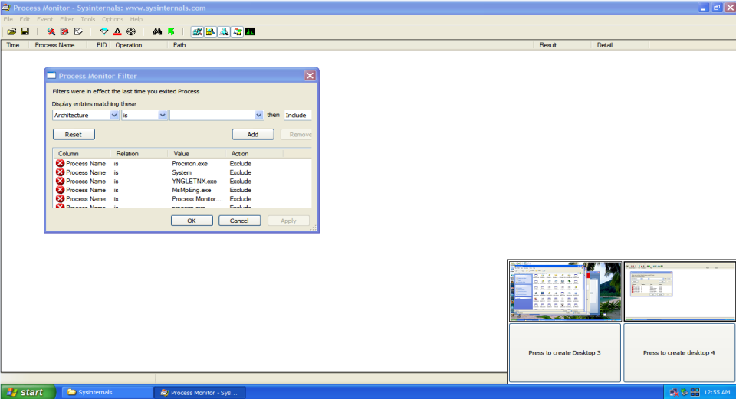
The Case of the Sysinternals-Blocking Malware (Cont)
Looking through Sysinternals suite, noticed Desktops utility
  Hoped malware might not be smart enough to monitor additional desktops
Sure enough, was able to launch Process Monitor and other tools:
  Malware probably
  looks for tools in
  window titles
  Window enumeration
  only returns windows
  of current desktop

Slide 37
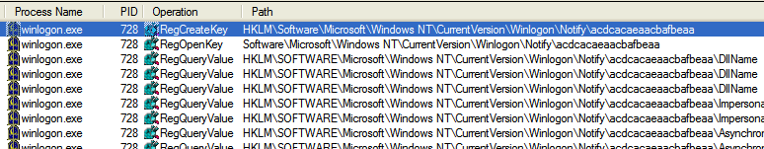

The Case of the Sysinternals-Blocking Malware (Cont)
Nothing suspicious in Process Explorer
Next, ran Process Monitor
  Noticed a lot of Winlogon activity, so set a filter to include it
  Could see a once-per-second check of a strange key:
Saw name of random DLL in the key:

Slide 38
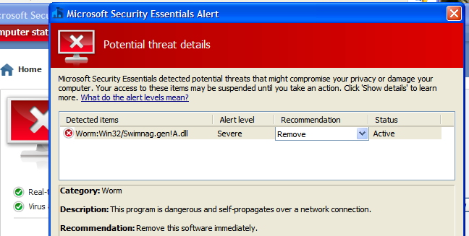
The Case of the Sysinternals-Blocking Malware: Solved
Tried deleting the key, but after refreshing it was back
Went back to MSE and directed it to scan just the random DLL image file on disk:
After clean, was able to delete Registry key and system was back to normal: problem solved

Slide 39
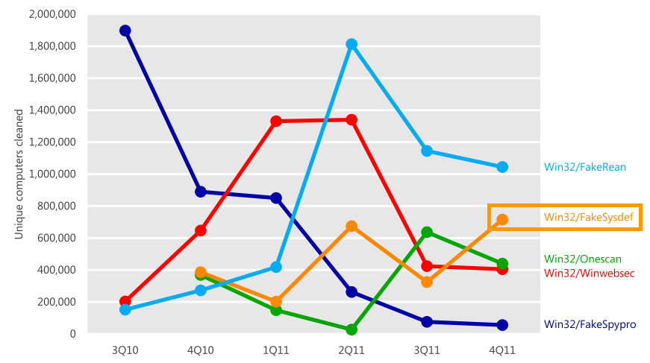
Cleaning FakeSysDef Scareware
Give a man a stolen credit card & he'll eat like a king for a day.
Teach a man to phish and he'll be set for life.
-- Ancient Nigerian proverb
http://www.microsoft.com/security/portal/Threat/Encyclopedia/Entry.aspx?name=Trojan:Win32/FakeSysdef

Slide 40
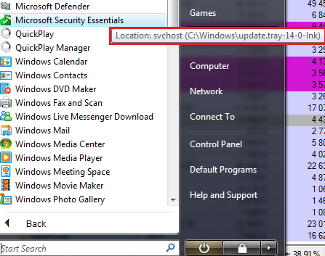
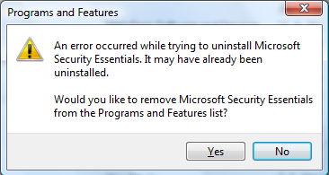
The Case of the Strange Reboots
Laptop would reboot immediately after connecting to wireless networks:
  Followed by boot to safe mode
  Then boot back to normal mode
Boot to safe mode resulted in automatic logoff
Tried to run Microsoft Security Essentials (MSE), but it was damaged

Slide 41
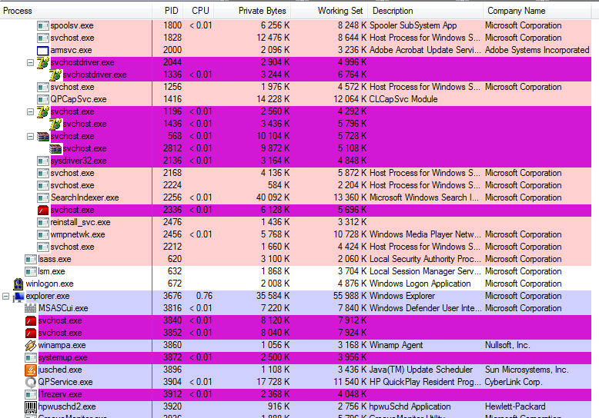
The Case of the Strange Reboots
Ran Process Explorer and saw many processes exhibiting malware characteristics:

Slide 42
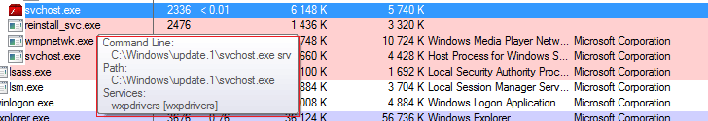
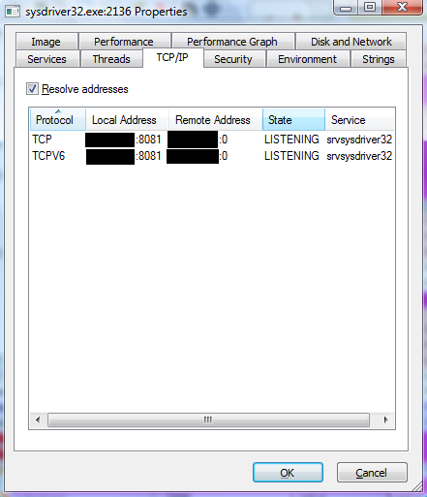
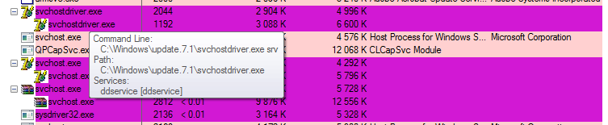
The Case of the Strange Reboots (Cont)
Processes with names mimicking Windows processes were clearly malicious:

Slide 43
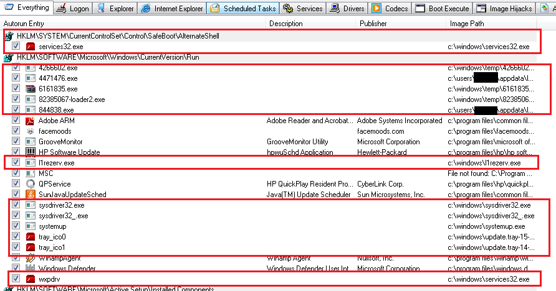
The Case of the Strange Reboots (Cont)
Autoruns showed system massively infected:

Slide 44
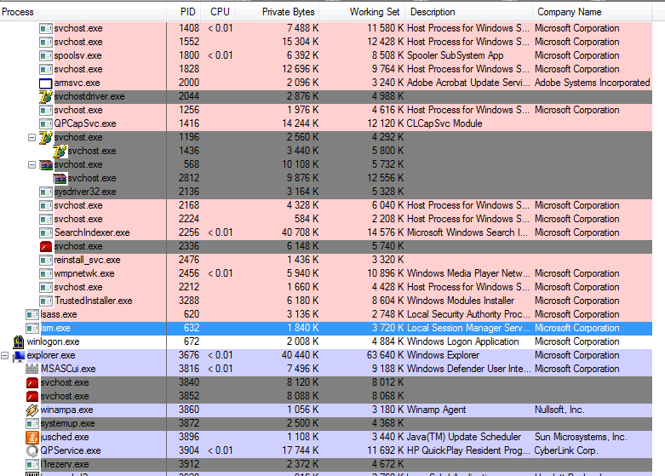
The Case of the Strange Reboots (Cont)
Suspended all packed processes

Slide 45
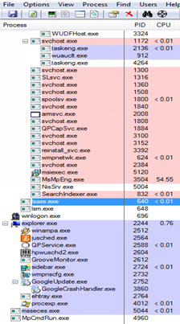

The Case of the Strange Reboots: Solved
Connected to network: no restart
Downloaded and ran fresh copy of MSE
  MSE detected several malware variants:
After cleaning, no more suspicious
processes and system behaved
normally: problem solved

Slide 46
Cleaning Cycbot
http://www.microsoft.com/security/portal/Threat/Encyclopedia/Entry.aspx?Name=Win32%2fCycbot

Slide 47
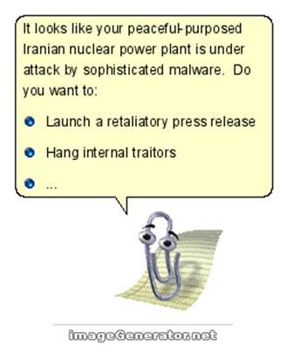
Analyzing and Cleaning Stuxnet and Flame
http://www.microsoft.com/security/portal/Threat/Encyclopedia/Entry.aspx?Name=WinNT%2fStuxnet
http://www.microsoft.com/security/portal/Threat/Encyclopedia/Entry.aspx?Name=Worm:Win32/Flame.gen!B

Slide 48
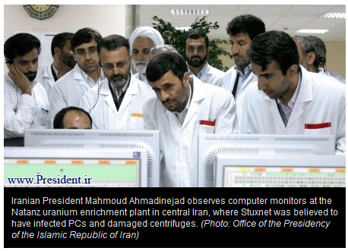
Stuxnet
Discovered June 2010 after it had
spread for year
Exploited 4 zero day Windows
vulnerabilities
  Print spooler for remote code execution
  Shell link Explorer code execution from
  infected key
  Win2K/Windows XP Win32k.sys privilege
  elevation
  Windows 7 Task Scheduler privilege elevation
Drivers signed by certificates stolen from RealTek and JMicron
Rootkit code for Siemens Step 7 SCADA PLC for centrifuges
Suspected to have targeted Iranian centrifuges used for Uranium enrichment at Natanz nuclear facility
  Iran confirms in September 2010 that thousands were destroyed
  Suspected to be created by Israel and US

Slide 49
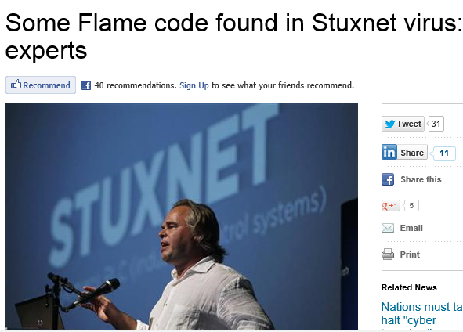
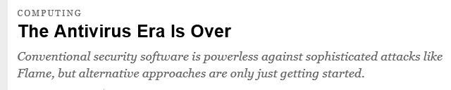
Flame
Disovered a few weeks ago
Considered by some to be more sophisticated than Stuxnet
http://www.reuters.com/article/2012/06/12/us-media-tech-summit-flame-idUSBRE85A0TN20120612

Slide 50
Summary

Slide 51
The Future of Malware
We’ve seen the trends:
  Malware that pretends to be from Microsoft or other legitimate companies
  Malware protected by sophisticated rootkits
  Malware that has stolen certificates
Cleaning is going to get much, much harder
  Targeted and polymorphic malware won’t get AV/AS signatures
  Malware can directly manipulate Windows structures to cause misdirection
  All standard tools will be directly attacked by malware
  There will be more un-cleanable malware
You can’t know you’re infected unless you find a symptom
Prevent and Detect

Slide 52



Zero Day – A Novel
A cyberthriller true to the science
www.zerodaythebook.com
September 1

Slide 53
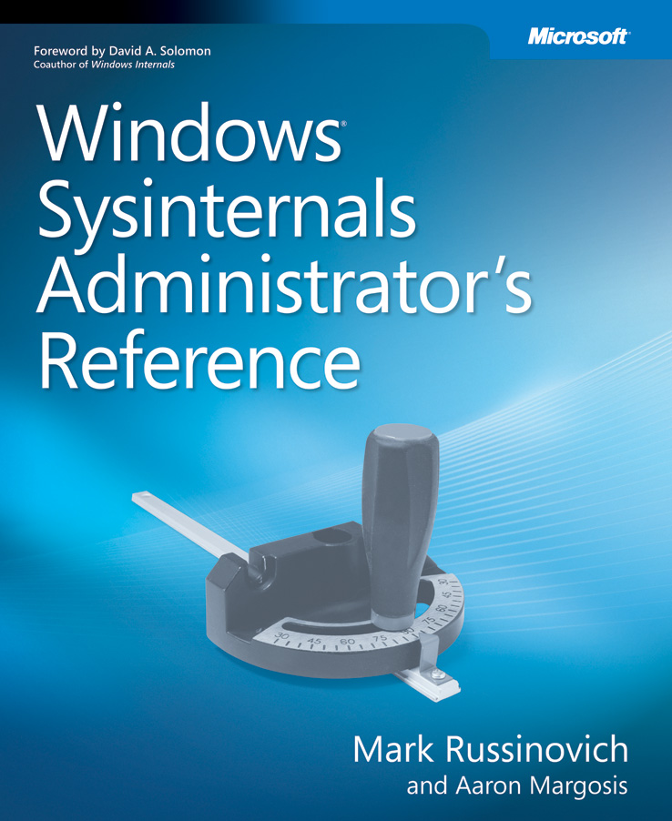
The Sysinternals Administrator’s Reference
The official guide to the Sysinternals tools
  Covers every tool, every feature, with tips
  Written by Mark Russinovich and
  Aaron Margosis
Full chapters on the major tools:
  Process Explorer
  Process Monitor
  Autoruns
Other chapters by tool group
  Security, process, AD, desktop, …
Book signings with Mark and Aaron
Wed. and Thurs., 11:30am
TechEd bookstore
Mark will also be signing Zero Day and Windows Internals 6th Ed Pt. 1

Slide 54
References
Sysinternals
  Mark’s Sysinternals Blog
  Mark’s Webcasts
Microsoft Security Intelligence Report
http://www.microsoft.com/security/sir/default.aspx
Symantec Stuxnet Dossier http://www.symantec.com/content/en/us/enterprise/media/security_response/whitepapers/w32_stuxnet_dossier.pdf
Arstechnica Stuxnet story http://www.wired.com/threatlevel/2011/07/how-digital-detectives-deciphered-stuxnet/
Windows Internals, by Mark Russinovich and David Solomon with Alex Ionescu, Microsoft Press

Slide 55



Track Resources
www.microsoft.com/twc
www.microsoft.com/security
www.microsoft.com/privacy
www.microsoft.com/reliability

Slide 56



Resources
Learning
  Connect. Share. Discuss.
  Microsoft Certification & Training Resources
http://europe.msteched.com
www.microsoft.com/learning
TechNet
  Resources for IT Professionals
  Resources for Developers
http://microsoft.com/technet
http://microsoft.com/msdn

Slide 57
Submit your evals online
Evaluations
http://europe.msteched.com/sessions

Slide 58
© 2012 Microsoft Corporation. All rights reserved. Microsoft, Windows, Windows Vista and other product names are or may be registered trademarks and/or trademarks in the U.S. and/or other countries.
The information herein is for informational purposes only and represents the current view of Microsoft Corporation as of the date of this presentation. Because Microsoft must respond to changing market conditions, it should not be interpreted to be a commitment on the
part of Microsoft, and Microsoft cannot guarantee the accuracy of any information provided after the date of this presentation. MICROSOFT MAKES NO WARRANTIES, EXPRESS, IMPLIED OR STATUTORY, AS TO THE INFORMATION IN THIS PRESENTATION.

