Slide 1
REST/SOAP Security
A Brief Introduction

Slide 2
Quick Review: Protocol Layering
The Internet can be viewed as a layered stack of protocols
Each layer offers services to the layer above and consumes those provided by the underlying layer
The services provided by a layer form its service model
Two protocols that belong to the same layer should offer some common service:
TCP and UDP both offer a transport service for application-layer messages
But the general nature of the service may vary:
TCP is connection-oriented – UDP is connectionless
Same goes for the properties of the service
TCP guarantees delivery – UDP provides no guarantees

Slide 3
Quick Review: Protocol Layering (cont.)
In a broad sense, web services are application-layer entities that use HTTP as a communication protocol
Security is not included in HTTP’s service model
If we want a secure web service, we have a few options:
Provide security measures at the service level (or the periphery thereof)
Use a more secure message transport protocol (f. ex. HTTP over SSL)
Both

Slide 4
Web Service Security: An Approach to the Topic
“Wire-level” security (HTTPS)
Peer authentication
Integrity
Confidentiality
Credential processing:
Phase I: User authentication
Phase II: User authorization

Slide 5
Wire-level Security
Problem: As a government official, I want to conduct business securely.
Solution: Set up a private phone line.
Analogy: HTTPS connections

Slide 6
Wire-level Security: Confidentiality
Problem: My “private” phone line is still connected to the central telephone network. A listening device could be attached to it.
Solution: Encode all wire traffic before it leaves the office, decode traffic as it enters the office.
Analogy: HTTPS Encryption/Decryption

Slide 7
Wire-level Security: Peer authentication
Problems:
I only want to accept phone calls from people on the green list
Impostors could call a green listed person and pretend to be me
Solution: Before discussing any confidential issues, callers should introduce themselves by exchanging (sufficient) information about their respective identities.
Analogy: HTTPS digital certificate exchange

Slide 8
Wire-level Security: Integrity
Problem: Callers may mishear me due to interference or deliberate tampering.
Solution: End each sentence by relaying the first letter of every word spoken – the caller will then try to match this against the message they received.
Analogy: HTTPS Message Digests

Slide 9
Credential Processing
Web services provide clients with access to resources
If a resource is secured, the client should have the appropriate credentials to gain access
The credentials are presented and verified through a two-phase process:
Phase I: Authentication
Phase II: Authorization

Slide 10
Credential Processing & Wire-level Security
Under users/roles security, a client furnishes a form of identification together with a security credential that vouches for the identification
To avoid hijacking, the credentials should be relayed over a secure channel whose setup and teardown is generally the responsibility of a wire-level security framework
Wire-level security is thus the foundation upon which users/roles security is implemented
HTTPS is a good way to provide wire-level security for web services (REST & SOAP)

Slide 11
Credential Processing: Authentication
Problem: I’m a security guard in charge of a warehouse. Someone wants to enter the building but since I am uncertain of their identity I am unable to proceed.
Solution: Ask the caller for their identification code.
Analogy: Username/password combination

Slide 12
A Note on Credential Format
Username and password pair – self-explanatory
API key – basically a unique identifier handed out to each user
Pros:
UN/PW often less secure
Easy reset
Independent of master credentials (i.e. actual UN/PW)
Saves time since UN/PW processing is slower by necessity (due to extra steps and protection against cyber attacks)
https://stormpath.com/blog/top-six-reasons-use-api-keys-and-how
Cons:
Still need a secure comm. channel
Not really a security feature
http://nordicapis.com/why-api-keys-are-not-enough/

Slide 13
Credential Transmission over HTTPS
Basic
Encoded transmission, not much better than plain text
Digest
Hash transmission, a slight improvement
Cryptographic scheme
Public key cryptography (symmetric/asymmetric)

Slide 14
Basic access authentication

Slide 15
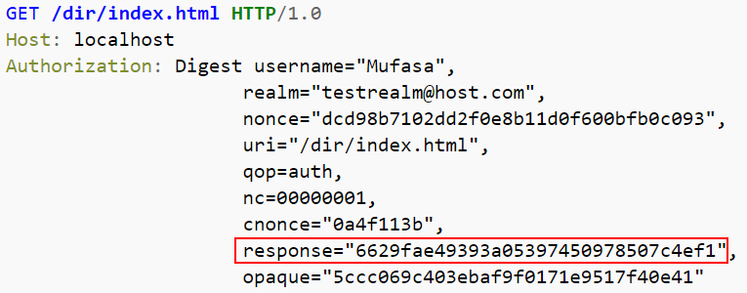
Digest access authentication

Slide 16
Credential Processing: Authorization
Problem: An authenticated party has already entered the building. He is requesting access for storage compartment #43.
Solution: Come up with a mapping that associates each authenticated party to the storage compartments they are allowed to access.
Analogy: Authorization schemes

Slide 17
What about SOAP and REST?
SOAP – a messaging framework often employed by web services
REST – an architecture style often used in the design of web services
Irrespective of which particular framework/style was used in the implementation of a web service, the previously discussion about security measures still applies
Additionally, there is always the option to define custom security schemes:
Custom HTTP headers for REST
Custom SOAP extensions

Slide 18
A Note on WS-Security (WSS)
A family of specifications providing a unified, transport-neutral, container-neutral, end-to-end framework for higher levels of security such as message confidentiality and authentication/authorization
“The protocol specifies how integrity and confidentiality can be enforced on messages and allows the communication of various security token formats” (https://en.wikipedia.org/wiki/WS-Security)
F. ex. WSS specifies how digital signatures and encryption information can be inserted into SOAP headers

Slide 19
A Note on WS-Security (WSS) (cont.)

Slide 20
Recap
“Wire-level” security (HTTPS)
Peer authentication
Integrity
Confidentiality
Credential processing:
Phase I: User authentication
Phase II: User authorization

Slide 21
Sources
Martin Kalin. “Java Web Services: Up and Running” 2nd ed. pg. 231 – 291.
James F. Kurose, Keith W. Ross. “Computer Networking: A Top-Down Approach” 6th Intl. ed. pg. 81 – 87, 73 – 79.

