Slide 1
REST URI
Merli Lall

Slide 2
REST – Representational State Transfer
Is the software architectural style for building web applications and services.
The client passes to the server anything that server needs to perform the action - the server returns to the client with action complete. Server doesn’t remember anything about the client.
REST provides a definition of a resource (URI).
Uses HTTP protocol verbs.
Requires specific media types as response (like XML or JSON).

Slide 3
Instead of directory structure and a specific file in the specific folder:
http://example.com/UpdateEmployee.aspx
In RESTful service the URI represents data :
http://example.com/Employee/Edit/12345

Slide 4
HTTP methods
GET - Requests data from a specified resource
POST - Submits data to be processed to a specified resource
PUT – Updates data
Create, Retrieve, Update, Delete becomes POST, GET, PUT, and DELETE

Slide 5
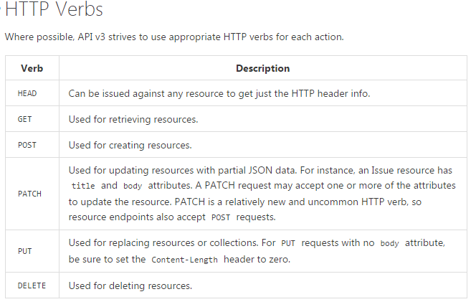

Slide 6
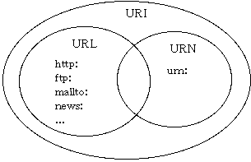

Slide 7
URI? URL?? URN???
Uniform Resource Identificator has two specializations known as URL and URN.
URI : locator, a name, or both.
URL : locator.
URN: historical name for URI or a unique resource name.
URIs identify and URLs locate; however, locators are also identifiers, so every URL is also a URI, but there are URIs which are not URLs.

Slide 8
URI
URI - Is a resource locator, a name, or both.
Resource - every interesting piece of information the server can provide

Slide 9
Resource examples:
Users of the system.
Courses in which a student is enrolled.
A user's timeline of posts.
The users that follow another user.
An article about what ever.
Each resource = at least one URI identifying it.

Slide 10
Important notes!
RESTful APIs are written for consumers.
The name and structure of URIs should convey meaning to those consumers.
Design for your clients, not for your data.

Slide 11
URIs should be written:
All in the same way (Predictable structure)
In a way that data has structure/relationships (Hierarchical structure)
Why?
To increase understandability and usability.
Example:
GET http://www.example.com/customers/33245/orders/8769/lineitems/1

Slide 12
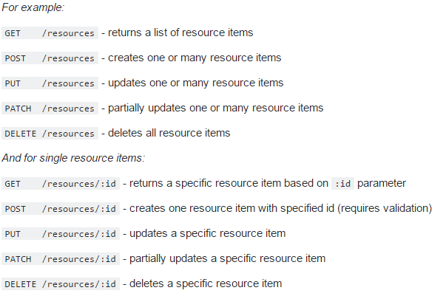

Slide 13
Important notes!
RESTful URI should refer to a resource that is an object instead of referring to an action.
So you should….
Name your resources as nouns! Don’t name them as verbs or actions!
Nouns have properties/attributes as verbs do not.

Slide 14
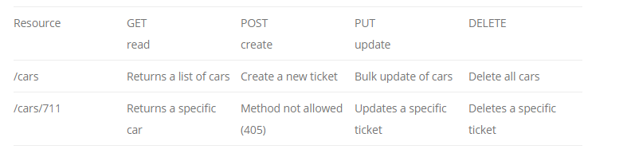
Good examples
Don’t use verbs:
/getAllCars
/createNewCar
/deleteAllRedCars
Use PUT, POST and DELETE methods instead of the GET method to alter the state.

Slide 15
Noun names?
Do not mix up singular and plural nouns. Keep it simple and use only plural nouns for all resources.
/cars instead of /car
/users instead of /user
/products instead of /product
/settings instead of /setting
Pluralization of resource names in REST URIs is the widely adopted standard followed by the overwhelming majority of public and private APIs.

Slide 16
Maybe one exception..
It's acceptable to use a singularized resource name when there can only be one of the resource—it's a singleton resource.
GET|PUT|DELETE http://www.example.com/configuration
GET|PUT|DELETE http://www.example.com/customers/12345/configuration

Slide 17
Kokkuvõtteks:
REST URI võiks olla:
- Intuitiivne ehk üheselt mõistetav ja sama stiili.
- Hierarhiline ehk omab struktuuri ja seotust
- Ilma tegusõnadeta
- Resursside nimed mitmuses
GET http://www.example.com/customers/33245/orders/8769/lineitems/1

Slide 18
Tänan kuulamast!

Slide 19
Kasutatud lingid
http://www.looah.com/source/view/2284
https://developer.github.com/v3/
http://blog.mwaysolutions.com/2014/06/05/10-best-practices-for-better-restful-api/
http://www.vinaysahni.com/best-practices-for-a-pragmatic-restful-api#restful
http://www.restapitutorial.com/lessons/restfulresourcenaming.html
https://www.youtube.com/watch?v=LHJk_ISxHHc

