Slide 1

SOAP Security

Slide 2
Definition

Slide 3
A Web service is a method of communication between two electronic devices over World Wide Web.

Slide 4
Example (B2B)
A creates a currency conversion Web service
B uses this Web service to provide the currency conversion functionality to its customers.

Slide 5
WS-Security (Web Services Security, short WSS) is an extension to SOAP to apply security to web services.

Slide 6
The protocol was originally developed by IBM, Microsoft, and VeriSign.
WS-Security 1.0 was released on 19 April 2004.
Version 1.1 was released on 17 February 2006.

Slide 7
WS-Security incorporates security features in the header of a SOAP message, working in the application layer.

Slide 8
How to sign SOAP messages to assure integrity (have they been modified in transit?).
Signed messages also provide non-repudiation (can the sender deny sending them?).
How to encrypt SOAP messages to assure confidentiality (who sent them?).

Slide 9
Non-repudiation refers to a state of affairs where the purported maker of a statement will not be able to successfully challenge the validity of the statement or contract.

Slide 10
Confidentiality is a set of rules or a promise that limits access or places restrictions on certain types of information.

Slide 11
Integrity is a concept of consistency of actions, values, methods, measures, principles, expectations, and outcomes.

Slide 12
WS-Security offers confidentiality and integrity protection from the creation of the message to it's consumption.

Slide 13
So instead of ensuring that the content of the communications can only be read by the right server it ensures that it can only be read by the right process on the server

Slide 14
If there are frequent message exchanges between service provider and consumer, the overhead of XML SIG and XML ENC are significant.

Slide 16
XML Signature

Slide 17
<Signature>
  <SignedInfo>
  <CanonicalizationMethod />
  <SignatureMethod />
  <Reference>
  <Transforms>
  <DigestMethod>
  <DigestValue>
  </Reference>
  <Reference /> etc.
  </SignedInfo>
  <SignatureValue />
  <KeyInfo />
  <Object />
  </Signature>

Slide 18
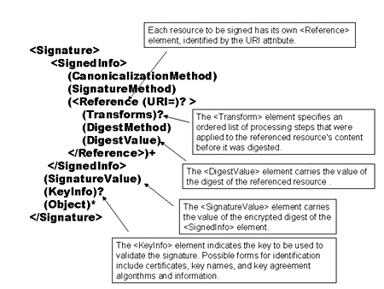

Slide 19
The SignedInfo element contains or references the signed data and specifies what algorithms are used.

Slide 20
The SignatureValue element contains the Base64 encoded signature result - the signature generated with the parameters specified in the SignatureMethod element - of the SignedInfo element after applying the algorithm specified by the CanonicalizationMethod.

Slide 21
KeyInfo element optionally allows the signer to provide recipients with the key that validates the signature, usually in the form of one or more X.509 digital certificates. The relying party must identify the key from context if KeyInfo is not present.

Slide 22
The Object element (optional) contains the signed data if this is an enveloping signature.

Slide 23
DigestMethod specifies the hash algorithm before applying the hash.

Slide 24
DigestValue contains the result of applying the hash algorithm to the transformed resource(s).

Slide 25
KeyInfo element optionally allows the signer to provide recipients with the key that validates the signature.

Slide 26
The Object element (optional) contains the signed data if this is an enveloping signature.

Slide 27
End to End security example
(Https vs. WSS)

Slide 28
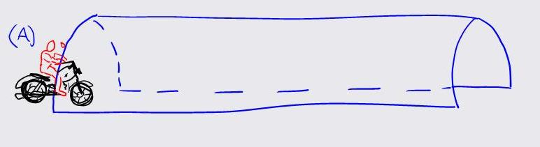
POST

Slide 29
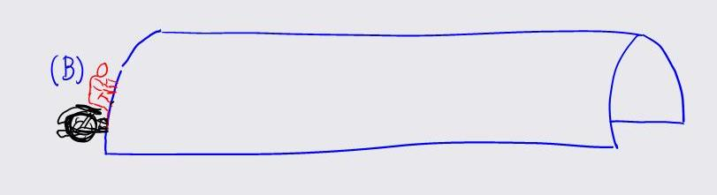
HTTPS

Slide 30
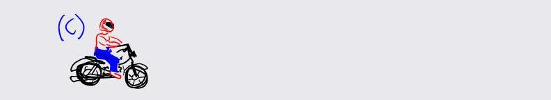
WSS

Slide 31
http://www.xml.com/pub/a/2001/08/08/xmldsig.html

