Slide 1
IDU0075 Sissejuhatus veebiteenustesse
Tarvo Treier
Tarvo.treier@gmail.com

Slide 2
Täna kavas
REST-i tutvustus
  5-minuti näide
  REST-i põhimõtted
  Ressurss
  The Google Geocoding API näited
Ettekannete teemad

Slide 3
Representational State Transfer (REST)
Tarvo Treier tarvo.treier@gmail.com
REST is an architecture style for designing networked applications. The idea is that, rather than using complex mechanisms such as CORBA, RPC or SOAP to connect between machines, simple HTTP is used to make calls between machines.
Allikas: http://rest.elkstein.org/
Notes:
3

Slide 4
Spetsifikatsioon
Tarvo Treier tarvo.treier@gmail.com
SOAP is a specification.
WSDL is a specification.
XML Schema is a specification.
SOA and REST have no specifications.
Notes:
4

Slide 5
5-minutiline REST-i sissejuhatus
www.xfront.com/5-minute-intro-to-REST.ppt

Slide 6
Tekkelugu
REST-i defineeris 2000 aastal oma doktoritöös Roy T. Fielding.
Roy T. Fielding on HTTP ja URI standardite kaasautor.

Slide 7
REST ja Web
REST doesn’t build on the principles of the Web—the Web was built based on RESTful principles. They just weren’t so named until a few years later.
The idea of REST is essentially a reverse-engineering of how the Web works. HTTP itself, and URIs themselves, are written with REST principles.

Slide 8
REST vs SOAP
Much like Web Services, a REST service is:
  Platform-independent (you don't care if the server is Unix, the client is a Mac, or anything else),
  Language-independent (C# can talk to Java, etc.),
  Standards-based (runs on top of HTTP).
With REST, a simple network connection is all you need. You can even test the API directly, using your browser.
Postkaart vs Ümbrikuga kirja saatmine

Slide 9
SOAP (querying a phonebook)
<?xml version="1.0"?> <soap:Envelope xmlns:soap=http://www.w3.org/2001/12/soap-envelope soap:encodingStyle="http://www.w3.org/2001/12/soap-encoding">
  <soap:body pb="http://www.acme.com/phonebook"> <pb:GetUserDetails>
      <pb:UserID>12345</pb:UserID>
    </pb:GetUserDetails>
  </soap:Body>
  </soap:Envelope>

Slide 10
REST (querying a phonebook)
Hea näide:
  http://www.acme.com/phonebook/UserDetails/12345
Halb näide
  http://www.acme.com/phonebook/getUserDetails?id=12345
Veel halvem näide☺
  http://www.acme.com/phonebook/user12345.xml

Slide 11
REST-i põhimõtted
REST services are stateless
  no cookies; Cache-ability is important too, especially for GETs.
REST services have a uniform interface
  There is no WSDL in REST.
  Interface is provided by the standard HTTP methods (PUT, GET,POST, DELETE).
Resources are manipulated through representations
  The components in the system exchange data (usually XML documents) that represents the resource.
    XML
    XHTML
    JPEG image

Slide 12
Soovituslikud põhimõtted 1
Do not use "physical" URLs. A physical URL points at something physical.
Physical: http://www.acme.com/inventory/product003.xml.
Logical: http://www.acme.com/inventory/product/003

Slide 13
Soovituslikud põhimõtted 2
Queries should not return an overload of data.
If needed, provide a paging mechanism. For example, a "product list" GET request should return the first n products (e.g., the first 10), with next/prev links.

Slide 14
Soovituslikud põhimõtted 3
Even though the REST response can be anything, make sure it's well documented, and do not change the output format lightly (since it will break existing clients).
Remember, even if the output is human-readable, your clients aren't human users.
If the output is in XML, make sure you document it with a schema.

Slide 15
Soovituslikud põhimõtted 4
Rather than letting clients construct URLs for additional actions, include the actual URLs with REST responses. For example, a "product list" request could return an ID per product, and the specification says that you should use http://www.acme.com/product/PRODUCT_ID to get additional details. That's bad design. Rather, the response should include the actual URL with each item: http://www.acme.com/product/001263, etc.
Yes, this means that the output is larger. But it also means that you can easily direct clients to new URLs as needed, without requiring a change in client code.

Slide 16
Soovituslikud põhimõtted 5
GET access requests should never cause a state change. Anything that changes the server state should be a POST request (or other HTTP verbs, such as DELETE)
Mis võib juhtuda, kui panete veebi lingi, millega on võimalik näiteks andmebaasist rida kustutada?

Slide 17
Ressurss
Resources are the key abstractions in REST.
They are the remote accessible objects of the application.
A resource is a unit of identification.
Everything that might be accessed or be manipulated remotely could be a resource.
  http://soacookbook.com/customers
  http://soacookbook.com/customers/1234
  http://soacookbook.com/orders/456/customer

Slide 18
Järgnevad REST ja WS-* näited
Allikas: http://www.jopera.org/files/soa-amsterdam-restws-pautasso-talk.pdf

Slide 19
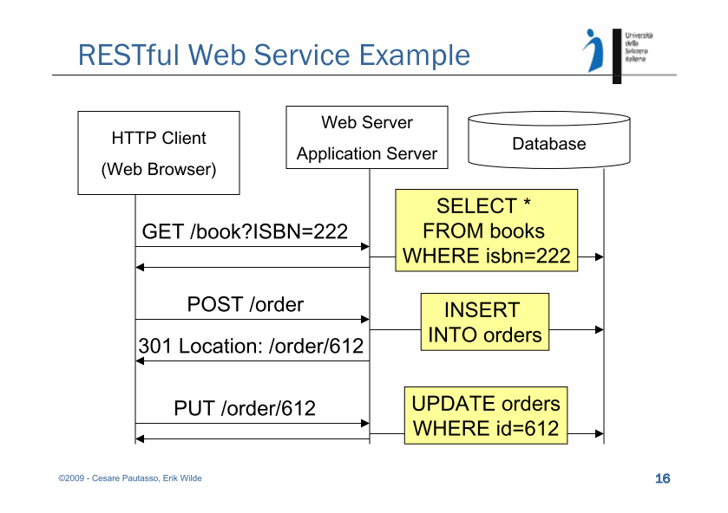

Slide 20
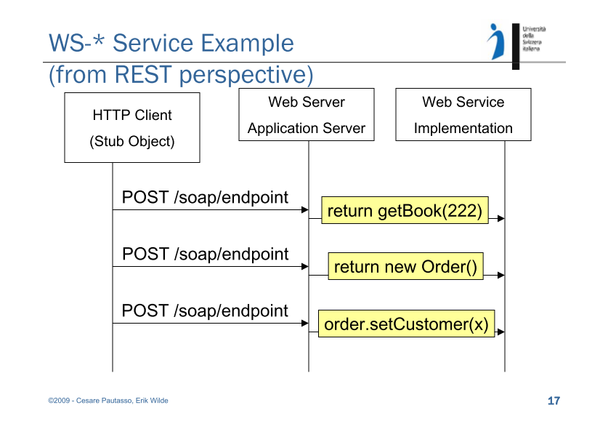

Slide 21
The Google Geocoding API
Documentation
  https://developers.google.com/maps/documentation/geocoding/
Request for XML response
  http://maps.googleapis.com/maps/api/geocode/xml?address=1600+Amphitheatre+Parkway,+Mountain+View,+CA&sensor=true
Request for JSON response
  http://maps.googleapis.com/maps/api/geocode/json?address=1600+Amphitheatre+Parkway,+Mountain+View,+CA&sensor=true

Slide 22
Ettekannete teemad
Järgmises loengus võimalik teenida 10-15 min pikkuse ettekandega 5 boonuspunkti
  JSON
  WADL
  REST Security (https)
  SOAP Security (WS-Security)
  Mocking REST Service (SoapUI)
  Testing REST Service (SoapUI)

Slide 23
Kasulikke viiteid
http://rest.elkstein.org/
http://www.infoq.com/articles/designing-restful-http-apps-roth
http://www.xfront.com/REST-Web-Services.html

