Slide 1
Work Breakdown Structure
by
Nino Lazuashvili
Software Project Management

Slide 2
What Is a Work Breakdown Structure?
A hierarchical decomposition of the total scope of work to be carried out by the project team to accomplish the project objectives and create the required deliverables.

Slide 3
History
HISTORY
In 1957, the US Navy’s Fleet Ballistic Missile (Polaris) Program was behind schedule and needed help resolving the problem. A formula was developed to determine tasks and estimate effort needed for a project based on outcome, which became known as PERT (program evaluation and review technique).
With PERT as a model, in 1962, the Department of Defence (DOD) and NASA published the first description of the work breakdown structure process.
in 1987, the Project Management Institute (PMI), through PMBOK, established work breakdown structures as standard practice for a range of non-military applications.

Slide 4
What is deliverable?
In a WBS, the deliverable can be
a thing
a service
an activity
By focusing on deliverables rather than methods—the what, not the how—a work breakdown structure helps to eliminate unnecessary work to get the intended result. A well thought out WBS aids in scheduling, estimating costs, and determining risk.

Slide 5
Work Breakdown Structure in Project Management
WBS should be the first deliverable at the start of a project. With the WBS defined, it’s then possible to scope out other resources, including human resources and particular skill sets, material resources including equipment and space, and facilities. The project scope of work and baseline schedule can be created, task lists drawn up, and assignments given.

Slide 6
The Visual Advantage of Work Breakdown Structures
The work breakdown structure chart easily displays project details and status. To present your work, you have a few options. The classic WBS view is the tree structure diagram, but you can also use numbered lists or tables. An outline is one of the easiest ways to represent a work breakdown structure.
During the project, the elements in the work breakdown structure can be color-coded to indicate work status: for example, on-target=green, late=red, at-risk=yellow, completed=blue. Color coding can help you identify schedule risks at a glance.

Slide 7
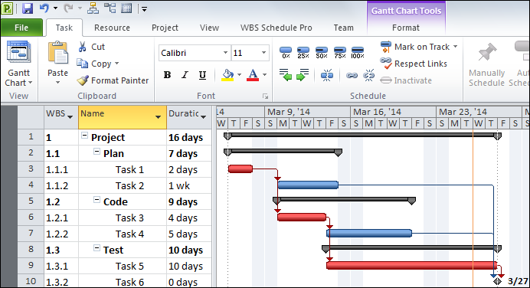
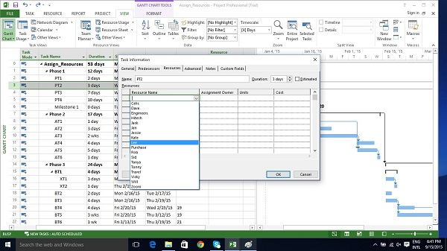
Essential Parts of a Work Breakdown Structure
Terminal elements (aka work packages)
WBS coding
WBS dictionary

Slide 8
Benefits of Work Breakdown Structures
Provides a visual representation of all parts of a project.
Offers an ongoing view for management and team members into how the entire project is progressing.
Defines specific and measurable outcomes.
Breaks the work into manageable chunks.
Provides a way to make successful experiences repeatable.
Provides a foundation for estimating costs and allocating human and other resources.
Ensures no overlap and no gaps in responsibility or resources.
Minimizes the chance of adding something outside the scope of work or forgetting a critical deliverable.

Slide 9
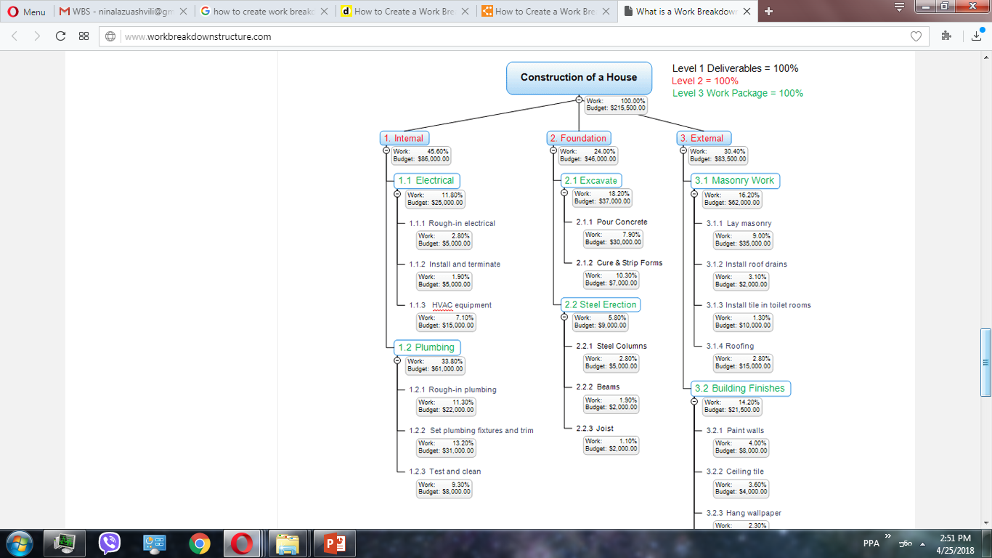
Best Practices for Work Breakdown Structures
Focus on deliverables, not methods
No overlap (also called mutual exclusivity)
Follow the 100% rule
Look at the level of detail

Slide 10
Creating the Work Breakdown Structure
Involve the whole team
Brainstorm deliverables
Divide work
Use sticky notes
Choose software
Use wall
define level one, the main deliverable of the project.
VR collaborative whiteboarding software

Slide 11
Thank you!

